Slide 1

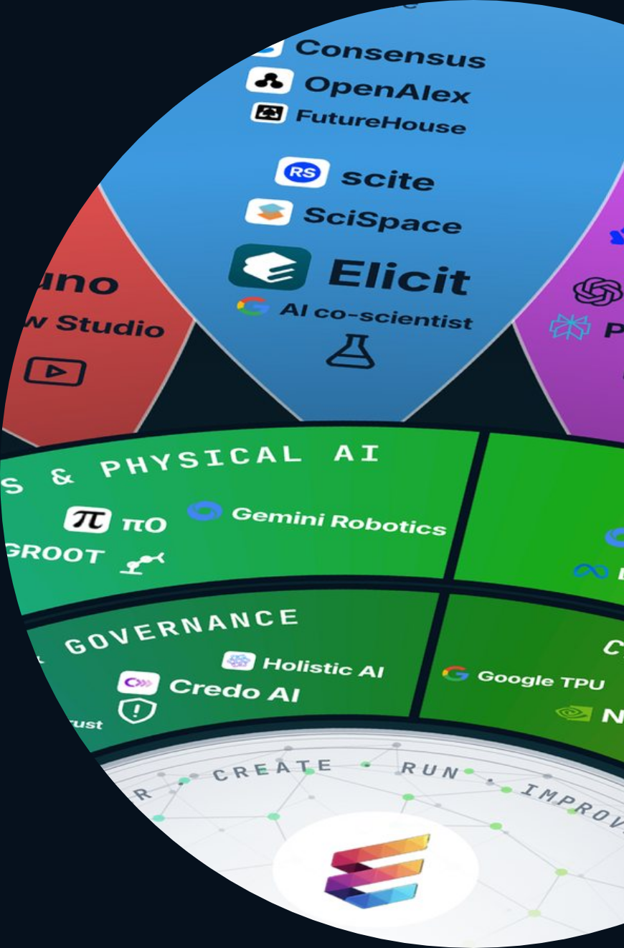
ETHORITY®
KEYNOTE · MARKET STUDY 2026/27
AI BUSINESS OPERATING SYSTEM
ETHORITY · KEYNOTE · GOOD AI PRISM MARKET STUDY 2026/27
Make AI work for your business.
Find the right AI. Build a sound business case. Put it to work responsibly. A keynote by Sten Franke on the Good AI Prism Market Study 2026/27.
US$2.67tn
961
1 in 5
worldwide AI spending forecast for 2026
AI offerings on one map
EU firms with 10+ staff use AI
GOOD AI PRISM, OCT 2026
EUROSTAT, DEC 2025
GARTNER, SEP 2026
Good AI Prism artwork © 2026 ETHORITY & STEN.AI LLC · CC BY-NC-ND 4.0 · commercial use by licence on request · data and third-party marks not covered
ETHORITY · KEYNOTE · EN · V3.5 · 29 OCT 2026
01 / 21
Notes:
Make AI work for your business.
Find the right AI. Build a sound business case. Put it to work responsibly. A keynote by Sten Franke on the Good AI Prism Market Study 2026/27.
US$2.67tn worldwide AI spending forecast for 2026 (Gartner, Sep 2026)
961 AI offerings on one map (Good AI Prism, Oct 2026)
1 in 5 EU firms with 10+ staff use AI (Eurostat, Dec 2025)

Slide 2
ETHORITY®
KEYNOTE · MARKET STUDY 2026/27
AI BUSINESS OPERATING SYSTEM
THE STUDY IN ONE MINUTE
Nine in ten surveyed organisations use AI; 37% see an effect on profit.
Three separate answers from one global survey: respondents report regular use, scaling and some effect on profit. Your decisions turn use into results.
≈90%
44%
37%
use AI regularly in at least one function
report scaling AI
attribute some effect on profit (EBIT) to AI
MCKINSEY, THE STATE OF AI, AUG 2026
MCKINSEY, THE STATE OF AI, AUG 2026
MCKINSEY, THE STATE OF AI, AUG 2026
ETHORITY · KEYNOTE · EN · V3.5 · 29 OCT 2026
02 / 21
Notes:
Nine in ten surveyed organisations use AI; 37% see an effect on profit.
Three separate answers from one global survey: respondents report regular use, scaling and some effect on profit. Your decisions turn use into results.
≈90% use AI regularly in at least one function (McKinsey, The state of AI, Aug 2026)
44% report scaling AI (McKinsey, The state of AI, Aug 2026)
37% attribute some effect on profit (EBIT) to AI (McKinsey, The state of AI, Aug 2026)

Slide 3
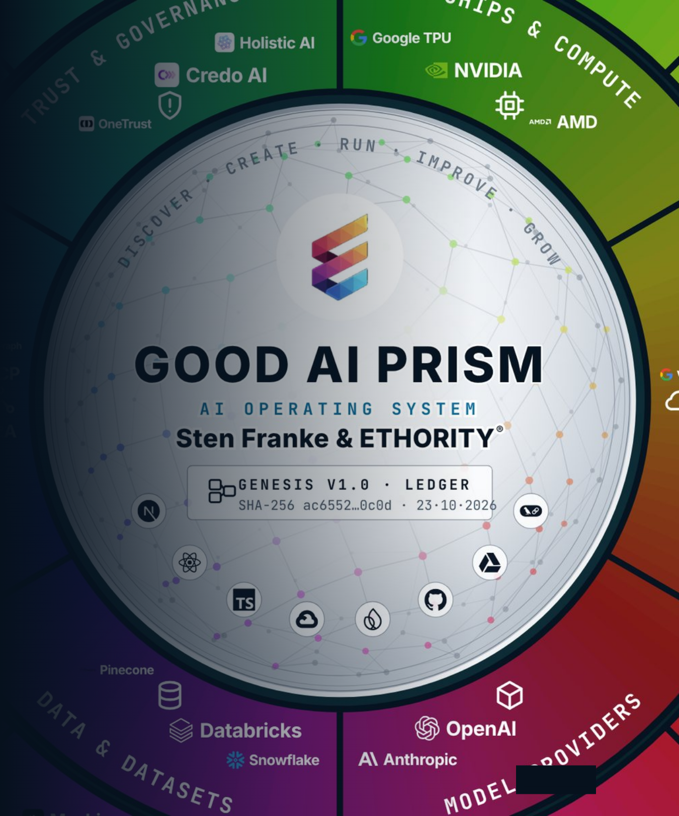
ETHORITY®
KEYNOTE · MARKET STUDY 2026/27
AI BUSINESS OPERATING SYSTEM
01
MOVE 01 · WHERE AI CAN HELP
Find where AI helps before you choose a tool.
Start with a task, such as answering customer requests or closing the books. The Good AI Prism shows 961 AI offerings by task and industry, so you see your options before you decide.
Source · Good AI Prism v3.12
Good AI Prism artwork © 2026 ETHORITY & STEN.AI LLC · CC BY-NC-ND 4.0 · commercial use by licence on request · data and third-party marks not covered
ETHORITY · KEYNOTE · EN · V3.5 · 29 OCT 2026
03 / 21
Notes:
Find where AI helps before you choose a tool.
Start with a task, such as answering customer requests or closing the books. The Good AI Prism shows 961 AI offerings by task and industry, so you see your options before you decide.
Source: Good AI Prism v3.12

Slide 4
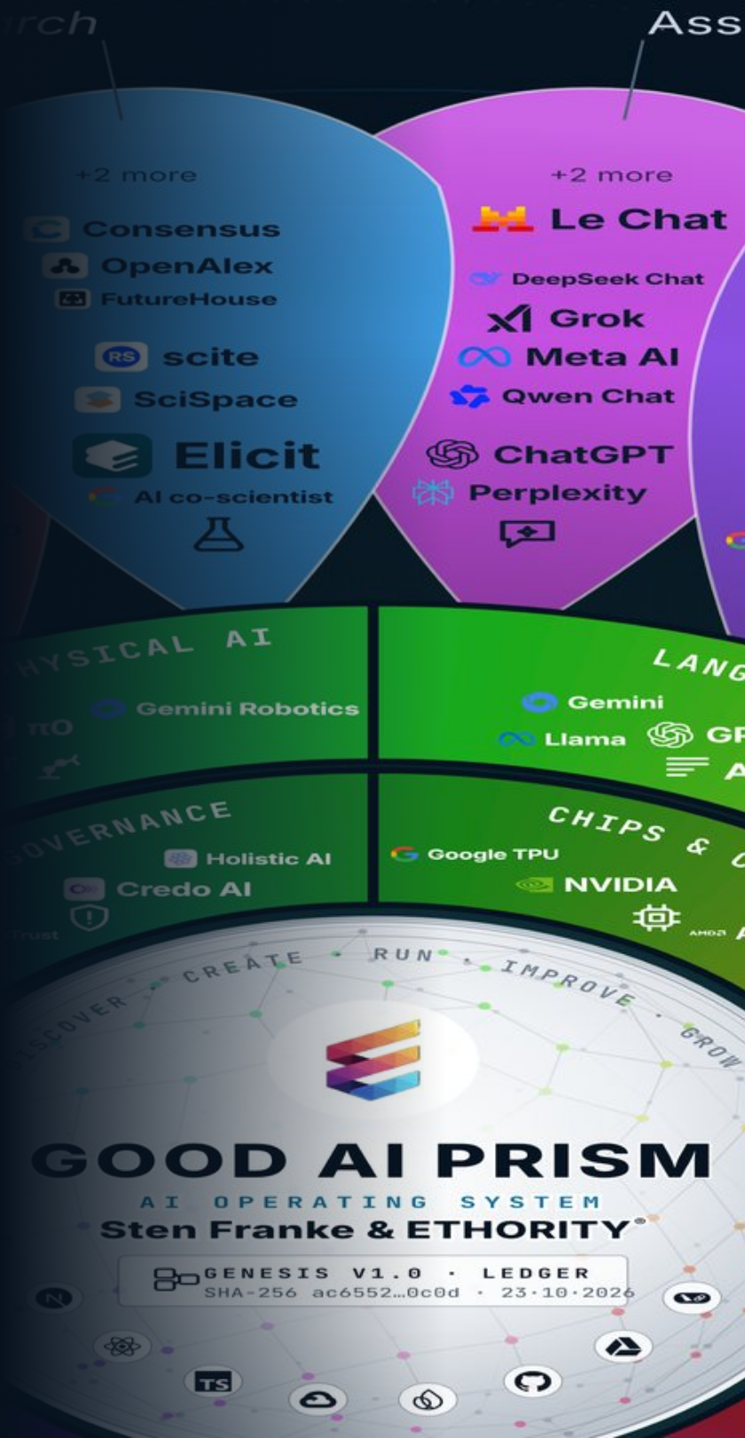
ETHORITY®
KEYNOTE · MARKET STUDY 2026/27
AI BUSINESS OPERATING SYSTEM
AI SPENDING 2026
Worldwide AI spending is forecast to rise by half in 2026.
US$2.67tn
forecast for 2026, up 49.5%. US$1.48tn of it goes into infrastructure.
Source · Gartner, Sep 2026 · Good AI Prism Market Study 2026/27, chapter 1
Good AI Prism artwork © 2026 ETHORITY & STEN.AI LLC · CC BY-NC-ND 4.0 · commercial use by licence on request · data and third-party marks not covered
ETHORITY · KEYNOTE · EN · V3.5 · 29 OCT 2026
04 / 21
Notes:
Worldwide AI spending is forecast to rise by half in 2026.
US$2.67tn
forecast for 2026, up 49.5%. US$1.48tn of it goes into infrastructure.
Source: Gartner, Sep 2026 · Good AI Prism Market Study 2026/27, chapter 1

Slide 5
ETHORITY®
KEYNOTE · MARKET STUDY 2026/27
AI BUSINESS OPERATING SYSTEM
EXHIBIT 1.3 · ADOPTION BY OFFICIAL COUNT
Official statistics count one firm in five in the EU, and two in five in Denmark.
Denmark
42%
Global executive surveys report nearly nine in ten; statistics offices count all firms with ten or more staff.
Finland
37.8%
UK (Jun 2026)
35%
Sweden
35%
The range runs from 5.2% in Romania to 42% in Denmark.
Netherlands
33.2%
Germany
26%
Plan with the official figure for your market, not with the survey headline.
Spain
21.1%
EU-27
20%
France
18%
Italy
16.4%
Australia (all firms)
12%
Poland
8.4%
Romania
5.2%
Source · Eurostat, Dec 2025 · ONS · INE · INSEE · Istat · ABS · Exhibit 1.3, Good AI Prism Market Study 2026/27
ETHORITY · KEYNOTE · EN · V3.5 · 29 OCT 2026
05 / 21
Notes:
Official statistics count one firm in five in the EU, and two in five in Denmark.
Global executive surveys report nearly nine in ten; statistics offices count all firms with ten or more staff.
The range runs from 5.2% in Romania to 42% in Denmark.
Plan with the official figure for your market, not with the survey headline.
Denmark: 42%
Finland: 37.8%
UK (Jun 2026): 35%
Sweden: 35%
Netherlands: 33.2%
Germany: 26%
Spain: 21.1%
EU-27: 20%
France: 18%
Italy: 16.4%
Australia (all firms): 12%
Poland: 8.4%
Romania: 5.2%
Source: Eurostat, Dec 2025 · ONS · INE · INSEE · Istat · ABS · Exhibit 1.3, Good AI Prism Market Study 2026/27

Slide 6
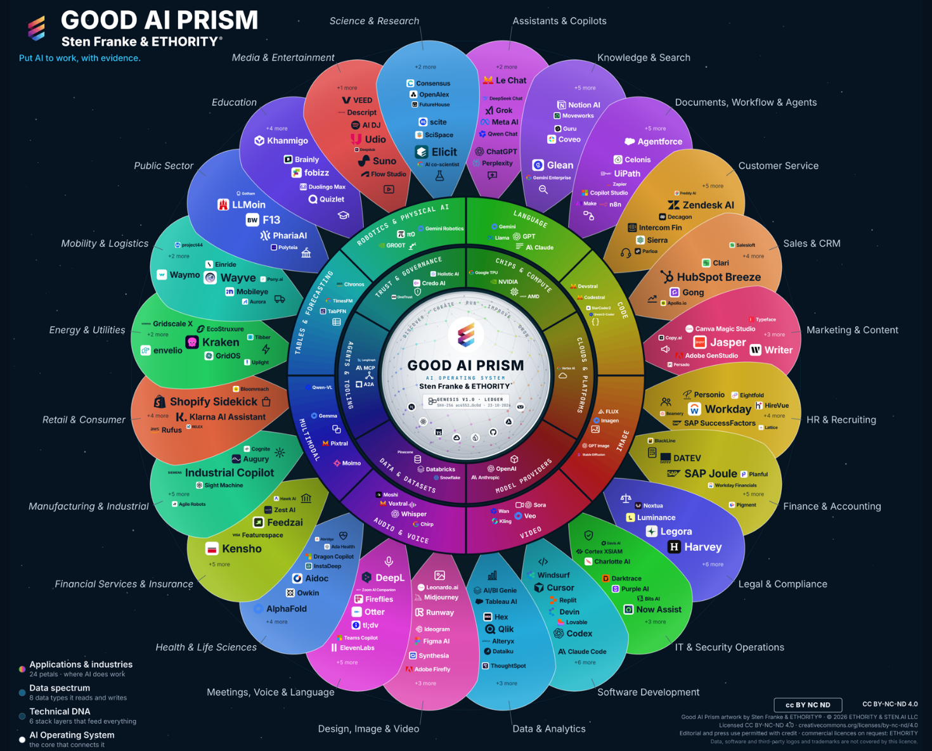
ETHORITY®
KEYNOTE · MARKET STUDY 2026/27
AI BUSINESS OPERATING SYSTEM
THE GOOD AI PRISM · V3.12
Start with your task. Compare what matters.
The Good AI Prism places 998 market entries on one wheel, including 961 AI offerings. Open your business function or industry, compare the offerings with their sources and take the next step.
24
8
6
topic areas by task and industry
data types AI reads and writes
technology layers that feed everything
Source · Good AI Prism v3.12 · Good AI Prism, Oct 2026
Good AI Prism artwork © 2026 ETHORITY & STEN.AI LLC · CC BY-NC-ND 4.0 · commercial use by licence on request · data and third-party marks not covered
ETHORITY · KEYNOTE · EN · V3.5 · 29 OCT 2026
06 / 21
Notes:
Start with your task. Compare what matters.
The Good AI Prism places 998 market entries on one wheel, including 961 AI offerings. Open your business function or industry, compare the offerings with their sources and take the next step.
Source: Good AI Prism v3.12 · Good AI Prism, Oct 2026

Slide 7
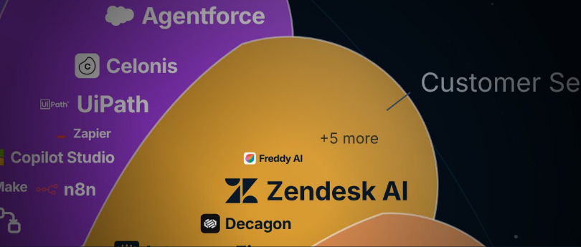
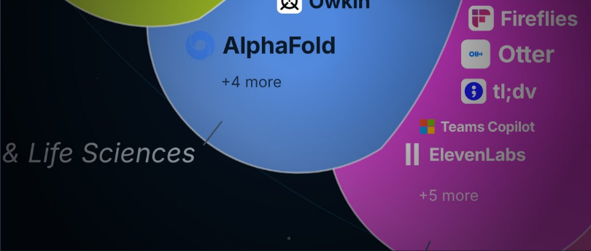

ETHORITY®
KEYNOTE · MARKET STUDY 2026/27
AI BUSINESS OPERATING SYSTEM
THREE WAYS IN
Three questions lead you to the AI that fits your decision.
01
02
03
Where does AI help in my work?
What does AI change in my industry?
Which AI fits our decision?
Search a task or a provider.
Choose a business function, such as customer service or finance.
Choose an industry, such as health, logistics or manufacturing.
→ Uses and matching offers
→ Industry study, cases, relevant providers
→ Profile → Compare → economics → next step
Good AI Prism artwork © 2026 ETHORITY & STEN.AI LLC · CC BY-NC-ND 4.0 · commercial use by licence on request · data and third-party marks not covered
ETHORITY · KEYNOTE · EN · V3.5 · 29 OCT 2026
07 / 21
Notes:
Three questions lead you to the AI that fits your decision.
Where does AI help in my work? Choose a business function, such as customer service or finance. → Uses and matching offers
What does AI change in my industry? Choose an industry, such as health, logistics or manufacturing. → Industry study, cases, relevant providers
Which AI fits our decision? Search a task or a provider. → Profile → Compare → economics → next step

Slide 8
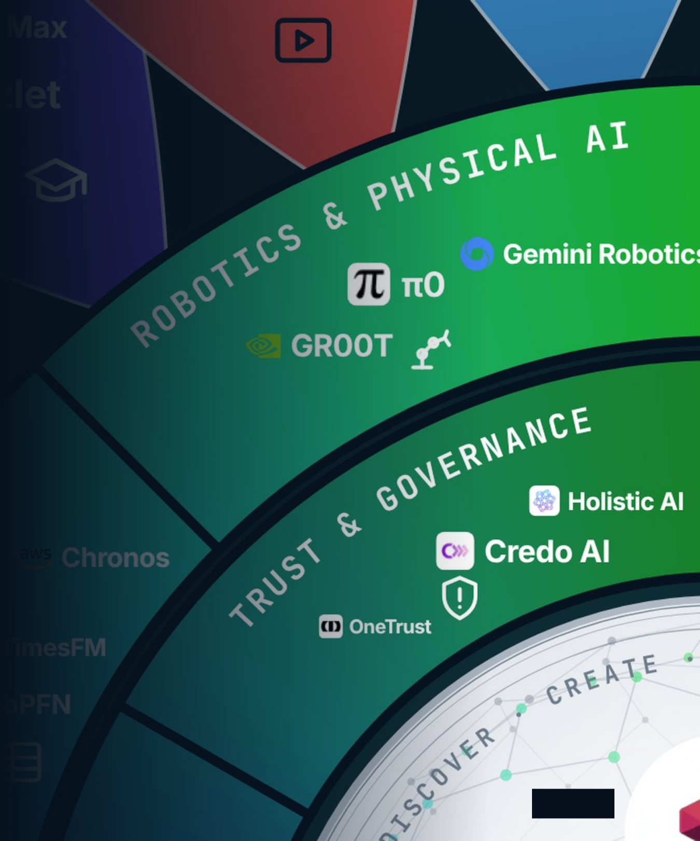
ETHORITY®
KEYNOTE · MARKET STUDY 2026/27
AI BUSINESS OPERATING SYSTEM
02
MOVE 02 · CHOOSE RESPONSIBLY
Choose AI on facts, with clear owners and a cost you can defend.
Four qualities, five governance questions and an honest count of costs separate a sound choice from an expensive trial.
Good AI Prism artwork © 2026 ETHORITY & STEN.AI LLC · CC BY-NC-ND 4.0 · commercial use by licence on request · data and third-party marks not covered
ETHORITY · KEYNOTE · EN · V3.5 · 29 OCT 2026
08 / 21
Notes:
Choose AI on facts, with clear owners and a cost you can defend.
Four qualities, five governance questions and an honest count of costs separate a sound choice from an expensive trial.

Slide 9
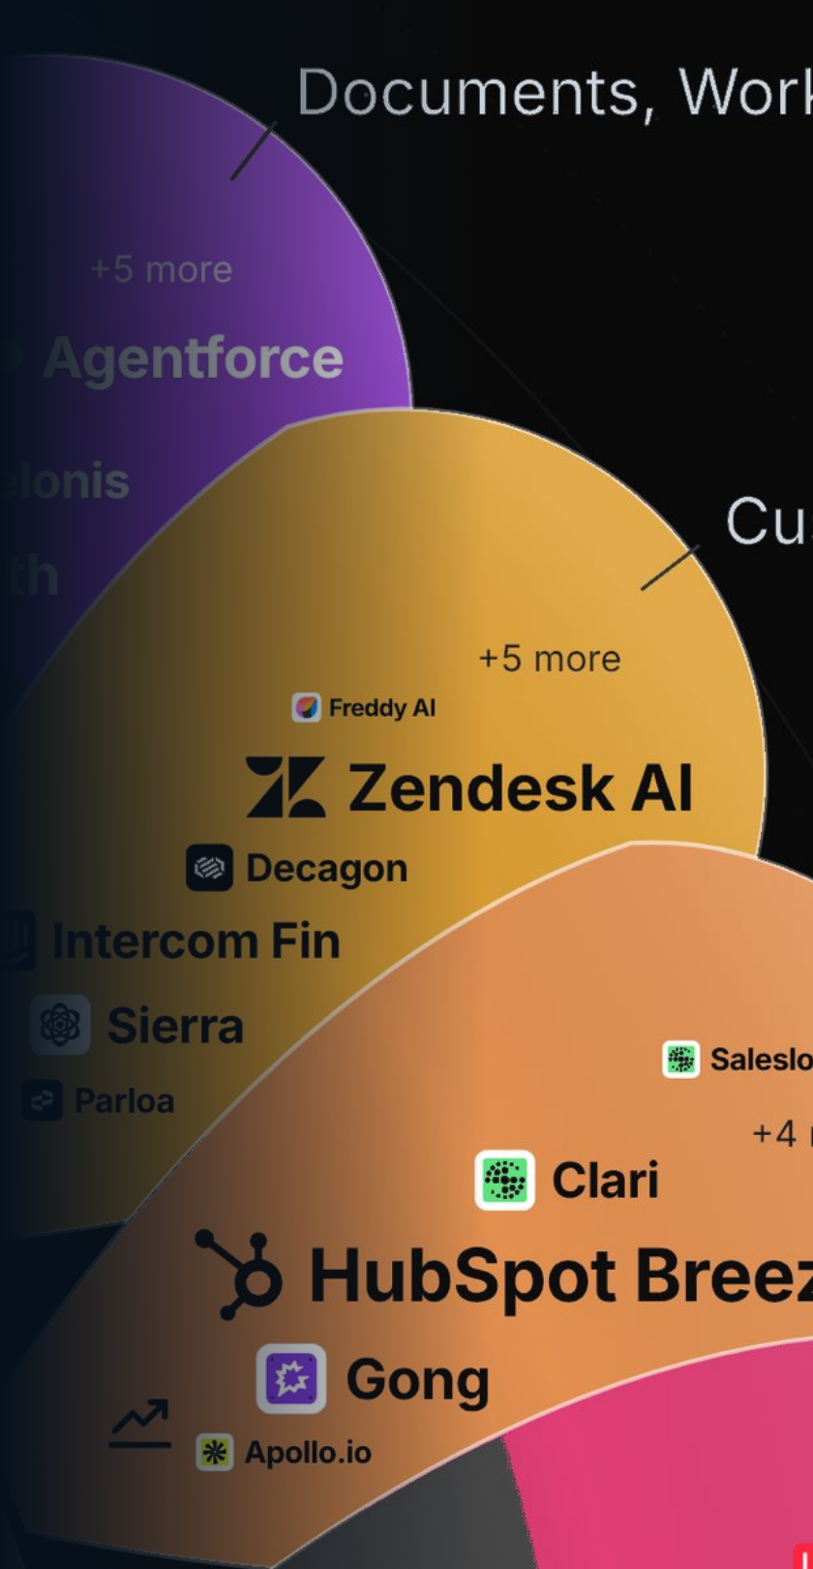
ETHORITY®
KEYNOTE · MARKET STUDY 2026/27
AI BUSINESS OPERATING SYSTEM
BUYING AI · WHAT PROVIDERS PUBLISH
Buyers can rarely compare AI offerings on facts.
43 of 107
customer-service AI offerings publish a price; 38 document an EU hosting option.
Source · Good AI Prism, October 2026 survey of provider information (reviewed 19–20 Oct 2026)
Good AI Prism artwork © 2026 ETHORITY & STEN.AI LLC · CC BY-NC-ND 4.0 · commercial use by licence on request · data and third-party marks not covered
ETHORITY · KEYNOTE · EN · V3.5 · 29 OCT 2026
09 / 21
Notes:
Buyers can rarely compare AI offerings on facts.
43 of 107
customer-service AI offerings publish a price; 38 document an EU hosting option.
Source: Good AI Prism, October 2026 survey of provider information (reviewed 19–20 Oct 2026)

Slide 10

ETHORITY®
KEYNOTE · MARKET STUDY 2026/27
AI BUSINESS OPERATING SYSTEM
THE FOUR QUALITIES
Good AI is effective, efficient, economic and responsible.
Compliance is part of responsible implementation. Responsibility goes further: a legally permitted application can still be badly designed or harm the people affected.
01
02
03
04
Effective
Efficient
Economic
Responsible
AI supports a concrete goal with results you can check.
Effort, cost and human rework are counted.
A technical gain is tested for its real business value.
People, rights, safety and ethical consequences are part of the decision.
ETHORITY · KEYNOTE · EN · V3.5 · 29 OCT 2026
10 / 21
Notes:
Good AI is effective, efficient, economic and responsible.
Compliance is part of responsible implementation. Responsibility goes further: a legally permitted application can still be badly designed or harm the people affected.
Effective: AI supports a concrete goal with results you can check.
Efficient: Effort, cost and human rework are counted.
Economic: A technical gain is tested for its real business value.
Responsible: People, rights, safety and ethical consequences are part of the decision.

Slide 11
ETHORITY®
KEYNOTE · MARKET STUDY 2026/27
AI BUSINESS OPERATING SYSTEM
GOVERNANCE IN ONE CASE · SCENARIO
An AI agent answers customers and triggers refunds: five questions help make it safe and worth it.
1
2
3
4
5
Responsibility
Authority
Evidence
Control
Benefit
Who decides and carries the consequences?
What may the agent do alone, and up to which amount?
Which answers need proof?
When does a person step in?
Does the result really improve?
ETHORITY · KEYNOTE · EN · V3.5 · 29 OCT 2026
11 / 21
Notes:
An AI agent answers customers and triggers refunds: five questions help make it safe and worth it.
Responsibility: Who decides and carries the consequences?
Authority: What may the agent do alone, and up to which amount?
Evidence: Which answers need proof?
Control: When does a person step in?
Benefit: Does the result really improve?
Scenario detail for the speaker:
Responsibility: One named owner in customer service; finance owns the refund budget, IT the connections. → AI Governance Setup
Authority: It sees orders and delivery status and refunds up to a limit finance sets. → Profiles & Compare
Evidence: Prices and return rules name their source; every refund is recorded with reason and approval. → AI Trust Record
Control: A person reviews refunds above the limit, complaints and unclear cases; a stop rule pauses the agent. → AI Trust Pilot
Benefit: Measure accepted answers, complaints and rework time before and during the pilot. → AI calculators

Slide 12
ETHORITY®
KEYNOTE · MARKET STUDY 2026/27
AI BUSINESS OPERATING SYSTEM
EXHIBIT 2.1 · EU AI ACT
Transparency duties already apply; duties for listed high-risk uses follow on 2 Dec 2027.
2 Aug 2026
2 Dec 2026
2 Dec 2027
2 Aug 2028
Transparency: people must be told when they deal with an AI (Article 50).
Machine-readable marking for generative AI already on the market (Article 50(2)).
High-risk duties for uses listed in Annex III, such as certain AI in hiring, credit, insurance, education and public services.
High-risk duties for AI in regulated products such as machines and medical devices, where Annex I applies.
APPLIES NOW
PLAN NOW
Source · Regulation (EU) 2026/1744, EUR-Lex · Exhibit 2.1, Good AI Prism Market Study 2026/27
ETHORITY · KEYNOTE · EN · V3.5 · 29 OCT 2026
12 / 21
Notes:
Transparency duties already apply; duties for listed high-risk uses follow on 2 Dec 2027.
Since 2 Aug 2026, people must be told when they are dealing with an AI (Article 50).
High-risk duties cover uses listed in Annex III, such as certain AI in hiring, credit, insurance, education and public services.
Start with one list of all AI in use; it serves every jurisdiction you operate in.
2 Aug 2026: Transparency: people must be told when they deal with an AI (Article 50).
2 Dec 2026: Machine-readable marking for generative AI already on the market (Article 50(2)).
2 Dec 2027: High-risk duties for uses listed in Annex III, such as certain AI in hiring, credit, insurance, education and public services.
2 Aug 2028: High-risk duties for AI in regulated products such as machines and medical devices, where Annex I applies.
Source: Regulation (EU) 2026/1744, EUR-Lex · Exhibit 2.1, Good AI Prism Market Study 2026/27

Slide 13
ETHORITY®
KEYNOTE · MARKET STUDY 2026/27
AI BUSINESS OPERATING SYSTEM
ECONOMICS · SCENARIO
Freed hours are capacity, not savings: they become money only when costs fall or revenue grows.
CAPACITY · HOURS PER MONTH
SCENARIO
Hours freed by AI (potential)
1,000 h
This is a modelled value. It becomes a financial result only when you can measure a lower cost or an extra contribution.
Hours your team uses productively
600 h
MODELLED VALUE · € PER MONTH
AI cost starts in month one, while your team is still learning.
Modelled value of the hours used, at €50 per hour
€30,000
AI cost, human review and rework
– €12,000
Calculate your own case with the ETHORITY AI calculators.
Modelled capacity value after costs
€18,000
Source · Scenario values chosen to explain the method · ETHORITY AI calculators, https://ethority.ai/solutions/calculators, Oct 2026
ETHORITY · KEYNOTE · EN · V3.5 · 29 OCT 2026
13 / 21
Notes:
Freed hours are capacity, not savings: they become money only when costs fall or revenue grows.
Source: Scenario values chosen to explain the method · ETHORITY AI calculators, https://ethority.ai/solutions/calculators, Oct 2026

Slide 14
ETHORITY®
KEYNOTE · MARKET STUDY 2026/27
AI BUSINESS OPERATING SYSTEM
AI AS A RUNNING COST
AI is becoming a running cost: about one surveyed organisation in five says it already limits use.
1 in 5
HOW VISIBLE AI COSTS ARE
of large US firms see their AI costs in real time
26%
KPMG AI PULSE Q2 2026 · REVENUE US$1BN+
of large US firms name AI cost management as a barrier
organisations say operating costs limit their use of AI.
35%
KPMG AI PULSE Q2 2026 · REVENUE US$1BN+
of firms in Mexico find AI cost structures hard to understand
46%
KPMG MEXICO, Q2 2026 · REVENUE ABOVE US$50M
Source · McKinsey, The state of AI, Aug 2026 · KPMG AI Pulse Q2 2026 · KPMG Mexico, Global AI Pulse Q2 2026 · Good AI Prism Market Study 2026/27, finding 08
ETHORITY · KEYNOTE · EN · V3.5 · 29 OCT 2026
14 / 21
Notes:
AI is becoming a running cost: about one surveyed organisation in five says it already limits use.
1 in 5
organisations say operating costs limit their use of AI.
1 in 5 organisations say operating costs limit their use of AI.
26% of large US firms see their AI costs in real time (KPMG AI Pulse Q2 2026 · revenue US$1bn+)
35% of large US firms name AI cost management as a barrier (KPMG AI Pulse Q2 2026 · revenue US$1bn+)
46% of firms in Mexico find AI cost structures hard to understand (KPMG Mexico, Q2 2026 · revenue above US$50m)
Source: McKinsey, The state of AI, Aug 2026 · KPMG AI Pulse Q2 2026 · KPMG Mexico, Global AI Pulse Q2 2026 · Good AI Prism Market Study 2026/27, finding 08

Slide 15
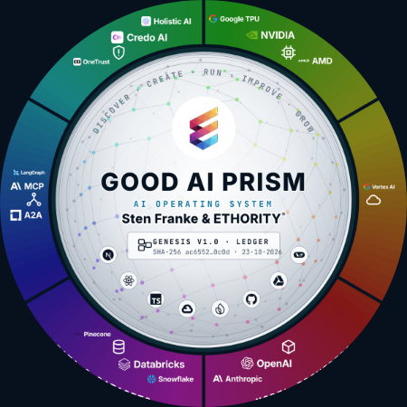
ETHORITY®
KEYNOTE · MARKET STUDY 2026/27
AI BUSINESS OPERATING SYSTEM
MOVE 03 · PUT THE DECISION TO WORK
Put the decision to work in steps you can measure.
1
2
3
4
5
Discover
Create
Run
Improve
Grow
Find where AI can help your business and what the market offers for it.
Choose the option and build the solution, including its costs, data and responsibilities.
Operate the system day to day, with named owners and agreed checks.
Measure the result against the starting point and adjust what does not work.
Extend what works to more teams, sites or countries.
Good AI Prism artwork © 2026 ETHORITY & STEN.AI LLC · CC BY-NC-ND 4.0 · commercial use by licence on request · data and third-party marks not covered
ETHORITY · KEYNOTE · EN · V3.5 · 29 OCT 2026
15 / 21
Notes:
Put the decision to work in steps you can measure.
Discover – Find where AI can help your business and what the market offers for it.
Create – Choose the option and build the solution, including its costs, data and responsibilities.
Run – Operate the system day to day, with named owners and agreed checks.
Improve – Measure the result against the starting point and adjust what does not work.
Grow – Extend what works to more teams, sites or countries.

Slide 16
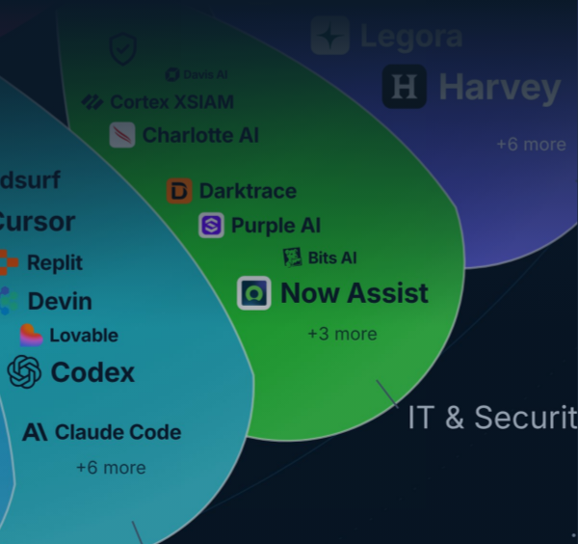
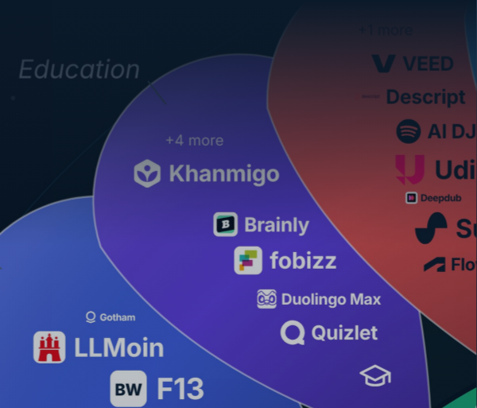


ETHORITY®
KEYNOTE · MARKET STUDY 2026/27
AI BUSINESS OPERATING SYSTEM
SEVEN SERVICES · NET PRICES
Seven services take you in four steps from a first check to AI that runs.
04 · RUN
Run
03 · ENABLE
Keep your AI rules and decisions up to date.
Enable
02 · DECIDE
Your team uses AI well and safely.
Decide
AI Governance Retainer
01 · CHECK
Set the rules, map your AI, price the big bet.
AI Literacy & Adoption
from €2,500 / month
Check
from €2,400
Know where you stand and what the rules require.
AI Governance Setup
from €19,500
AI Readiness & Maturity Check
AI Estate Audit & Mapping
€3,500
Focus €25,000
Group €45,000 · Group+ €75,000
AI Act Readiness Sprint
from €6,900
AI Opportunity Case
Enterprise €19,500
Priced after scoping
Source · ethority.ai offer pages · net prices plus VAT where applicable · Oct 2026
Good AI Prism artwork © 2026 ETHORITY & STEN.AI LLC · CC BY-NC-ND 4.0 · commercial use by licence on request · data and third-party marks not covered
ETHORITY · KEYNOTE · EN · V3.5 · 29 OCT 2026
16 / 21
Notes:
Seven services take you in four steps from a first check to AI that runs.
Check: AI Readiness & Maturity Check €3,500; AI Act Readiness Sprint from €6,900 Enterprise €19,500
Decide: AI Governance Setup from €19,500; AI Estate Audit & Mapping Focus €25,000 Group €45,000 · Group+ €75,000; AI Opportunity Case Priced after scoping
Enable: AI Literacy & Adoption from €2,400
Run: AI Governance Retainer from €2,500 / month
Source: ethority.ai offer pages · net prices plus VAT where applicable · Oct 2026

Slide 17
ETHORITY®
KEYNOTE · MARKET STUDY 2026/27
AI BUSINESS OPERATING SYSTEM
FIVE ENTRY OFFERS · NET PRICES
Five entry offers answer your question before you commit a larger budget.
Compare up to three AI offerings on dated facts before you buy.
AI Decision Brief
€195 net · one-time
COMPARE
Turn one business goal into an AI plan for the next 90 days.
AI Business Blueprint
€495 net · one-time
PLAN
Delivery date agreed before the work starts
Get a clear answer on one AI system: pilot, redesign, expand or stop.
AI Trust Record
€4,500 net · one-time
ASSESS
10 working days from receipt of the agreed inputs
Run one AI use case under real conditions, with stop rules agreed upfront.
AI Trust Pilot
€25,000 net · one-time
TEST
Six weeks
Know what would make an AI investment of about €200,000 or more pay.
AI Opportunity Case
Priced after scoping
INVEST
Standard 4 weeks · Extended 6 weeks
Source · ethority.ai offer pages · net prices plus VAT where applicable · Oct 2026
ETHORITY · KEYNOTE · EN · V3.5 · 29 OCT 2026
17 / 21
Notes:
Five entry offers answer your question before you commit a larger budget.
Compare up to three AI offerings on dated facts before you buy. AI Decision Brief: €195 net · one-time
Turn one business goal into an AI plan for the next 90 days. AI Business Blueprint: €495 net · one-time · Delivery date agreed before the work starts
Get a clear answer on one AI system: pilot, redesign, expand or stop. AI Trust Record: €4,500 net · one-time · 10 working days from receipt of the agreed inputs
Run one AI use case under real conditions, with stop rules agreed upfront. AI Trust Pilot: €25,000 net · one-time · Six weeks
Know what would make an AI investment of about €200,000 or more pay. AI Opportunity Case: Priced after scoping · Standard 4 weeks · Extended 6 weeks
Source: ethority.ai offer pages · net prices plus VAT where applicable · Oct 2026

Slide 18

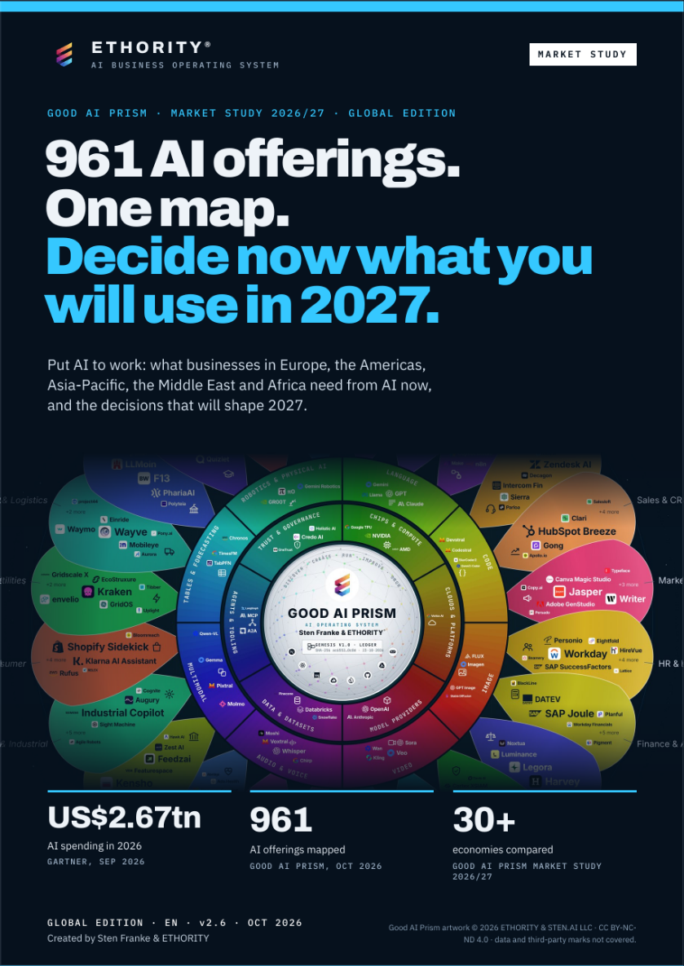
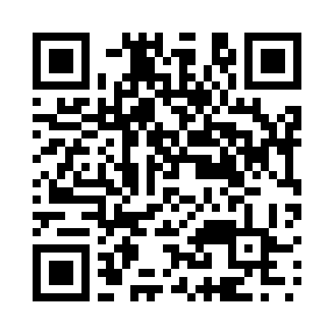
ETHORITY®
KEYNOTE · MARKET STUDY 2026/27
AI BUSINESS OPERATING SYSTEM
THE STUDY · GLOBAL EDITION · V2.6
961 AI offerings on one map: decide now what you will use in 2027.
How companies worldwide adopt AI, what 961 offerings promise and document, and how to run AI once you have chosen it. Every figure has a source.
961
30+
90
AI offerings mapped
economies compared
pages, English edition
GOOD AI PRISM, OCT 2026
MARKET STUDY 2026/27
GLOBAL EDITION V2.6
READ THE STUDY (PDF, 90 PAGES)
https://ethority.ai/research
Read the study
https://ethority.ai/
research/publications/
market-global-en
Good AI Prism artwork © 2026 ETHORITY & STEN.AI LLC · CC BY-NC-ND 4.0 · commercial use by licence on request · data and third-party marks not covered
ETHORITY · KEYNOTE · EN · V3.5 · 29 OCT 2026
18 / 21
Notes:
961 AI offerings on one map: decide now what you will use in 2027.
How companies worldwide adopt AI, what 961 offerings promise and document, and how to run AI once you have chosen it. Every figure has a source.
961 AI offerings mapped (Good AI Prism, Oct 2026)
30+ economies compared (Market Study 2026/27)
90 pages, English edition (Global edition v2.6)
Read the study (PDF, 90 pages) · https://ethority.ai/research/publications/market-global-en
https://ethority.ai/research
QR · Read the study: https://ethority.ai/research/publications/market-global-en

Slide 19

ETHORITY®
KEYNOTE · MARKET STUDY 2026/27
AI BUSINESS OPERATING SYSTEM
WHO LEADS YOUR PROJECT
Sten Franke leads every project.
STEN FRANKE · FOUNDER & CEO · CHIEF AI ARCHITECT
Practical AI architecture: programming, LLM testing, Google Cloud and AWS setup, and interfaces in Next.js and React. Business decisions, software and user experience are developed together.
2009
961
11
the first German Social Media Prisma
AI offerings on the Good AI Prism
entry offers and services with a clear scope
Source · ETHORITY company history · Good AI Prism, Oct 2026 · ethority.ai offer pages, Oct 2026
ETHORITY · KEYNOTE · EN · V3.5 · 29 OCT 2026
19 / 21
Notes:
Sten Franke leads every project.
“I help you make sense of the AI market, take sound decisions and shape the implementation — combining market intelligence, systems architecture and economic evaluation.”
Source: ETHORITY company history · Good AI Prism, Oct 2026 · ethority.ai offer pages, Oct 2026

Slide 20

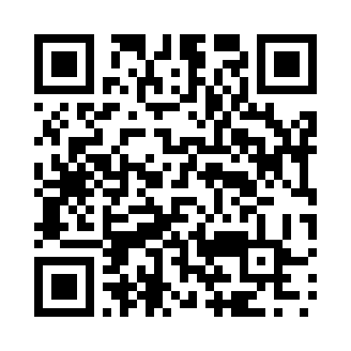
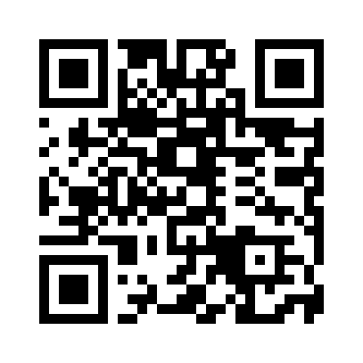
ETHORITY®
KEYNOTE · MARKET STUDY 2026/27
AI BUSINESS OPERATING SYSTEM
NEXT STEP
Discuss your case with Sten Franke.
AI Readiness & Maturity Check: one workshop day, then the written assessment · €3,500
Sten Franke
CHECK
FOUNDER & CEO · CHIEF AI ARCHITECT, ETHORITY
https://ethority.ai/products/enterprise-services/readiness-maturity-check
sten@ethority.ai · ethority.ai
CALCULATE
Test your own case with the AI calculators
https://ethority.ai/solutions/calculators
READ
The Global Market Study 2026/27 (90 pages)
https://ethority.ai/research
E-MAIL
sten@ethority.ai
This presentation online
Connect with Sten Franke
Sten Franke
https://ethority.ai/
research/publications/
keynote-full-en
https://www.linkedin.com/
in/stenfranke
Good AI Prism by Sten Franke & ETHORITY® · since the first Social Media Prisma in 2009 · roots: ETHORITY.AI and STEN.AI · text © 2026 ETHORITY & STEN.AI LLC
Source · ethority.ai offer page · net price plus VAT where applicable · Oct 2026
ETHORITY · KEYNOTE · EN · V3.5 · 29 OCT 2026
20 / 21
Notes:
Discuss your case with Sten Franke.
Check: AI Readiness & Maturity Check: one workshop day, then the written assessment · €3,500 · https://ethority.ai/products/enterprise-services/readiness-maturity-check
Calculate: Test your own case with the AI calculators · https://ethority.ai/solutions/calculators
Read: The Global Market Study 2026/27 (90 pages) · https://ethority.ai/research
E-mail: sten@ethority.ai · Sten Franke
QR · This presentation online: https://ethority.ai/research/publications/keynote-full-en
QR · Connect with Sten Franke: https://www.linkedin.com/in/stenfranke
Source: ethority.ai offer page · net price plus VAT where applicable · Oct 2026

Slide 21
ETHORITY®
KEYNOTE · MARKET STUDY 2026/27
AI BUSINESS OPERATING SYSTEM
CONTINUE ON ETHORITY.AI
Every page, offer and study in this deck is one click away.
PAGES
FIVE ENTRY OFFERS
SEVEN SERVICES
STUDIES, ARTICLES, TOOLS
Home
Overview →
Overview → · AI Opportunity Case: see entry offers
Global Market Study 2026/27
https://ethority.ai/
AI Decision Brief
AI Readiness & Maturity Check
https://ethority.ai/research/publications/
market-global-en
Good AI Prism
https://ethority.ai/offers/ai-decision-brief
https://ethority.ai/products/
enterprise-services/readiness-maturity-check
https://ethority.ai/ai-prism
AI Business Blueprint
All studies
Registry of AI offerings
https://ethority.ai/offers/
ai-business-blueprint
AI Act Readiness Sprint
https://ethority.ai/research/publications
https://ethority.ai/explore/registry
https://ethority.ai/products/
enterprise-services/ai-act-readiness-sprint
Articles
AI Trust Record
https://ethority.ai/articles
Compare offerings
https://ethority.ai/offers/ai-trust-record
AI Literacy & Adoption
AI calculators
https://ethority.ai/explore/compare
AI Trust Pilot
https://ethority.ai/products/
enterprise-services/literacy-adoption
https://ethority.ai/solutions/calculators
Company
https://ethority.ai/offers/ai-trust-pilot
Glossary
https://ethority.ai/company
AI Opportunity Case
AI Governance Setup
https://ethority.ai/learn/glossary
Founder & network
https://ethority.ai/products/
enterprise-services/opportunity-case
https://ethority.ai/products/
enterprise-services/governance-setup
https://ethority.ai/company/team
Method
Contact
AI Estate Audit & Mapping
https://ethority.ai/methodology
https://ethority.ai/contact
https://ethority.ai/products/
enterprise-services/estate-audit
AI Governance Retainer
https://ethority.ai/products/
enterprise-services/governance-retainer
Source · Pages as published on ethority.ai, Oct 2026
ETHORITY · KEYNOTE · EN · V3.5 · 29 OCT 2026
21 / 21
Notes:
Every page, offer and study in this deck is one click away.
Pages: Home https://ethority.ai/; Good AI Prism https://ethority.ai/ai-prism; Registry of AI offerings https://ethority.ai/explore/registry; Compare offerings https://ethority.ai/explore/compare; Company https://ethority.ai/company; Founder & network https://ethority.ai/company/team; Contact https://ethority.ai/contact
Five entry offers: AI Decision Brief https://ethority.ai/offers/ai-decision-brief; AI Business Blueprint https://ethority.ai/offers/ai-business-blueprint; AI Trust Record https://ethority.ai/offers/ai-trust-record; AI Trust Pilot https://ethority.ai/offers/ai-trust-pilot; AI Opportunity Case https://ethority.ai/products/enterprise-services/opportunity-case
Seven services: AI Readiness & Maturity Check https://ethority.ai/products/enterprise-services/readiness-maturity-check; AI Act Readiness Sprint https://ethority.ai/products/enterprise-services/ai-act-readiness-sprint; AI Literacy & Adoption https://ethority.ai/products/enterprise-services/literacy-adoption; AI Governance Setup https://ethority.ai/products/enterprise-services/governance-setup; AI Estate Audit & Mapping https://ethority.ai/products/enterprise-services/estate-audit; AI Governance Retainer https://ethority.ai/products/enterprise-services/governance-retainer
Studies, articles, tools: Global Market Study 2026/27 https://ethority.ai/research/publications/market-global-en; All studies https://ethority.ai/research/publications; Articles https://ethority.ai/articles; AI calculators https://ethority.ai/solutions/calculators; Glossary https://ethority.ai/learn/glossary; Method https://ethority.ai/methodology
Source: Pages as published on ethority.ai, Oct 2026

