Slide 1

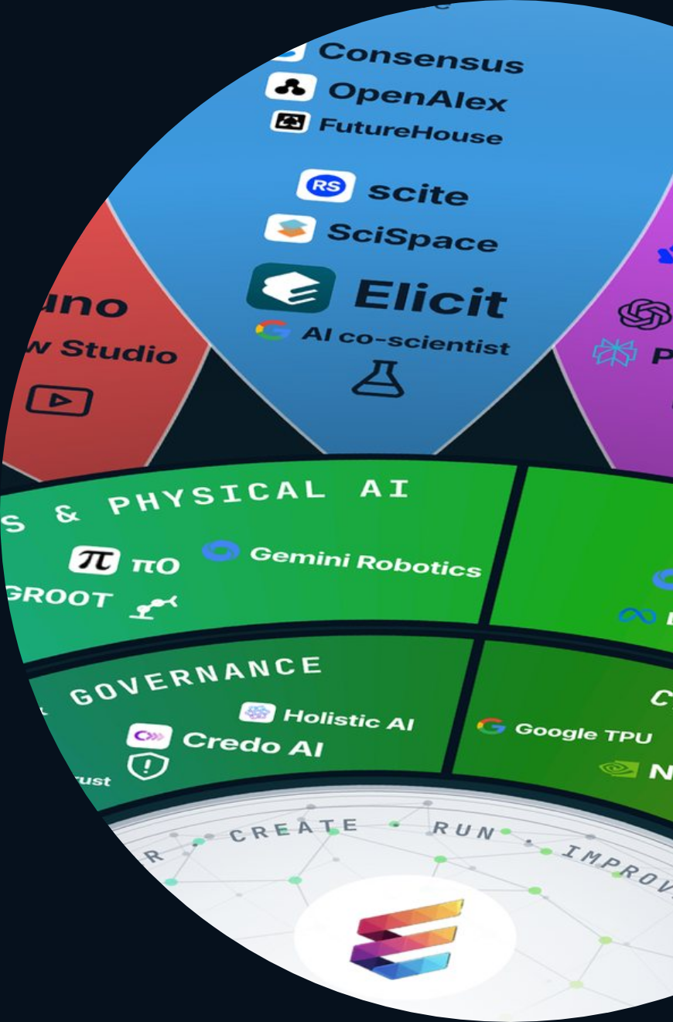
ETHORITY®
MARKET STUDY 2026/27
AI BUSINESS OPERATING SYSTEM
GOOD AI PRISM · MARKET STUDY 2026/27 · GLOBAL EDITION
961 AI offerings on one map: decide now what you will use in 2027.
What businesses in Europe, the Americas, Asia-Pacific, the Middle East and Africa need from AI now, and the decisions that will shape 2027. Presented by Sten Franke.
US$2.67tn
961
30+
worldwide AI spending forecast for 2026
AI offerings mapped
economies compared
GOOD AI PRISM, OCT 2026
MARKET STUDY 2026/27, V2.6
GARTNER, SEP 2026
Good AI Prism artwork © 2026 ETHORITY & STEN.AI LLC · CC BY-NC-ND 4.0 · commercial use by licence on request · data and third-party marks not covered
GOOD AI PRISM · STUDY PRESENTATION · EN · V3.3 · 27 OCT 2026
01 / 19
Notes:
961 AI offerings on one map: decide now what you will use in 2027.
What businesses in Europe, the Americas, Asia-Pacific, the Middle East and Africa need from AI now, and the decisions that will shape 2027. Presented by Sten Franke.
US$2.67tn worldwide AI spending forecast for 2026 (Gartner, Sep 2026)
961 AI offerings mapped (Good AI Prism, Oct 2026)
30+ economies compared (Market Study 2026/27, v2.6)

Slide 2
ETHORITY®
MARKET STUDY 2026/27
AI BUSINESS OPERATING SYSTEM
THE STUDY IN ONE MINUTE
Nine in ten surveyed organisations use AI; 37% see an effect on profit.
Three separate answers from one global survey: respondents report regular use, scaling and some effect on profit. Your decisions turn use into results.
≈90%
44%
37%
use AI regularly in at least one function
report scaling AI
attribute some effect on profit (EBIT) to AI
MCKINSEY, THE STATE OF AI, AUG 2026
MCKINSEY, THE STATE OF AI, AUG 2026
MCKINSEY, THE STATE OF AI, AUG 2026
GOOD AI PRISM · STUDY PRESENTATION · EN · V3.3 · 27 OCT 2026
02 / 19
Notes:
Nine in ten surveyed organisations use AI; 37% see an effect on profit.
Three separate answers from one global survey: respondents report regular use, scaling and some effect on profit. Your decisions turn use into results.
≈90% use AI regularly in at least one function (McKinsey, The state of AI, Aug 2026)
44% report scaling AI (McKinsey, The state of AI, Aug 2026)
37% attribute some effect on profit (EBIT) to AI (McKinsey, The state of AI, Aug 2026)

Slide 3
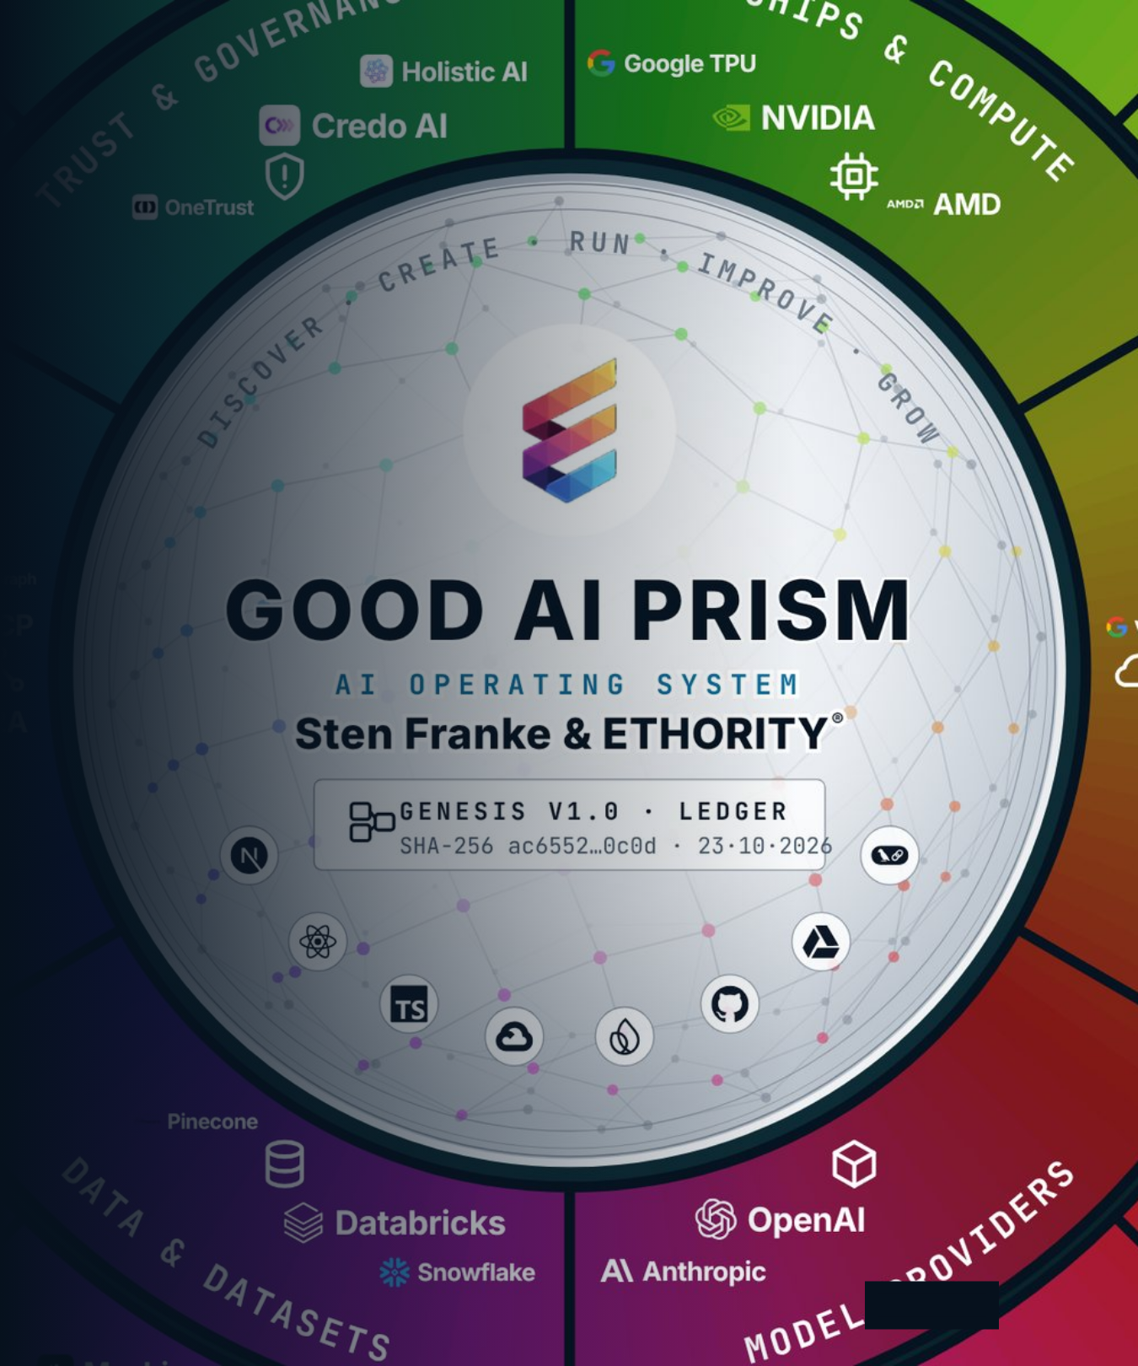
ETHORITY®
MARKET STUDY 2026/27
AI BUSINESS OPERATING SYSTEM
01
CHAPTER 01 · THE MARKET
Spending is forecast to rise by half. Know-how is the most-named barrier.
Spending is forecast to rise by half, mostly into infrastructure. In the surveys cited, most responding organisations use AI somewhere, and missing know-how is the barrier named most often.
Source · Gartner, Sep 2026 · Eurostat, 2025 · Good AI Prism Market Study 2026/27, chapter 1
Good AI Prism artwork © 2026 ETHORITY & STEN.AI LLC · CC BY-NC-ND 4.0 · commercial use by licence on request · data and third-party marks not covered
GOOD AI PRISM · STUDY PRESENTATION · EN · V3.3 · 27 OCT 2026
03 / 19
Notes:
Spending is forecast to rise by half. Know-how is the most-named barrier.
Spending is forecast to rise by half, mostly into infrastructure. In the surveys cited, most responding organisations use AI somewhere, and missing know-how is the barrier named most often.
Source: Gartner, Sep 2026 · Eurostat, 2025 · Good AI Prism Market Study 2026/27, chapter 1

Slide 4
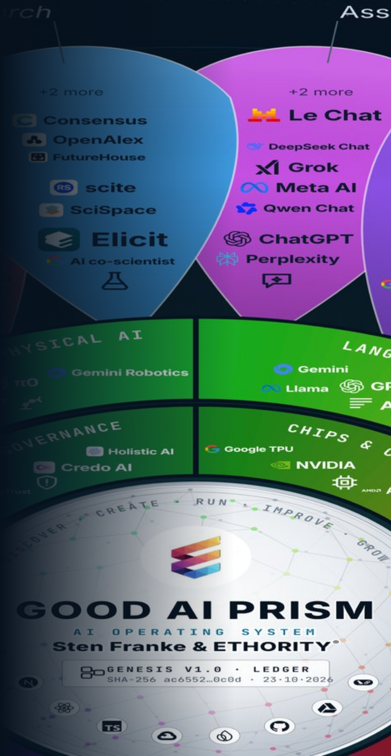
ETHORITY®
MARKET STUDY 2026/27
AI BUSINESS OPERATING SYSTEM
AI SPENDING 2026
Worldwide AI spending is forecast to rise by half in 2026.
US$2.67tn
forecast for 2026, up 49.5%. US$1.48tn of it goes into infrastructure.
Source · Gartner, Sep 2026 · Good AI Prism Market Study 2026/27, chapter 1
Good AI Prism artwork © 2026 ETHORITY & STEN.AI LLC · CC BY-NC-ND 4.0 · commercial use by licence on request · data and third-party marks not covered
GOOD AI PRISM · STUDY PRESENTATION · EN · V3.3 · 27 OCT 2026
04 / 19
Notes:
Worldwide AI spending is forecast to rise by half in 2026.
US$2.67tn
forecast for 2026, up 49.5%. US$1.48tn of it goes into infrastructure.
Source: Gartner, Sep 2026 · Good AI Prism Market Study 2026/27, chapter 1

Slide 5
ETHORITY®
MARKET STUDY 2026/27
AI BUSINESS OPERATING SYSTEM
EXHIBIT 1.3 · ADOPTION BY OFFICIAL COUNT
Official statistics count one firm in five in the EU, and two in five in Denmark.
Denmark
42%
Global executive surveys report nearly nine in ten; statistics offices count all firms with ten or more staff.
Finland
37.8%
UK (Jun 2026)
35%
Sweden
35%
The range runs from 5.2% in Romania to 42% in Denmark.
Netherlands
33.2%
Germany
26%
Plan with the official figure for your market, not with the survey headline.
Spain
21.1%
EU-27
20%
France
18%
Italy
16.4%
Australia (all firms)
12%
Poland
8.4%
Romania
5.2%
Source · Eurostat, Dec 2025 · ONS · INE · INSEE · Istat · ABS · Exhibit 1.3, Good AI Prism Market Study 2026/27
GOOD AI PRISM · STUDY PRESENTATION · EN · V3.3 · 27 OCT 2026
05 / 19
Notes:
Official statistics count one firm in five in the EU, and two in five in Denmark.
Global executive surveys report nearly nine in ten; statistics offices count all firms with ten or more staff.
The range runs from 5.2% in Romania to 42% in Denmark.
Plan with the official figure for your market, not with the survey headline.
Denmark: 42%
Finland: 37.8%
UK (Jun 2026): 35%
Sweden: 35%
Netherlands: 33.2%
Germany: 26%
Spain: 21.1%
EU-27: 20%
France: 18%
Italy: 16.4%
Australia (all firms): 12%
Poland: 8.4%
Romania: 5.2%
Source: Eurostat, Dec 2025 · ONS · INE · INSEE · Istat · ABS · Exhibit 1.3, Good AI Prism Market Study 2026/27

Slide 6
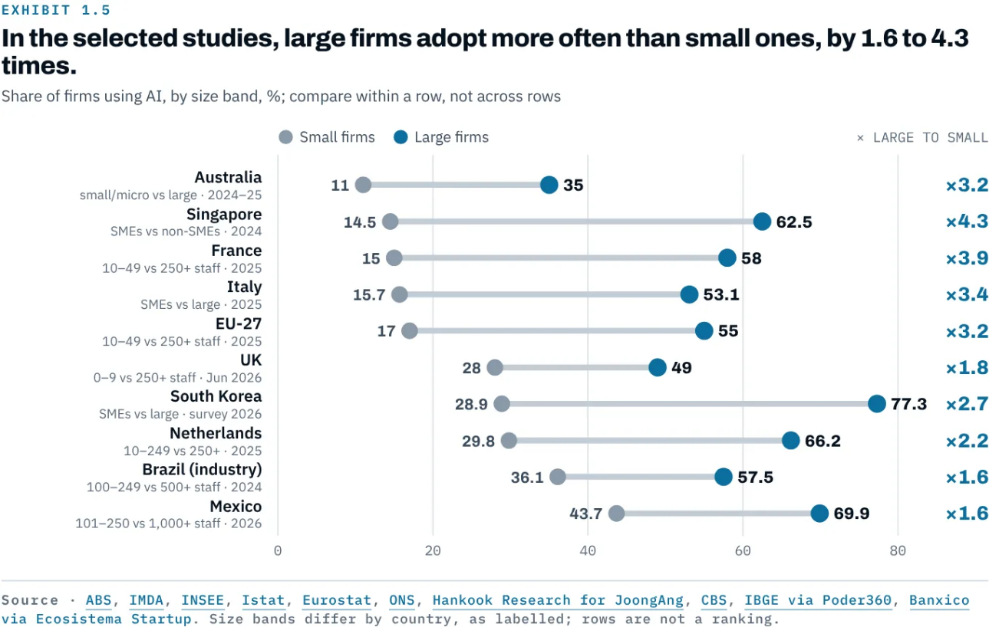
ETHORITY®
MARKET STUDY 2026/27
AI BUSINESS OPERATING SYSTEM
EXHIBIT 1.5 · THE SIZE GAP
Large firms use AI 1.6 to 4.3 times as often as small ones.
In the EU, 55% of large firms use AI, against 17% of small ones.
AI agents widen the gap: 40% of large organisations scale them, against 22% of smaller ones.
The study recommends offers and programmes built for small firms.
Source · National statistics offices 2024–26, as in Exhibit 1.5 · McKinsey, Aug 2026 · Good AI Prism Market Study 2026/27
GOOD AI PRISM · STUDY PRESENTATION · EN · V3.3 · 27 OCT 2026
06 / 19
Notes:
Large firms use AI 1.6 to 4.3 times as often as small ones.
In the EU, 55% of large firms use AI, against 17% of small ones.
AI agents widen the gap: 40% of large organisations scale them, against 22% of smaller ones.
The study recommends offers and programmes built for small firms.
Source: National statistics offices 2024–26, as in Exhibit 1.5 · McKinsey, Aug 2026 · Good AI Prism Market Study 2026/27

Slide 7
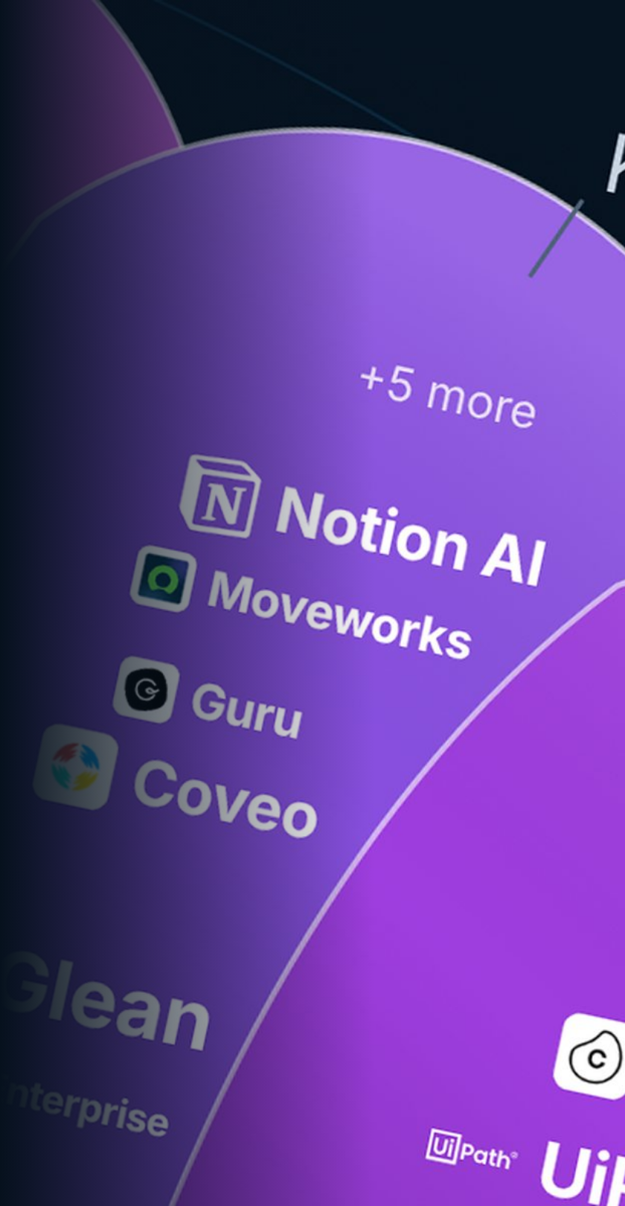
ETHORITY®
MARKET STUDY 2026/27
AI BUSINESS OPERATING SYSTEM
WHAT HOLDS FIRMS BACK
Lack of know-how is the barrier named most often.
71%
of EU firms that considered AI say they lack the expertise to use it.
Source · Eurostat, 2025 · Good AI Prism Market Study 2026/27, finding 05
Good AI Prism artwork © 2026 ETHORITY & STEN.AI LLC · CC BY-NC-ND 4.0 · commercial use by licence on request · data and third-party marks not covered
GOOD AI PRISM · STUDY PRESENTATION · EN · V3.3 · 27 OCT 2026
07 / 19
Notes:
Lack of know-how is the barrier named most often.
71%
of EU firms that considered AI say they lack the expertise to use it.
Source: Eurostat, 2025 · Good AI Prism Market Study 2026/27, finding 05

Slide 8
ETHORITY®
MARKET STUDY 2026/27
AI BUSINESS OPERATING SYSTEM
AI AS A RUNNING COST
AI is becoming a running cost: about one surveyed organisation in five says it already limits use.
1 in 5
HOW VISIBLE AI COSTS ARE
of large US firms see their AI costs in real time
26%
KPMG AI PULSE Q2 2026 · REVENUE US$1BN+
of large US firms name AI cost management as a barrier
organisations say operating costs limit their use of AI.
35%
KPMG AI PULSE Q2 2026 · REVENUE US$1BN+
of firms in Mexico find AI cost structures hard to understand
46%
KPMG MEXICO, Q2 2026 · REVENUE ABOVE US$50M
Source · McKinsey, The state of AI, Aug 2026 · KPMG AI Pulse Q2 2026 · KPMG Mexico, Global AI Pulse Q2 2026 · Good AI Prism Market Study 2026/27, finding 08
GOOD AI PRISM · STUDY PRESENTATION · EN · V3.3 · 27 OCT 2026
08 / 19
Notes:
AI is becoming a running cost: about one surveyed organisation in five says it already limits use.
1 in 5
organisations say operating costs limit their use of AI.
1 in 5 organisations say operating costs limit their use of AI.
26% of large US firms see their AI costs in real time (KPMG AI Pulse Q2 2026 · revenue US$1bn+)
35% of large US firms name AI cost management as a barrier (KPMG AI Pulse Q2 2026 · revenue US$1bn+)
46% of firms in Mexico find AI cost structures hard to understand (KPMG Mexico, Q2 2026 · revenue above US$50m)
Source: McKinsey, The state of AI, Aug 2026 · KPMG AI Pulse Q2 2026 · KPMG Mexico, Global AI Pulse Q2 2026 · Good AI Prism Market Study 2026/27, finding 08

Slide 9
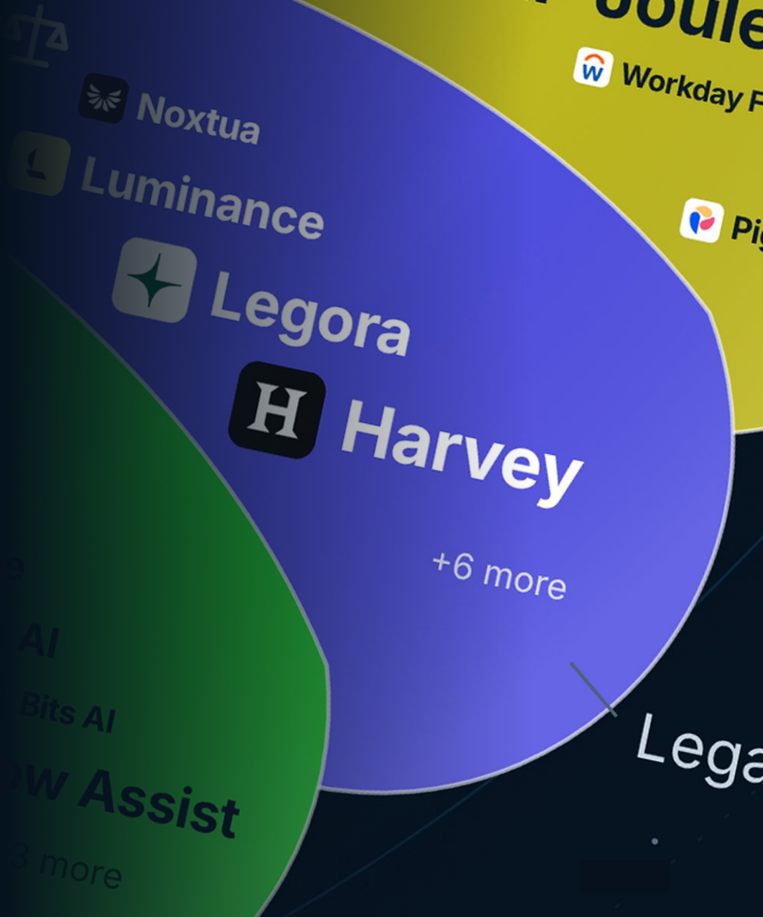
ETHORITY®
MARKET STUDY 2026/27
AI BUSINESS OPERATING SYSTEM
02
CHAPTER 02 · THE RULES
AI laws already apply in South Korea and Vietnam; EU duties for listed high-risk uses from 2 Dec 2027.
AI laws apply in South Korea and Vietnam, US state rules from 1 Jan 2027, EU high-risk duties from 2 Dec 2027 and India’s data-protection duties from 13 May 2027.
Source · Regulation (EU) 2026/1744 · Good AI Prism Market Study 2026/27, finding 09
Good AI Prism artwork © 2026 ETHORITY & STEN.AI LLC · CC BY-NC-ND 4.0 · commercial use by licence on request · data and third-party marks not covered
GOOD AI PRISM · STUDY PRESENTATION · EN · V3.3 · 27 OCT 2026
09 / 19
Notes:
AI laws already apply in South Korea and Vietnam; EU duties for listed high-risk uses from 2 Dec 2027.
AI laws apply in South Korea and Vietnam, US state rules from 1 Jan 2027, EU high-risk duties from 2 Dec 2027 and India’s data-protection duties from 13 May 2027.
Source: Regulation (EU) 2026/1744 · Good AI Prism Market Study 2026/27, finding 09

Slide 10
ETHORITY®
MARKET STUDY 2026/27
AI BUSINESS OPERATING SYSTEM
EXHIBIT 2.1 · EU AI ACT
Transparency duties already apply; duties for listed high-risk uses follow on 2 Dec 2027.
2 Aug 2026
2 Dec 2026
2 Dec 2027
2 Aug 2028
Transparency: people must be told when they deal with an AI (Article 50).
Machine-readable marking for generative AI already on the market (Article 50(2)).
High-risk duties for uses listed in Annex III, such as certain AI in hiring, credit, insurance, education and public services.
High-risk duties for AI in regulated products such as machines and medical devices, where Annex I applies.
APPLIES NOW
PLAN NOW
Source · Regulation (EU) 2026/1744, EUR-Lex · Exhibit 2.1, Good AI Prism Market Study 2026/27
GOOD AI PRISM · STUDY PRESENTATION · EN · V3.3 · 27 OCT 2026
10 / 19
Notes:
Transparency duties already apply; duties for listed high-risk uses follow on 2 Dec 2027.
Since 2 Aug 2026, people must be told when they are dealing with an AI (Article 50).
High-risk duties cover uses listed in Annex III, such as certain AI in hiring, credit, insurance, education and public services.
Start with one list of all AI in use; it serves every jurisdiction you operate in.
2 Aug 2026: Transparency: people must be told when they deal with an AI (Article 50).
2 Dec 2026: Machine-readable marking for generative AI already on the market (Article 50(2)).
2 Dec 2027: High-risk duties for uses listed in Annex III, such as certain AI in hiring, credit, insurance, education and public services.
2 Aug 2028: High-risk duties for AI in regulated products such as machines and medical devices, where Annex I applies.
Source: Regulation (EU) 2026/1744, EUR-Lex · Exhibit 2.1, Good AI Prism Market Study 2026/27

Slide 11
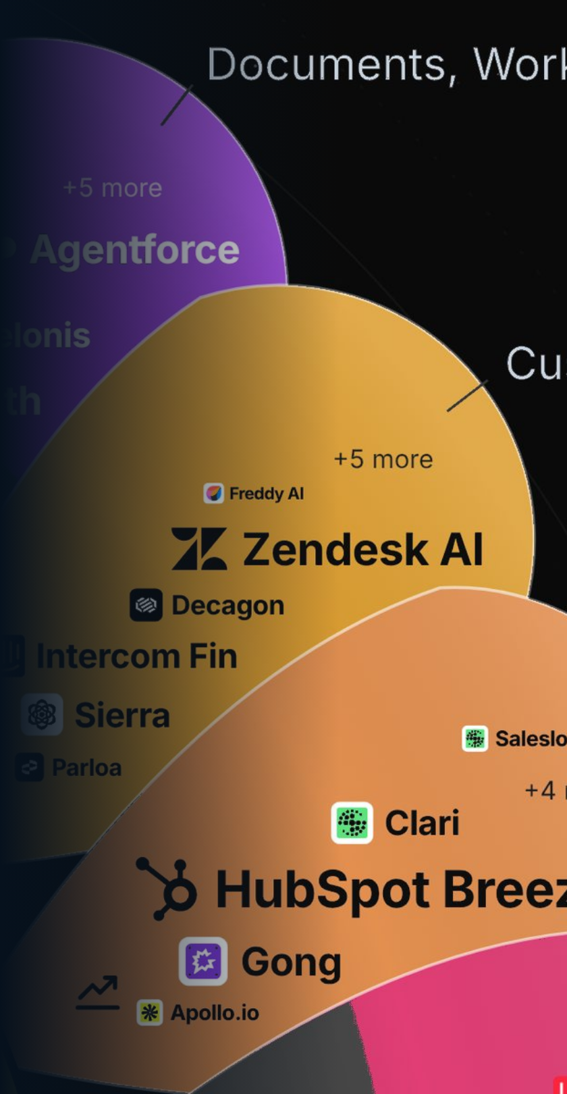
ETHORITY®
MARKET STUDY 2026/27
AI BUSINESS OPERATING SYSTEM
BUYING AI · WHAT PROVIDERS PUBLISH
Buyers can rarely compare AI offerings on facts.
43 of 107
customer-service AI offerings publish a price; 38 document an EU hosting option.
Source · Good AI Prism, October 2026 survey of provider information (reviewed 19–20 Oct 2026)
Good AI Prism artwork © 2026 ETHORITY & STEN.AI LLC · CC BY-NC-ND 4.0 · commercial use by licence on request · data and third-party marks not covered
GOOD AI PRISM · STUDY PRESENTATION · EN · V3.3 · 27 OCT 2026
11 / 19
Notes:
Buyers can rarely compare AI offerings on facts.
43 of 107
customer-service AI offerings publish a price; 38 document an EU hosting option.
Source: Good AI Prism, October 2026 survey of provider information (reviewed 19–20 Oct 2026)

Slide 12
ETHORITY®
MARKET STUDY 2026/27
AI BUSINESS OPERATING SYSTEM
EXHIBIT 8.2 · THE DECISION
Five questions decide whether you pilot, ask for evidence, redesign or stop.
1
2
3
4
5
Relevance
Baseline
Facts
Checks
Result
Is the process important enough to change?
Is there a measured baseline and an owner?
Do the deciding facts exist in writing for at least two options?
Are privacy, security, workplace and contract checks done, and is the use high-risk?
Did the pilot meet its threshold for accepted results?
If not: choose another process.
If not: measure first (checkpoint 1).
If not: ask for them before any demo.
If not: redesign or stop. If yes: scale (checkpoint 2).
If high-risk: add the extra controls first.
Source · ETHORITY decision sequence · Exhibit 8.2, Good AI Prism Market Study 2026/27
GOOD AI PRISM · STUDY PRESENTATION · EN · V3.3 · 27 OCT 2026
12 / 19
Notes:
Five questions decide whether you pilot, ask for evidence, redesign or stop.
Relevance – Is the process important enough to change? – If not: choose another process.
Baseline – Is there a measured baseline and an owner? – If not: measure first (checkpoint 1).
Facts – Do the deciding facts exist in writing for at least two options? – If not: ask for them before any demo.
Checks – Are privacy, security, workplace and contract checks done, and is the use high-risk? – If high-risk: add the extra controls first.
Result – Did the pilot meet its threshold for accepted results? – If not: redesign or stop. If yes: scale (checkpoint 2).
Source: ETHORITY decision sequence · Exhibit 8.2, Good AI Prism Market Study 2026/27

Slide 13

ETHORITY®
MARKET STUDY 2026/27
AI BUSINESS OPERATING SYSTEM
THE FOUR QUALITIES
Good AI is effective, efficient, economic and responsible.
Compliance is part of responsible implementation. Responsibility goes further: a legally permitted application can still be badly designed or harm the people affected.
01
02
03
04
Effective
Efficient
Economic
Responsible
AI supports a concrete goal with results you can check.
Effort, cost and human rework are counted.
A technical gain is tested for its real business value.
People, rights, safety and ethical consequences are part of the decision.
GOOD AI PRISM · STUDY PRESENTATION · EN · V3.3 · 27 OCT 2026
13 / 19
Notes:
Good AI is effective, efficient, economic and responsible.
Compliance is part of responsible implementation. Responsibility goes further: a legally permitted application can still be badly designed or harm the people affected.
Effective: AI supports a concrete goal with results you can check.
Efficient: Effort, cost and human rework are counted.
Economic: A technical gain is tested for its real business value.
Responsible: People, rights, safety and ethical consequences are part of the decision.

Slide 14


ETHORITY®
MARKET STUDY 2026/27
AI BUSINESS OPERATING SYSTEM
“
THE FOUNDER’S VIEW
AI pays off when people can work with it. Bring your teams in early, train them alongside the rollout and name who decides. Then AI grows with your organisation as conditions change.
Sten Franke
FOUNDER & CEO · CHIEF AI ARCHITECT, ETHORITY
Good AI Prism artwork © 2026 ETHORITY & STEN.AI LLC · CC BY-NC-ND 4.0 · commercial use by licence on request · data and third-party marks not covered
GOOD AI PRISM · STUDY PRESENTATION · EN · V3.3 · 27 OCT 2026
14 / 19
Notes:
AI pays off when people can work with it. Bring your teams in early, train them alongside the rollout and name who decides. Then AI grows with your organisation as conditions change.

Slide 15

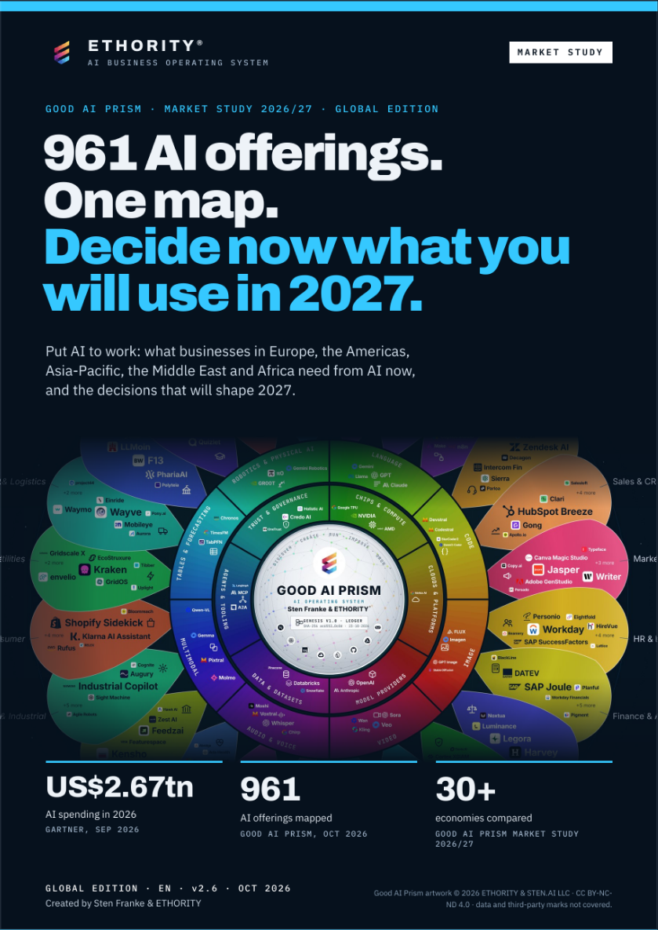
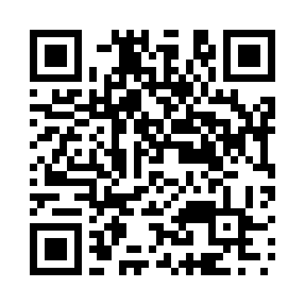
ETHORITY®
MARKET STUDY 2026/27
AI BUSINESS OPERATING SYSTEM
THE STUDY · GLOBAL EDITION · V2.6
961 AI offerings on one map: decide now what you will use in 2027.
How companies worldwide adopt AI, what 961 offerings promise and document, and how to run AI once you have chosen it. Every figure has a source.
961
30+
90
AI offerings mapped
economies compared
pages, English edition
GOOD AI PRISM, OCT 2026
MARKET STUDY 2026/27
GLOBAL EDITION V2.6
READ THE STUDY (PDF, 90 PAGES)
https://ethority.ai/research
Read the study
https://ethority.ai/
research/publications/
market-global-en
Good AI Prism artwork © 2026 ETHORITY & STEN.AI LLC · CC BY-NC-ND 4.0 · commercial use by licence on request · data and third-party marks not covered
GOOD AI PRISM · STUDY PRESENTATION · EN · V3.3 · 27 OCT 2026
15 / 19
Notes:
961 AI offerings on one map: decide now what you will use in 2027.
How companies worldwide adopt AI, what 961 offerings promise and document, and how to run AI once you have chosen it. Every figure has a source.
961 AI offerings mapped (Good AI Prism, Oct 2026)
30+ economies compared (Market Study 2026/27)
90 pages, English edition (Global edition v2.6)
Read the study (PDF, 90 pages) · https://ethority.ai/research/publications/market-global-en
https://ethority.ai/research
QR · Read the study: https://ethority.ai/research/publications/market-global-en

Slide 16

ETHORITY®
MARKET STUDY 2026/27
AI BUSINESS OPERATING SYSTEM
WHO LEADS YOUR PROJECT
Sten Franke leads every project.
STEN FRANKE · FOUNDER & CEO · CHIEF AI ARCHITECT
“I help you make sense of the AI market, take sound decisions and shape the implementation — combining market intelligence, systems architecture and economic evaluation.”
2009
961
11
the first German Social Media Prisma
AI offerings on the Good AI Prism
entry offers and services with a clear scope
Source · ETHORITY company history · Good AI Prism, Oct 2026 · ethority.ai offer pages, Oct 2026
GOOD AI PRISM · STUDY PRESENTATION · EN · V3.3 · 27 OCT 2026
16 / 19
Notes:
Sten Franke leads every project.
“I help you make sense of the AI market, take sound decisions and shape the implementation — combining market intelligence, systems architecture and economic evaluation.”
Source: ETHORITY company history · Good AI Prism, Oct 2026 · ethority.ai offer pages, Oct 2026

Slide 17

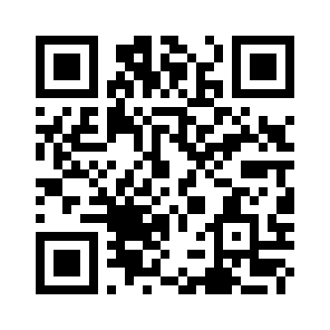
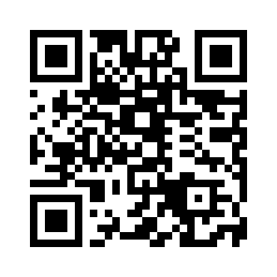
ETHORITY®
MARKET STUDY 2026/27
AI BUSINESS OPERATING SYSTEM
NEXT STEP
Discuss your case with Sten Franke.
AI Readiness & Maturity Check: one workshop day, then the written assessment
Sten Franke
CHECK
FOUNDER & CEO · CHIEF AI ARCHITECT, ETHORITY
https://ethority.ai/products/enterprise-services/readiness-maturity-check
sten@ethority.ai · ethority.ai
CALCULATE
Test your own case with the AI calculators
https://ethority.ai/solutions/calculators
READ
The Global Market Study 2026/27 (90 pages)
https://ethority.ai/research
E-MAIL
sten@ethority.ai
This presentation online
Connect with Sten Franke
Sten Franke
https://ethority.ai/
research/presentations
https://www.linkedin.com/
in/stenfranke
Source · ethority.ai offer and study pages · Oct 2026
GOOD AI PRISM · STUDY PRESENTATION · EN · V3.3 · 27 OCT 2026
17 / 19
Notes:
Discuss your case with Sten Franke.
Check: AI Readiness & Maturity Check: one workshop day, then the written assessment · https://ethority.ai/products/enterprise-services/readiness-maturity-check
Calculate: Test your own case with the AI calculators · https://ethority.ai/solutions/calculators
Read: The Global Market Study 2026/27 (90 pages) · https://ethority.ai/research
E-mail: sten@ethority.ai · Sten Franke
QR · This presentation online: https://ethority.ai/research/presentations
QR · Connect with Sten Franke: https://www.linkedin.com/in/stenfranke
Source: ethority.ai offer and study pages · Oct 2026

Slide 18
ETHORITY®
MARKET STUDY 2026/27
AI BUSINESS OPERATING SYSTEM
CONTINUE ON ETHORITY.AI
Every page, offer and study in this deck is one click away.
PAGES
FIVE ENTRY OFFERS
SEVEN SERVICES
STUDIES, ARTICLES, TOOLS
Home
Overview →
Overview → · AI Opportunity Case: see entry offers
Global Market Study 2026/27
https://ethority.ai/
AI Decision Brief
AI Readiness & Maturity Check
https://ethority.ai/research/publications/
market-global-en
Good AI Prism
https://ethority.ai/offers/ai-decision-brief
https://ethority.ai/products/
enterprise-services/readiness-maturity-check
https://ethority.ai/ai-prism
AI Business Blueprint
All studies
Registry of AI offerings
https://ethority.ai/offers/
ai-business-blueprint
AI Act Readiness Sprint
https://ethority.ai/research/publications
https://ethority.ai/explore/registry
https://ethority.ai/products/
enterprise-services/ai-act-readiness-sprint
Articles
AI Trust Record
https://ethority.ai/articles
Compare offerings
https://ethority.ai/offers/ai-trust-record
AI Literacy & Adoption
AI calculators
https://ethority.ai/explore/compare
AI Trust Pilot
https://ethority.ai/products/
enterprise-services/literacy-adoption
https://ethority.ai/solutions/calculators
Company
https://ethority.ai/offers/ai-trust-pilot
Glossary
https://ethority.ai/company
AI Opportunity Case
AI Governance Setup
https://ethority.ai/learn/glossary
Founder & network
https://ethority.ai/products/
enterprise-services/opportunity-case
https://ethority.ai/products/
enterprise-services/governance-setup
https://ethority.ai/company/team
Method
Contact
AI Estate Audit & Mapping
https://ethority.ai/methodology
https://ethority.ai/contact
https://ethority.ai/products/
enterprise-services/estate-audit
AI Governance Retainer
https://ethority.ai/products/
enterprise-services/governance-retainer
Source · Pages as published on ethority.ai, Oct 2026
GOOD AI PRISM · STUDY PRESENTATION · EN · V3.3 · 27 OCT 2026
18 / 19
Notes:
Every page, offer and study in this deck is one click away.
Pages: Home https://ethority.ai/; Good AI Prism https://ethority.ai/ai-prism; Registry of AI offerings https://ethority.ai/explore/registry; Compare offerings https://ethority.ai/explore/compare; Company https://ethority.ai/company; Founder & network https://ethority.ai/company/team; Contact https://ethority.ai/contact
Five entry offers: AI Decision Brief https://ethority.ai/offers/ai-decision-brief; AI Business Blueprint https://ethority.ai/offers/ai-business-blueprint; AI Trust Record https://ethority.ai/offers/ai-trust-record; AI Trust Pilot https://ethority.ai/offers/ai-trust-pilot; AI Opportunity Case https://ethority.ai/products/enterprise-services/opportunity-case
Seven services: AI Readiness & Maturity Check https://ethority.ai/products/enterprise-services/readiness-maturity-check; AI Act Readiness Sprint https://ethority.ai/products/enterprise-services/ai-act-readiness-sprint; AI Literacy & Adoption https://ethority.ai/products/enterprise-services/literacy-adoption; AI Governance Setup https://ethority.ai/products/enterprise-services/governance-setup; AI Estate Audit & Mapping https://ethority.ai/products/enterprise-services/estate-audit; AI Governance Retainer https://ethority.ai/products/enterprise-services/governance-retainer
Studies, articles, tools: Global Market Study 2026/27 https://ethority.ai/research/publications/market-global-en; All studies https://ethority.ai/research/publications; Articles https://ethority.ai/articles; AI calculators https://ethority.ai/solutions/calculators; Glossary https://ethority.ai/learn/glossary; Method https://ethority.ai/methodology
Source: Pages as published on ethority.ai, Oct 2026

Slide 19
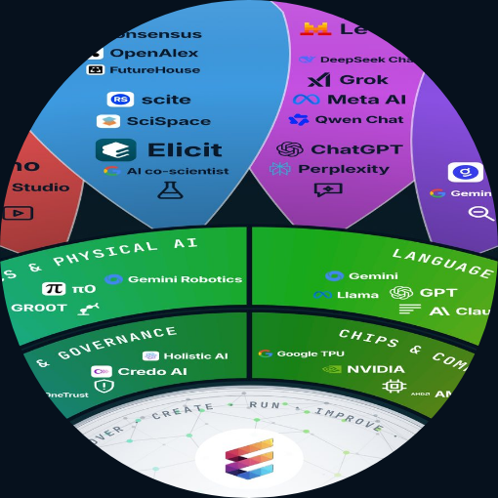
ETHORITY®
MARKET STUDY 2026/27
AI BUSINESS OPERATING SYSTEM
IMPRINT
Good AI Prism by Sten Franke & ETHORITY®
EDITION
Market Study presentation · EN · v3.3 · 27 Oct 2026
BASED ON
Put AI to Work: The Good AI Prism Global Market Study 2026/27, global edition v2.6
LINEAGE
Since the first Social Media Prisma in 2009 · Roots: ETHORITY.AI and STEN.AI
SOURCES
Named on every slide; study figures as in the Global Market Study v2.6
CONTACT
Sten Franke · sten@ethority.ai · ethority.ai
TEXT
© 2026 ETHORITY & STEN.AI LLC
Good AI Prism artwork © 2026 ETHORITY & STEN.AI LLC · CC BY-NC-ND 4.0 · commercial use by licence on request · data and third-party marks not covered
GOOD AI PRISM · STUDY PRESENTATION · EN · V3.3 · 27 OCT 2026
19 / 19
Notes:
Good AI Prism by Sten Franke & ETHORITY®

