Slide 1

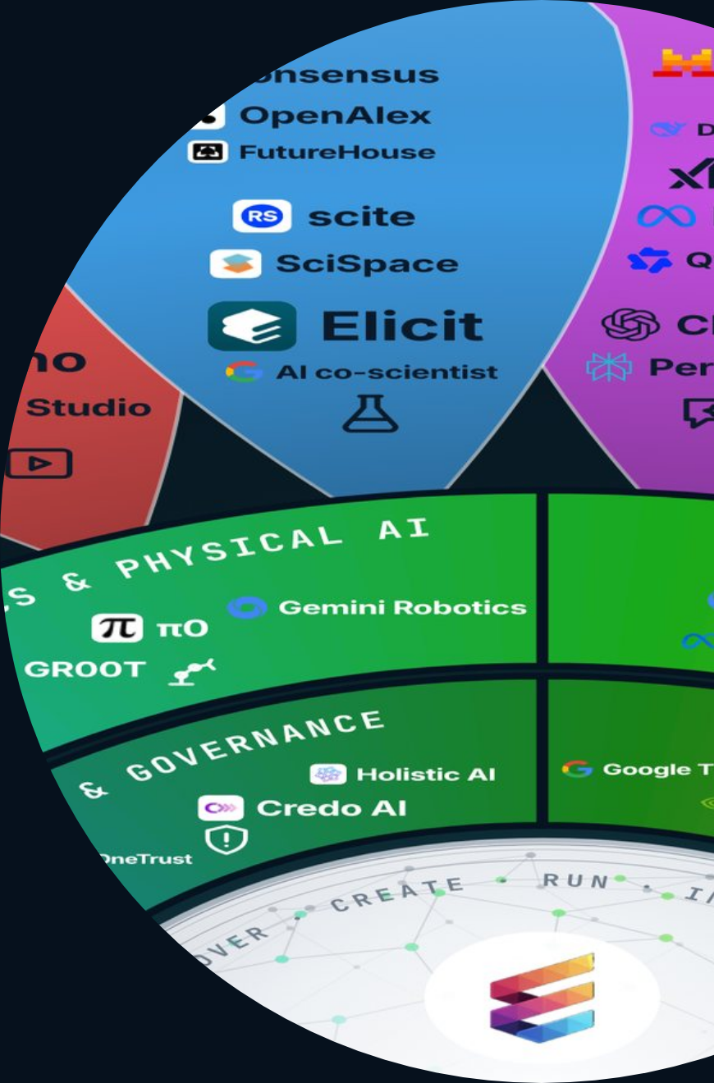
ETHORITY®
COMPANY & OFFERS
AI BUSINESS OPERATING SYSTEM
ETHORITY · COMPANY & OFFERS 2026/27
AI that fits your business – and keeps fitting.
ETHORITY makes AI work for your team, your project and your company, fits it to your customers and adapts it when your market or the rules change.
961
24
11
AI offerings mapped, each with its source
topic areas on one map, by task and industry
entry offers and services, from €195 net to monthly support
GOOD AI PRISM, OCT 2026
GOOD AI PRISM V3.12
ETHORITY.AI OFFER PAGES, OCT 2026
Good AI Prism artwork © 2026 ETHORITY & STEN.AI LLC · CC BY-NC-ND 4.0 · commercial use by licence on request · data and third-party marks not covered
ETHORITY · COMPANY & OFFERS · EN · V1.3 · 27 OCT 2026
01 / 22
Notes:
AI that fits your business – and keeps fitting.
ETHORITY makes AI work for your team, your project and your company, fits it to your customers and adapts it when your market or the rules change.
961 AI offerings mapped, each with its source (Good AI Prism, Oct 2026)
24 topic areas on one map, by task and industry (Good AI Prism v3.12)
11 entry offers and services, from €195 net to monthly support (ethority.ai offer pages, Oct 2026)

Slide 2
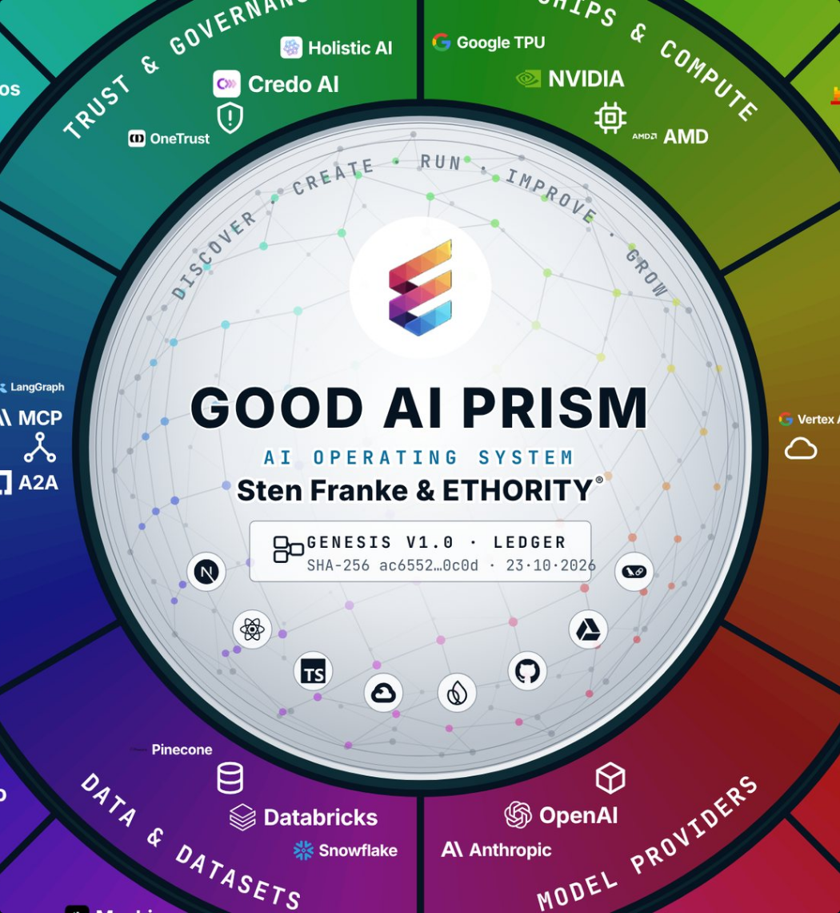
ETHORITY®
COMPANY & OFFERS
AI BUSINESS OPERATING SYSTEM
WHAT ETHORITY DOES
ETHORITY makes AI usable for a person, a project, an organisation or a team.
You may be choosing your first AI application, or your teams already use several. The Good AI Prism, our map of 961 AI offerings, shows you the options. We help you choose, build and run what fits your customers and your market.
Source · Good AI Prism, Oct 2026
Good AI Prism artwork © 2026 ETHORITY & STEN.AI LLC · CC BY-NC-ND 4.0 · commercial use by licence on request · data and third-party marks not covered
ETHORITY · COMPANY & OFFERS · EN · V1.3 · 27 OCT 2026
02 / 22
Notes:
ETHORITY makes AI usable for a person, a project, an organisation or a team.
You may be choosing your first AI application, or your teams already use several. The Good AI Prism, our map of 961 AI offerings, shows you the options. We help you choose, build and run what fits your customers and your market.
Source: Good AI Prism, Oct 2026

Slide 3

ETHORITY®
COMPANY & OFFERS
AI BUSINESS OPERATING SYSTEM
THE FOUR QUALITIES
Good AI is effective, efficient, economic and responsible.
Compliance is part of responsible implementation. Responsibility goes further: a legally permitted application can still be badly designed or harm the people affected.
01
02
03
04
Effective
Efficient
Economic
Responsible
AI supports a concrete goal with results you can check.
Effort, cost and human rework are counted.
A technical gain is tested for its real business value.
People, rights, safety and ethical consequences are part of the decision.
ETHORITY · COMPANY & OFFERS · EN · V1.3 · 27 OCT 2026
03 / 22
Notes:
Good AI is effective, efficient, economic and responsible.
Compliance is part of responsible implementation. Responsibility goes further: a legally permitted application can still be badly designed or harm the people affected.
Effective: AI supports a concrete goal with results you can check.
Efficient: Effort, cost and human rework are counted.
Economic: A technical gain is tested for its real business value.
Responsible: People, rights, safety and ethical consequences are part of the decision.

Slide 4
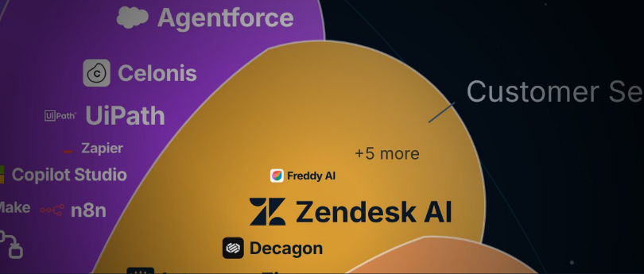
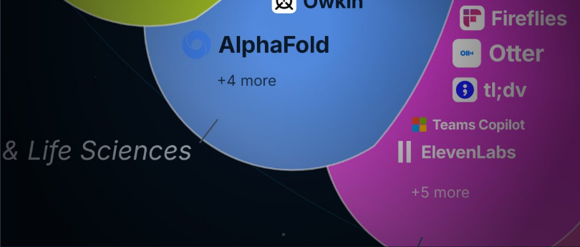
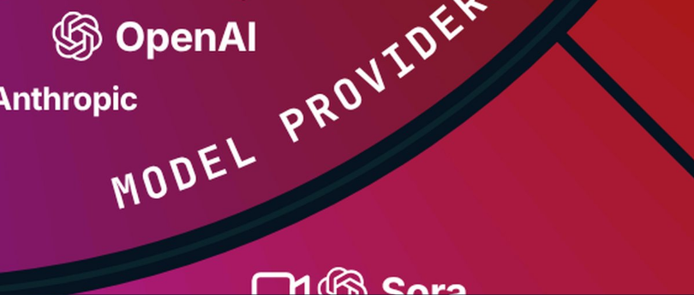
ETHORITY®
COMPANY & OFFERS
AI BUSINESS OPERATING SYSTEM
THREE WAYS IN
Three questions lead you to the AI that fits your decision.
01
02
03
Where does AI help in my work?
What does AI change in my industry?
Which AI fits our decision?
Search a task or a provider.
Choose a business function, such as customer service or finance.
Choose an industry, such as health, logistics or manufacturing.
→ Uses and matching offers
→ Industry study, cases, relevant providers
→ Profile → Compare → economics → next step
Good AI Prism artwork © 2026 ETHORITY & STEN.AI LLC · CC BY-NC-ND 4.0 · commercial use by licence on request · data and third-party marks not covered
ETHORITY · COMPANY & OFFERS · EN · V1.3 · 27 OCT 2026
04 / 22
Notes:
Three questions lead you to the AI that fits your decision.
Where does AI help in my work? Choose a business function, such as customer service or finance. → Uses and matching offers
What does AI change in my industry? Choose an industry, such as health, logistics or manufacturing. → Industry study, cases, relevant providers
Which AI fits our decision? Search a task or a provider. → Profile → Compare → economics → next step

Slide 5
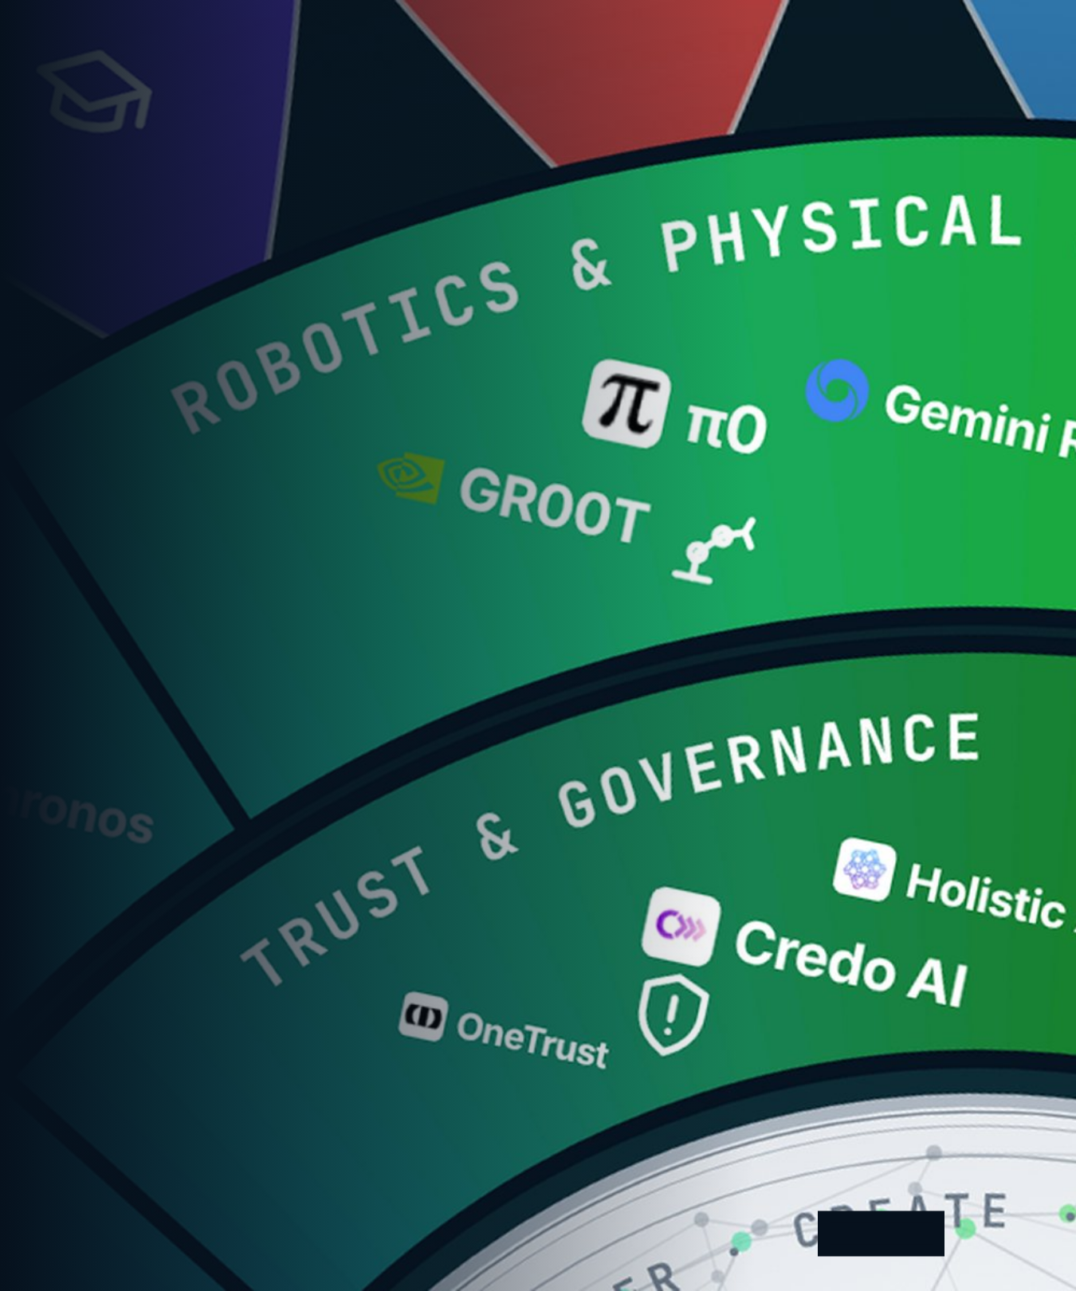
ETHORITY®
COMPANY & OFFERS
AI BUSINESS OPERATING SYSTEM
05
FIVE ENTRY OFFERS · SEVEN SERVICES
Start with a sound decision, then put AI to work effectively, efficiently, economically and responsibly.
Five entry offers answer one question each, from a written comparison for €195 net to a six-week pilot. Seven services carry the work that follows, from a readiness check with one workshop day to monthly support.
Source · ethority.ai offer pages · net prices plus VAT where applicable · Oct 2026
Good AI Prism artwork © 2026 ETHORITY & STEN.AI LLC · CC BY-NC-ND 4.0 · commercial use by licence on request · data and third-party marks not covered
ETHORITY · COMPANY & OFFERS · EN · V1.3 · 27 OCT 2026
05 / 22
Notes:
Start with a sound decision, then put AI to work effectively, efficiently, economically and responsibly.
Five entry offers answer one question each, from a written comparison for €195 net to a six-week pilot. Seven services carry the work that follows, from a readiness check with one workshop day to monthly support.
Source: ethority.ai offer pages · net prices plus VAT where applicable · Oct 2026

Slide 6
ETHORITY®
COMPANY & OFFERS
AI BUSINESS OPERATING SYSTEM
FIVE ENTRY OFFERS · NET PRICES
Five entry offers answer your question before you commit a larger budget.
Compare up to three AI offerings on dated facts before you buy.
AI Decision Brief
€195 net · one-time
COMPARE
Turn one business goal into an AI plan for the next 90 days.
AI Business Blueprint
€495 net · one-time
PLAN
Delivery date agreed before the work starts
Get a clear answer on one AI system: pilot, redesign, expand or stop.
AI Trust Record
€4,500 net · one-time
ASSESS
10 working days from receipt of the agreed inputs
Run one AI use case under real conditions, with stop rules agreed upfront.
AI Trust Pilot
€25,000 net · one-time
TEST
Six weeks
Know what would make an AI investment of about €200,000 or more pay.
AI Opportunity Case
Priced after scoping
INVEST
Standard 4 weeks · Extended 6 weeks
Source · ethority.ai offer pages · net prices plus VAT where applicable · Oct 2026
ETHORITY · COMPANY & OFFERS · EN · V1.3 · 27 OCT 2026
06 / 22
Notes:
Five entry offers answer your question before you commit a larger budget.
Compare up to three AI offerings on dated facts before you buy. AI Decision Brief: €195 net · one-time
Turn one business goal into an AI plan for the next 90 days. AI Business Blueprint: €495 net · one-time · Delivery date agreed before the work starts
Get a clear answer on one AI system: pilot, redesign, expand or stop. AI Trust Record: €4,500 net · one-time · 10 working days from receipt of the agreed inputs
Run one AI use case under real conditions, with stop rules agreed upfront. AI Trust Pilot: €25,000 net · one-time · Six weeks
Know what would make an AI investment of about €200,000 or more pay. AI Opportunity Case: Priced after scoping · Standard 4 weeks · Extended 6 weeks
Source: ethority.ai offer pages · net prices plus VAT where applicable · Oct 2026

Slide 7
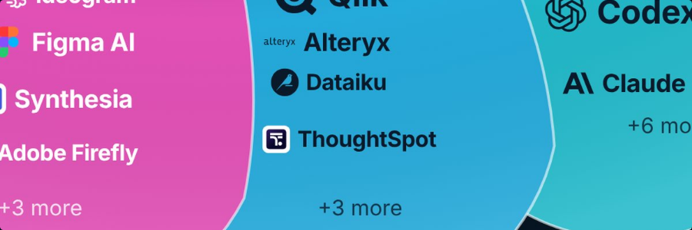
ETHORITY®
COMPANY & OFFERS
AI BUSINESS OPERATING SYSTEM
ENTRY OFFER · ONE-TIME · UP TO 3 OFFERINGS
Decide between up to three AI offerings with the facts side by side.
AI Decision Brief
WHAT YOU GET
€195
01
Up to three offerings from your comparison list, side by side
net · one-time · request by email through the offer page · reviewed before delivery
02
Price, data location, integrations and limits, each with source and date
03
The questions to ask each provider before you sign
04
A cost sketch based on your own volumes
NEXT STEP
Request a Decision Brief
https://ethority.ai/offers/ai-decision-brief
Source · ethority.ai offer pages · net prices plus VAT where applicable · Oct 2026
Good AI Prism artwork © 2026 ETHORITY & STEN.AI LLC · CC BY-NC-ND 4.0 · commercial use by licence on request · data and third-party marks not covered
ETHORITY · COMPANY & OFFERS · EN · V1.3 · 27 OCT 2026
07 / 22
Notes:
Decide between up to three AI offerings with the facts side by side.
Up to three offerings from your comparison list, side by side
Price, data location, integrations and limits, each with source and date
The questions to ask each provider before you sign
A cost sketch based on your own volumes
AI Decision Brief
€195
net · one-time · request by email through the offer page · reviewed before delivery
Next step: Request a Decision Brief · https://ethority.ai/offers/ai-decision-brief
Source: ethority.ai offer pages · net prices plus VAT where applicable · Oct 2026

Slide 8

ETHORITY®
COMPANY & OFFERS
AI BUSINESS OPERATING SYSTEM
ENTRY OFFER · ONE-TIME · ONE BUSINESS GOAL
Turn one business goal into an AI plan for the next 90 days.
AI Business Blueprint
WHAT YOU GET
€495
01
A one-page decision: the problem, three opportunities, three unknowns, three actions
net · one-time
02
A map of today’s work and where AI could change it
DELIVERYDate agreed with you before the work starts
03
What AI may do, what people decide, and when it would pay off
04
Two to four options and a 30/60/90-day roadmap
NEXT STEP
Request a Blueprint
https://ethority.ai/offers/ai-business-blueprint
Source · ethority.ai offer pages · net prices plus VAT where applicable · Oct 2026
Good AI Prism artwork © 2026 ETHORITY & STEN.AI LLC · CC BY-NC-ND 4.0 · commercial use by licence on request · data and third-party marks not covered
ETHORITY · COMPANY & OFFERS · EN · V1.3 · 27 OCT 2026
08 / 22
Notes:
Turn one business goal into an AI plan for the next 90 days.
A one-page decision: the problem, three opportunities, three unknowns, three actions
A map of today’s work and where AI could change it
What AI may do, what people decide, and when it would pay off
Two to four options and a 30/60/90-day roadmap
AI Business Blueprint
€495
net · one-time
Delivery: Date agreed with you before the work starts
Next step: Request a Blueprint · https://ethority.ai/offers/ai-business-blueprint
Source: ethority.ai offer pages · net prices plus VAT where applicable · Oct 2026

Slide 9

ETHORITY®
COMPANY & OFFERS
AI BUSINESS OPERATING SYSTEM
ENTRY OFFER · ONE NAMED AI SYSTEM
Get one clear answer about one AI system before you rely on it.
AI Trust Record
WHAT YOU GET
€4,500
01
A decision: pilot, redesign, expand or stop, with its conditions
net · one-time · standard scope; complex scope quoted separately
02
A Trust Chain: one page linking outcome, owner, data, AI and human approval
DELIVERY10 working days from receipt of the agreed inputs
03
A register of facts, evidence, assumptions and open points
04
A review plan with triggers for the next 90 days
NEXT STEP
Request a Trust Record
https://ethority.ai/offers/ai-trust-record
Source · ethority.ai offer pages · net prices plus VAT where applicable · Oct 2026
Good AI Prism artwork © 2026 ETHORITY & STEN.AI LLC · CC BY-NC-ND 4.0 · commercial use by licence on request · data and third-party marks not covered
ETHORITY · COMPANY & OFFERS · EN · V1.3 · 27 OCT 2026
09 / 22
Notes:
Get one clear answer about one AI system before you rely on it.
A decision: pilot, redesign, expand or stop, with its conditions
A Trust Chain: one page linking outcome, owner, data, AI and human approval
A register of facts, evidence, assumptions and open points
A review plan with triggers for the next 90 days
AI Trust Record
€4,500
net · one-time · standard scope; complex scope quoted separately
Delivery: 10 working days from receipt of the agreed inputs
Next step: Request a Trust Record · https://ethority.ai/offers/ai-trust-record
Source: ethority.ai offer pages · net prices plus VAT where applicable · Oct 2026

Slide 10
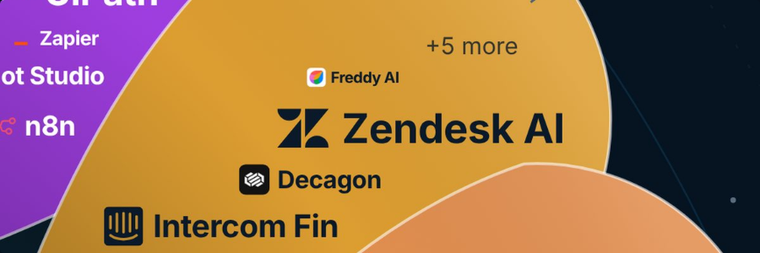
ETHORITY®
COMPANY & OFFERS
AI BUSINESS OPERATING SYSTEM
ENTRY OFFER · ONE USE CASE
Test one AI use case under real conditions and decide on evidence.
AI Trust Pilot
WHAT YOU GET
€25,000
01
Goals, limits and stop rules agreed before the start
02
The AI Trust Record as the starting structure
net · one-time · one use case in one accountable department
03
Independent review of changes and open points during the pilot
DURATIONSix weeks
04
A final decision: continue, redesign, expand or stop
NEXT STEP
Discuss a pilot
https://ethority.ai/offers/ai-trust-pilot
Source · ethority.ai offer pages · net prices plus VAT where applicable · Oct 2026
Good AI Prism artwork © 2026 ETHORITY & STEN.AI LLC · CC BY-NC-ND 4.0 · commercial use by licence on request · data and third-party marks not covered
ETHORITY · COMPANY & OFFERS · EN · V1.3 · 27 OCT 2026
10 / 22
Notes:
Test one AI use case under real conditions and decide on evidence.
Goals, limits and stop rules agreed before the start
The AI Trust Record as the starting structure
Independent review of changes and open points during the pilot
A final decision: continue, redesign, expand or stop
AI Trust Pilot
€25,000
net · one-time · one use case in one accountable department
Duration: Six weeks
Next step: Discuss a pilot · https://ethority.ai/offers/ai-trust-pilot
Source: ethority.ai offer pages · net prices plus VAT where applicable · Oct 2026

Slide 11

ETHORITY®
COMPANY & OFFERS
AI BUSINESS OPERATING SYSTEM
LARGE INVESTMENTS · PRICED AFTER SCOPING
Know what would make a large AI investment pay, with every assumption written down.
WHAT YOU GET
AI Opportunity Case
01
An independent business case built on your volumes
Priced after scoping
02
A comparison with real alternatives, including doing nothing
net · for AI investments of about €200,000 or more · scope by agreement
03
A clear recommendation: start, change, test first or stop
DURATIONStandard 4 weeks · Extended 6 weeks
04
A signed decision record
Discuss your investment
NEXT STEP
https://ethority.ai/products/enterprise-services/
opportunity-case
Source · ethority.ai offer pages · net prices plus VAT where applicable · Oct 2026
Good AI Prism artwork © 2026 ETHORITY & STEN.AI LLC · CC BY-NC-ND 4.0 · commercial use by licence on request · data and third-party marks not covered
ETHORITY · COMPANY & OFFERS · EN · V1.3 · 27 OCT 2026
11 / 22
Notes:
Know what would make a large AI investment pay, with every assumption written down.
An independent business case built on your volumes
A comparison with real alternatives, including doing nothing
A clear recommendation: start, change, test first or stop
A signed decision record
AI Opportunity Case
Priced after scoping
net · for AI investments of about €200,000 or more · scope by agreement
Duration: Standard 4 weeks · Extended 6 weeks
Next step: Discuss your investment · https://ethority.ai/products/enterprise-services/opportunity-case
Source: ethority.ai offer pages · net prices plus VAT where applicable · Oct 2026

Slide 12
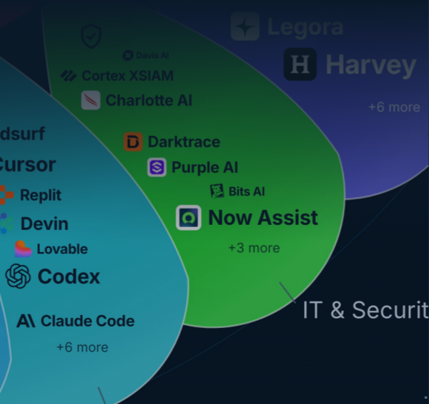
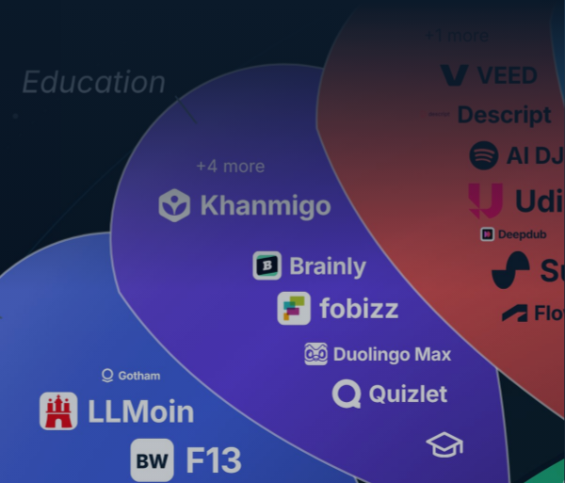


ETHORITY®
COMPANY & OFFERS
AI BUSINESS OPERATING SYSTEM
SEVEN SERVICES · NET PRICES
Seven services take you in four steps from a first check to AI that runs.
04 · RUN
Run
03 · ENABLE
Keep your AI rules and decisions up to date.
Enable
02 · DECIDE
Your team uses AI well and safely.
Decide
AI Governance Retainer
01 · CHECK
Set the rules, map your AI, price the big bet.
AI Literacy & Adoption
from €2,500 / month
Check
from €2,400
Know where you stand and what the rules require.
AI Governance Setup
from €19,500
AI Readiness & Maturity Check
AI Estate Audit & Mapping
€3,500
Focus €25,000
Group €45,000 · Group+ €75,000
AI Act Readiness Sprint
from €6,900
AI Opportunity Case
Enterprise €19,500
Priced after scoping
Source · ethority.ai offer pages · net prices plus VAT where applicable · Oct 2026
Good AI Prism artwork © 2026 ETHORITY & STEN.AI LLC · CC BY-NC-ND 4.0 · commercial use by licence on request · data and third-party marks not covered
ETHORITY · COMPANY & OFFERS · EN · V1.3 · 27 OCT 2026
12 / 22
Notes:
Seven services take you in four steps from a first check to AI that runs.
Check: AI Readiness & Maturity Check €3,500; AI Act Readiness Sprint from €6,900 Enterprise €19,500
Decide: AI Governance Setup from €19,500; AI Estate Audit & Mapping Focus €25,000 Group €45,000 · Group+ €75,000; AI Opportunity Case Priced after scoping
Enable: AI Literacy & Adoption from €2,400
Run: AI Governance Retainer from €2,500 / month
Source: ethority.ai offer pages · net prices plus VAT where applicable · Oct 2026

Slide 13
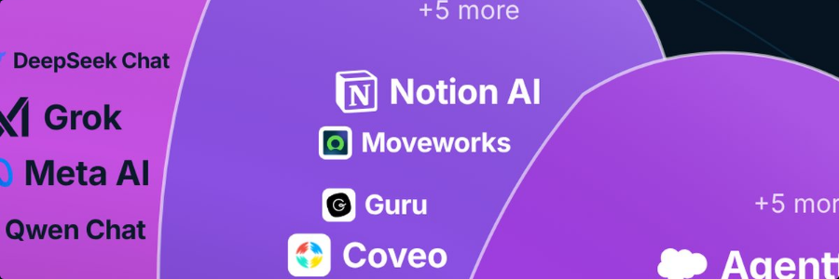
ETHORITY®
COMPANY & OFFERS
AI BUSINESS OPERATING SYSTEM
ADVISORY SERVICE · FIXED PRICE · ONE WORKSHOP DAY
Where you stand with AI: one workshop day, then a written assessment.
WHAT YOU GET
AI Readiness & Maturity Check
01
A scored maturity profile with written reasoning
€3,500
02
Your five most valuable AI uses, ranked by value, feasibility and risk
03
A draft 90-day plan for leadership review
net · one workshop day and a written assessment · date and place by agreement
04
One workshop day with up to 8 people from your team
Request a check
NEXT STEP
https://ethority.ai/products/enterprise-services/
readiness-maturity-check
Source · ethority.ai offer pages · net prices plus VAT where applicable · Oct 2026
Good AI Prism artwork © 2026 ETHORITY & STEN.AI LLC · CC BY-NC-ND 4.0 · commercial use by licence on request · data and third-party marks not covered
ETHORITY · COMPANY & OFFERS · EN · V1.3 · 27 OCT 2026
13 / 22
Notes:
Where you stand with AI: one workshop day, then a written assessment.
A scored maturity profile with written reasoning
Your five most valuable AI uses, ranked by value, feasibility and risk
A draft 90-day plan for leadership review
One workshop day with up to 8 people from your team
AI Readiness & Maturity Check
€3,500
net · one workshop day and a written assessment · date and place by agreement
Next step: Request a check · https://ethority.ai/products/enterprise-services/readiness-maturity-check
Source: ethority.ai offer pages · net prices plus VAT where applicable · Oct 2026

Slide 14
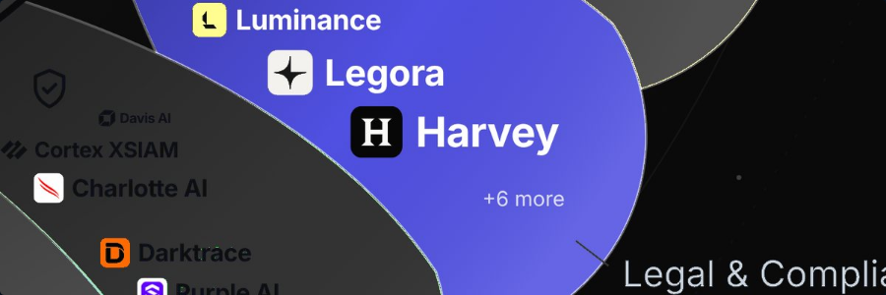
ETHORITY®
COMPANY & OFFERS
AI BUSINESS OPERATING SYSTEM
ADVISORY SERVICE · FIXED PRICE · 2–3 WEEKS
Know which AI you use and what the EU AI Act requires of you.
AI Act Readiness Sprint
WHAT YOU GET
from €6,900
01
Your AI systems classified under the EU AI Act
02
Gaps and a costed plan to 2 Dec 2027
net · mid-sized companies: 2 weeks, up to 15 AI uses · Enterprise €19,500: 3 weeks, up to 40 systems
03
The facts your legal team needs, prepared
04
A briefing for the board or management
Request a 30-minute scoping call
NEXT STEP
https://ethority.ai/products/enterprise-services/
ai-act-readiness-sprint
Source · ethority.ai offer pages · net prices plus VAT where applicable · Oct 2026
Good AI Prism artwork © 2026 ETHORITY & STEN.AI LLC · CC BY-NC-ND 4.0 · commercial use by licence on request · data and third-party marks not covered
ETHORITY · COMPANY & OFFERS · EN · V1.3 · 27 OCT 2026
14 / 22
Notes:
Know which AI you use and what the EU AI Act requires of you.
Your AI systems classified under the EU AI Act
Gaps and a costed plan to 2 Dec 2027
The facts your legal team needs, prepared
A briefing for the board or management
AI Act Readiness Sprint
from €6,900
net · mid-sized companies: 2 weeks, up to 15 AI uses · Enterprise €19,500: 3 weeks, up to 40 systems
Next step: Request a 30-minute scoping call · https://ethority.ai/products/enterprise-services/ai-act-readiness-sprint
Source: ethority.ai offer pages · net prices plus VAT where applicable · Oct 2026

Slide 15

ETHORITY®
COMPANY & OFFERS
AI BUSINESS OPERATING SYSTEM
TEAM OFFER · HALF DAY OR ONE DAY
Your team learns to use AI well and safely in daily work.
AI Literacy & Adoption
WHAT YOU GET
from €2,400
01
Role-based training for leaders, specialists and teams
02
A usage policy your staff can follow
net · half-day executive workshop or one-day team training
03
Training records for the EU AI Act literacy duty (Article 4)
Plan a training
NEXT STEP
https://ethority.ai/products/enterprise-services/
literacy-adoption
Source · ethority.ai offer pages · net prices plus VAT where applicable · Oct 2026
Good AI Prism artwork © 2026 ETHORITY & STEN.AI LLC · CC BY-NC-ND 4.0 · commercial use by licence on request · data and third-party marks not covered
ETHORITY · COMPANY & OFFERS · EN · V1.3 · 27 OCT 2026
15 / 22
Notes:
Your team learns to use AI well and safely in daily work.
Role-based training for leaders, specialists and teams
A usage policy your staff can follow
Training records for the EU AI Act literacy duty (Article 4)
AI Literacy & Adoption
from €2,400
net · half-day executive workshop or one-day team training
Next step: Plan a training · https://ethority.ai/products/enterprise-services/literacy-adoption
Source: ethority.ai offer pages · net prices plus VAT where applicable · Oct 2026

Slide 16
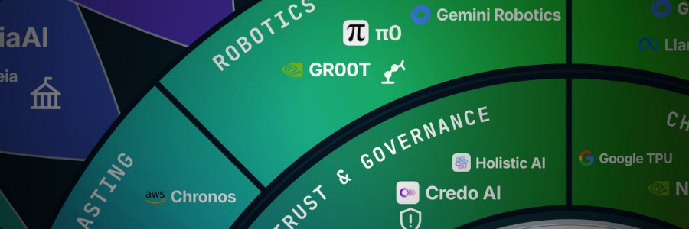
ETHORITY®
COMPANY & OFFERS
AI BUSINESS OPERATING SYSTEM
GOVERNANCE · 4 WEEKS
You set the rules for AI: who decides, who checks and when.
AI Governance Setup
WHAT YOU GET
from €19,500
01
Roles and decision rights for every AI use
02
An approval path from request to go-live
net · 4 weeks
03
An AI register and usage policies
04
Limits for what AI agents may do alone
Discuss your setup
NEXT STEP
https://ethority.ai/products/enterprise-services/
governance-setup
Source · ethority.ai offer pages · net prices plus VAT where applicable · Oct 2026
Good AI Prism artwork © 2026 ETHORITY & STEN.AI LLC · CC BY-NC-ND 4.0 · commercial use by licence on request · data and third-party marks not covered
ETHORITY · COMPANY & OFFERS · EN · V1.3 · 27 OCT 2026
16 / 22
Notes:
You set the rules for AI: who decides, who checks and when.
Roles and decision rights for every AI use
An approval path from request to go-live
An AI register and usage policies
Limits for what AI agents may do alone
AI Governance Setup
from €19,500
net · 4 weeks
Next step: Discuss your setup · https://ethority.ai/products/enterprise-services/governance-setup
Source: ethority.ai offer pages · net prices plus VAT where applicable · Oct 2026

Slide 17

ETHORITY®
COMPANY & OFFERS
AI BUSINESS OPERATING SYSTEM
YOUR AI ESTATE · 4–8 WEEKS
See the AI systems you use, what they cost and who is responsible for them.
WHAT YOU GET
AI Estate Audit & Mapping
01
A review of your AI tools, agents, pilots and licences within the agreed scope
from €25,000
02
Cost, owner and dependencies for each system
03
A decision per system: scale, fix, consolidate or stop
net · Focus €25,000 · Group €45,000 · Group+ €75,000 · 4–8 weeks
04
A register handed to the people who govern your AI
Request a scoping call
NEXT STEP
https://ethority.ai/products/enterprise-services/
estate-audit
Source · ethority.ai offer pages · net prices plus VAT where applicable · Oct 2026
Good AI Prism artwork © 2026 ETHORITY & STEN.AI LLC · CC BY-NC-ND 4.0 · commercial use by licence on request · data and third-party marks not covered
ETHORITY · COMPANY & OFFERS · EN · V1.3 · 27 OCT 2026
17 / 22
Notes:
See the AI systems you use, what they cost and who is responsible for them.
A review of your AI tools, agents, pilots and licences within the agreed scope
Cost, owner and dependencies for each system
A decision per system: scale, fix, consolidate or stop
A register handed to the people who govern your AI
AI Estate Audit & Mapping
from €25,000
net · Focus €25,000 · Group €45,000 · Group+ €75,000 · 4–8 weeks
Next step: Request a scoping call · https://ethority.ai/products/enterprise-services/estate-audit
Source: ethority.ai offer pages · net prices plus VAT where applicable · Oct 2026

Slide 18
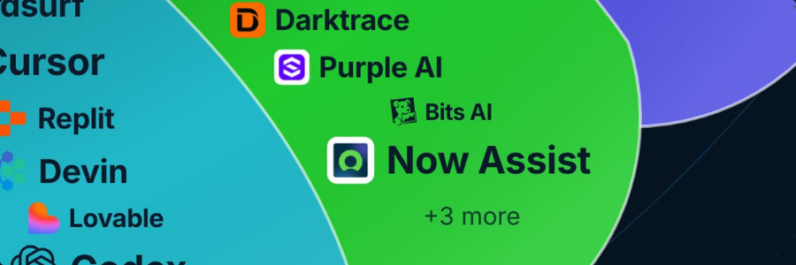
ETHORITY®
COMPANY & OFFERS
AI BUSINESS OPERATING SYSTEM
ONGOING · MONTHLY · SIX-MONTH MINIMUM
Monthly support keeps your AI rules and decisions up to date.
AI Governance Retainer
WHAT YOU GET
from €2,500
01
Upkeep of your AI register
02
A watch on regulation and providers
net per month · six-month minimum
03
A review of every new AI use
04
A quarterly report
Discuss ongoing support
NEXT STEP
https://ethority.ai/products/enterprise-services/
governance-retainer
Source · ethority.ai offer pages · net prices plus VAT where applicable · Oct 2026
Good AI Prism artwork © 2026 ETHORITY & STEN.AI LLC · CC BY-NC-ND 4.0 · commercial use by licence on request · data and third-party marks not covered
ETHORITY · COMPANY & OFFERS · EN · V1.3 · 27 OCT 2026
18 / 22
Notes:
Monthly support keeps your AI rules and decisions up to date.
Upkeep of your AI register
A watch on regulation and providers
A review of every new AI use
A quarterly report
AI Governance Retainer
from €2,500
net per month · six-month minimum
Next step: Discuss ongoing support · https://ethority.ai/products/enterprise-services/governance-retainer
Source: ethority.ai offer pages · net prices plus VAT where applicable · Oct 2026

Slide 19
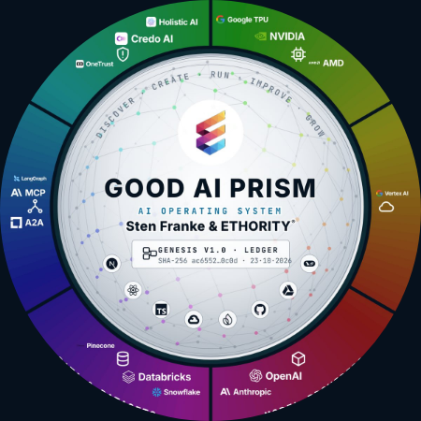
ETHORITY®
COMPANY & OFFERS
AI BUSINESS OPERATING SYSTEM
HOW THE WORK RUNS
ETHORITY works in a loop of five steps, and each step ends with a clear decision.
1
2
3
4
5
Discover
Create
Run
Improve
Grow
Find where AI can help your business and what the market offers for it.
Choose the option and build the solution, including its costs, data and responsibilities.
Operate the system day to day, with named owners and agreed checks.
Measure the result against the starting point and adjust what does not work.
Extend what works to more teams, sites or countries.
Good AI Prism artwork © 2026 ETHORITY & STEN.AI LLC · CC BY-NC-ND 4.0 · commercial use by licence on request · data and third-party marks not covered
ETHORITY · COMPANY & OFFERS · EN · V1.3 · 27 OCT 2026
19 / 22
Notes:
ETHORITY works in a loop of five steps, and each step ends with a clear decision.
Discover – Find where AI can help your business and what the market offers for it.
Create – Choose the option and build the solution, including its costs, data and responsibilities.
Run – Operate the system day to day, with named owners and agreed checks.
Improve – Measure the result against the starting point and adjust what does not work.
Grow – Extend what works to more teams, sites or countries.

Slide 20

ETHORITY®
COMPANY & OFFERS
AI BUSINESS OPERATING SYSTEM
WHO LEADS YOUR PROJECT
Sten Franke leads every project.
STEN FRANKE · FOUNDER & CEO · CHIEF AI ARCHITECT
“I help you make sense of the AI market, take sound decisions and shape the implementation — combining market intelligence, systems architecture and economic evaluation.”
2009
961
11
the first German Social Media Prisma
AI offerings on the Good AI Prism
entry offers and services with a clear scope
Source · ETHORITY company history · Good AI Prism, Oct 2026 · ethority.ai offer pages, Oct 2026
ETHORITY · COMPANY & OFFERS · EN · V1.3 · 27 OCT 2026
20 / 22
Notes:
Sten Franke leads every project.
“I help you make sense of the AI market, take sound decisions and shape the implementation — combining market intelligence, systems architecture and economic evaluation.”
Source: ETHORITY company history · Good AI Prism, Oct 2026 · ethority.ai offer pages, Oct 2026

Slide 21

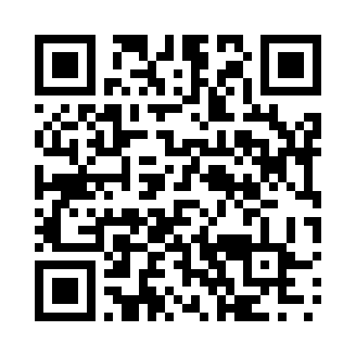
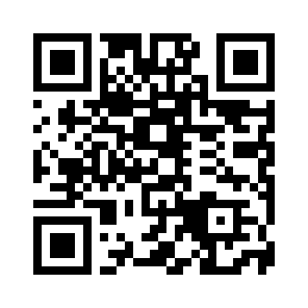
ETHORITY®
COMPANY & OFFERS
AI BUSINESS OPERATING SYSTEM
NEXT STEP
Discuss your case with Sten Franke.
AI Readiness & Maturity Check: one workshop day, then the written assessment · €3,500
Sten Franke
CHECK
FOUNDER & CEO · CHIEF AI ARCHITECT, ETHORITY
https://ethority.ai/products/enterprise-services/readiness-maturity-check
sten@ethority.ai · ethority.ai
CALCULATE
Test your own case with the AI calculators
https://ethority.ai/solutions/calculators
READ
The Global Market Study 2026/27 (90 pages)
https://ethority.ai/research
E-MAIL
sten@ethority.ai
This presentation online
Connect with Sten Franke
Sten Franke
https://ethority.ai/
research/publications/
company-full-en
https://www.linkedin.com/
in/stenfranke
Company & Offers · EN · v1.3 · 27 Oct 2026 · Good AI Prism by Sten Franke & ETHORITY® · since the first Social Media Prisma in 2009 · roots: ETHORITY.AI and STEN.AI · text © 2026 ETHORITY & STEN.AI LLC
Source · ethority.ai offer page · net price plus VAT where applicable · Oct 2026
ETHORITY · COMPANY & OFFERS · EN · V1.3 · 27 OCT 2026
21 / 22
Notes:
Discuss your case with Sten Franke.
Check: AI Readiness & Maturity Check: one workshop day, then the written assessment · €3,500 · https://ethority.ai/products/enterprise-services/readiness-maturity-check
Calculate: Test your own case with the AI calculators · https://ethority.ai/solutions/calculators
Read: The Global Market Study 2026/27 (90 pages) · https://ethority.ai/research
E-mail: sten@ethority.ai · Sten Franke
QR · This presentation online: https://ethority.ai/research/publications/company-full-en
QR · Connect with Sten Franke: https://www.linkedin.com/in/stenfranke
Source: ethority.ai offer page · net price plus VAT where applicable · Oct 2026

Slide 22

ETHORITY®
COMPANY & OFFERS
AI BUSINESS OPERATING SYSTEM
CONTINUE ON ETHORITY.AI
Every page, offer and study in this deck is one click away.
PAGES
FIVE ENTRY OFFERS
SEVEN SERVICES
STUDIES, ARTICLES, TOOLS
Home
Overview →
Overview → · AI Opportunity Case: see entry offers
Global Market Study 2026/27
https://ethority.ai/
AI Decision Brief
AI Readiness & Maturity Check
https://ethority.ai/research/publications/
market-global-en
Good AI Prism
https://ethority.ai/offers/ai-decision-brief
https://ethority.ai/products/
enterprise-services/readiness-maturity-check
https://ethority.ai/ai-prism
AI Business Blueprint
All studies
Registry of AI offerings
https://ethority.ai/offers/
ai-business-blueprint
AI Act Readiness Sprint
https://ethority.ai/research/publications
https://ethority.ai/explore/registry
https://ethority.ai/products/
enterprise-services/ai-act-readiness-sprint
Articles
AI Trust Record
https://ethority.ai/articles
Compare offerings
https://ethority.ai/offers/ai-trust-record
AI Literacy & Adoption
AI calculators
https://ethority.ai/explore/compare
AI Trust Pilot
https://ethority.ai/products/
enterprise-services/literacy-adoption
https://ethority.ai/solutions/calculators
Company
https://ethority.ai/offers/ai-trust-pilot
Glossary
https://ethority.ai/company
AI Opportunity Case
AI Governance Setup
https://ethority.ai/learn/glossary
Founder & network
https://ethority.ai/products/
enterprise-services/opportunity-case
https://ethority.ai/products/
enterprise-services/governance-setup
https://ethority.ai/company/team
Method
Contact
AI Estate Audit & Mapping
https://ethority.ai/methodology
https://ethority.ai/contact
https://ethority.ai/products/
enterprise-services/estate-audit
AI Governance Retainer
https://ethority.ai/products/
enterprise-services/governance-retainer
Source · Pages as published on ethority.ai, Oct 2026
ETHORITY · COMPANY & OFFERS · EN · V1.3 · 27 OCT 2026
22 / 22
Notes:
Every page, offer and study in this deck is one click away.
Pages: Home https://ethority.ai/; Good AI Prism https://ethority.ai/ai-prism; Registry of AI offerings https://ethority.ai/explore/registry; Compare offerings https://ethority.ai/explore/compare; Company https://ethority.ai/company; Founder & network https://ethority.ai/company/team; Contact https://ethority.ai/contact
Five entry offers: AI Decision Brief https://ethority.ai/offers/ai-decision-brief; AI Business Blueprint https://ethority.ai/offers/ai-business-blueprint; AI Trust Record https://ethority.ai/offers/ai-trust-record; AI Trust Pilot https://ethority.ai/offers/ai-trust-pilot; AI Opportunity Case https://ethority.ai/products/enterprise-services/opportunity-case
Seven services: AI Readiness & Maturity Check https://ethority.ai/products/enterprise-services/readiness-maturity-check; AI Act Readiness Sprint https://ethority.ai/products/enterprise-services/ai-act-readiness-sprint; AI Literacy & Adoption https://ethority.ai/products/enterprise-services/literacy-adoption; AI Governance Setup https://ethority.ai/products/enterprise-services/governance-setup; AI Estate Audit & Mapping https://ethority.ai/products/enterprise-services/estate-audit; AI Governance Retainer https://ethority.ai/products/enterprise-services/governance-retainer
Studies, articles, tools: Global Market Study 2026/27 https://ethority.ai/research/publications/market-global-en; All studies https://ethority.ai/research/publications; Articles https://ethority.ai/articles; AI calculators https://ethority.ai/solutions/calculators; Glossary https://ethority.ai/learn/glossary; Method https://ethority.ai/methodology
Source: Pages as published on ethority.ai, Oct 2026

