Slide 1

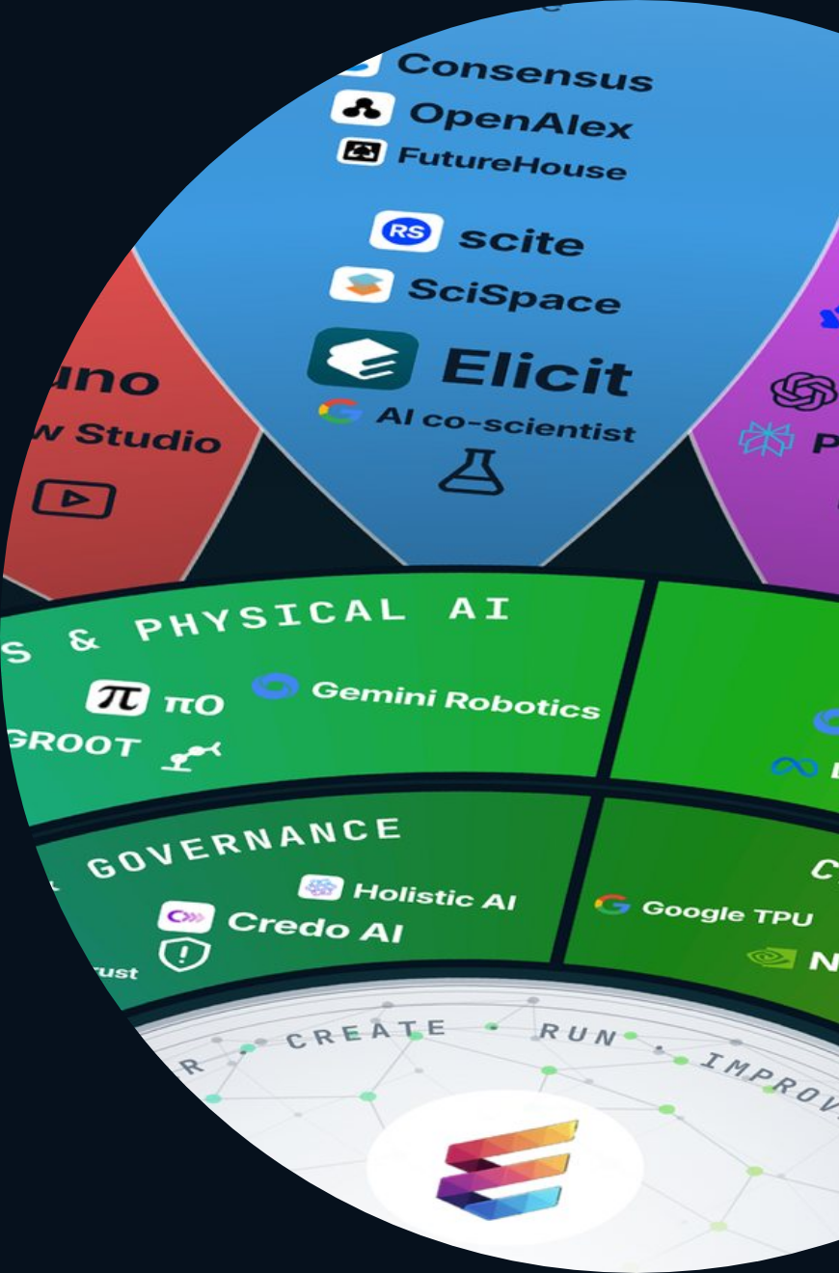
ETHORITY®
KEYNOTE · EXECUTIVE VERSION
AI BUSINESS OPERATING SYSTEM
ETHORITY · KEYNOTE · GOOD AI PRISM MARKET STUDY 2026/27
Make AI work for your business.
Find the right AI. Build a sound business case. Put it to work responsibly. A keynote by Sten Franke on the Good AI Prism Market Study 2026/27.
US$2.67tn
961
1 in 5
worldwide AI spending forecast for 2026
AI offerings on one map
EU firms with 10+ staff use AI
GOOD AI PRISM, OCT 2026
EUROSTAT, DEC 2025
GARTNER, SEP 2026
Good AI Prism artwork © 2026 ETHORITY & STEN.AI LLC · CC BY-NC-ND 4.0 · commercial use by licence on request · data and third-party marks not covered
ETHORITY · KEYNOTE EXECUTIVE · EN · V3.4 · 27 OCT 2026
01 / 05
Notes:
Make AI work for your business.
Find the right AI. Build a sound business case. Put it to work responsibly. A keynote by Sten Franke on the Good AI Prism Market Study 2026/27.
US$2.67tn worldwide AI spending forecast for 2026 (Gartner, Sep 2026)
961 AI offerings on one map (Good AI Prism, Oct 2026)
1 in 5 EU firms with 10+ staff use AI (Eurostat, Dec 2025)

Slide 2
ETHORITY®
KEYNOTE · EXECUTIVE VERSION
AI BUSINESS OPERATING SYSTEM
THE STUDY IN ONE MINUTE
Nine in ten surveyed organisations use AI; 37% see an effect on profit.
Three separate answers from one global survey: respondents report regular use, scaling and some effect on profit. Your decisions turn use into results.
≈90%
44%
37%
use AI regularly in at least one function
report scaling AI
attribute some effect on profit (EBIT) to AI
MCKINSEY, THE STATE OF AI, AUG 2026
MCKINSEY, THE STATE OF AI, AUG 2026
MCKINSEY, THE STATE OF AI, AUG 2026
ETHORITY · KEYNOTE EXECUTIVE · EN · V3.4 · 27 OCT 2026
02 / 05
Notes:
Nine in ten surveyed organisations use AI; 37% see an effect on profit.
Three separate answers from one global survey: respondents report regular use, scaling and some effect on profit. Your decisions turn use into results.
≈90% use AI regularly in at least one function (McKinsey, The state of AI, Aug 2026)
44% report scaling AI (McKinsey, The state of AI, Aug 2026)
37% attribute some effect on profit (EBIT) to AI (McKinsey, The state of AI, Aug 2026)

Slide 3
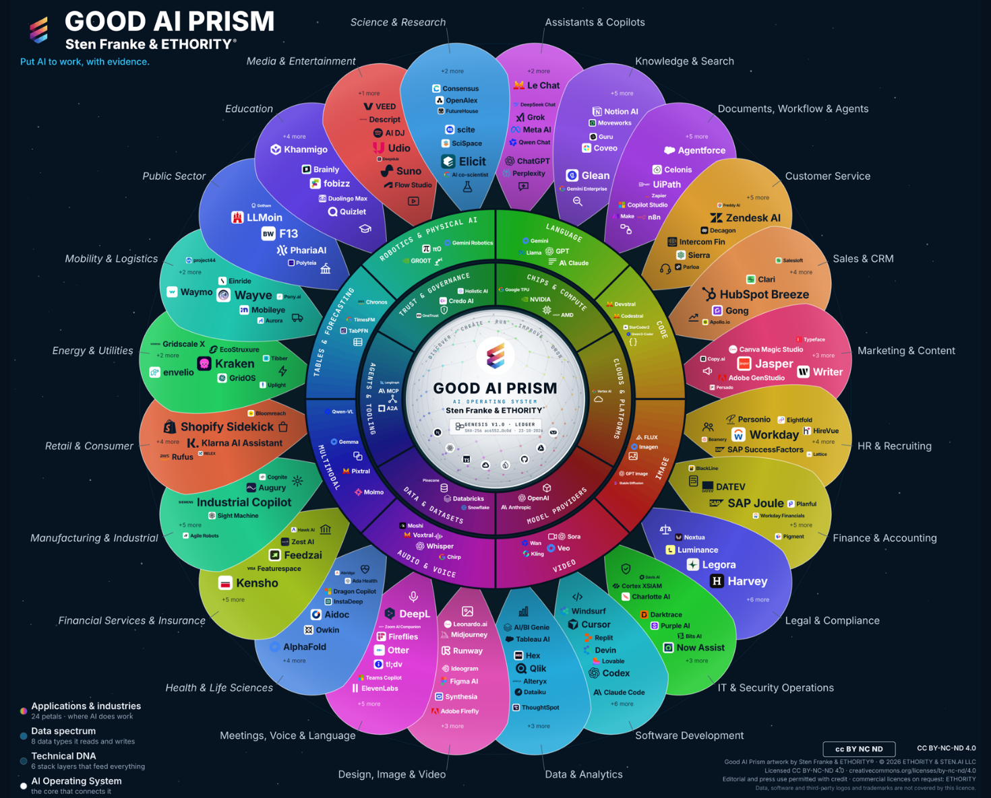
ETHORITY®
KEYNOTE · EXECUTIVE VERSION
AI BUSINESS OPERATING SYSTEM
THE GOOD AI PRISM · V3.12
Start with your task. Compare what matters.
The Good AI Prism places 998 market entries on one wheel, including 961 AI offerings. Open your business function or industry, compare the offerings with their sources and take the next step.
24
8
6
topic areas by task and industry
data types AI reads and writes
technology layers that feed everything
Source · Good AI Prism v3.12 · Good AI Prism, Oct 2026
Good AI Prism artwork © 2026 ETHORITY & STEN.AI LLC · CC BY-NC-ND 4.0 · commercial use by licence on request · data and third-party marks not covered
ETHORITY · KEYNOTE EXECUTIVE · EN · V3.4 · 27 OCT 2026
03 / 05
Notes:
Start with your task. Compare what matters.
The Good AI Prism places 998 market entries on one wheel, including 961 AI offerings. Open your business function or industry, compare the offerings with their sources and take the next step.
Source: Good AI Prism v3.12 · Good AI Prism, Oct 2026

Slide 4
ETHORITY®
KEYNOTE · EXECUTIVE VERSION
AI BUSINESS OPERATING SYSTEM
GOVERNANCE IN ONE CASE · SCENARIO
An AI agent answers customers and triggers refunds: five questions help make it safe and worth it.
1
2
3
4
5
Responsibility
Authority
Evidence
Control
Benefit
Who decides and carries the consequences?
What may the agent do alone, and up to which amount?
Which answers need proof?
When does a person step in?
Does the result really improve?
ETHORITY · KEYNOTE EXECUTIVE · EN · V3.4 · 27 OCT 2026
04 / 05
Notes:
An AI agent answers customers and triggers refunds: five questions help make it safe and worth it.
Responsibility: Who decides and carries the consequences?
Authority: What may the agent do alone, and up to which amount?
Evidence: Which answers need proof?
Control: When does a person step in?
Benefit: Does the result really improve?
Scenario detail for the speaker:
Responsibility: One named owner in customer service; finance owns the refund budget, IT the connections. → AI Governance Setup
Authority: It sees orders and delivery status and refunds up to a limit finance sets. → Profiles & Compare
Evidence: Prices and return rules name their source; every refund is recorded with reason and approval. → AI Trust Record
Control: A person reviews refunds above the limit, complaints and unclear cases; a stop rule pauses the agent. → AI Trust Pilot
Benefit: Measure accepted answers, complaints and rework time before and during the pilot. → AI calculators

Slide 5

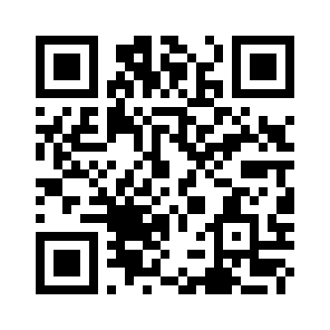
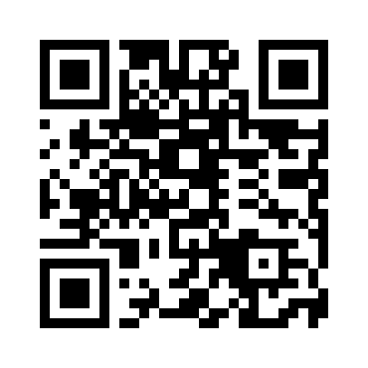
ETHORITY®
KEYNOTE · EXECUTIVE VERSION
AI BUSINESS OPERATING SYSTEM
YOUR NEXT MOVE
Start with one question and one owner this month.
CHECK
AI Readiness & Maturity Check: one workshop day, then the written assessment · €3,500
Sten Franke
https://ethority.ai/products/enterprise-services/readiness-maturity-check
FOUNDER & CEO · CHIEF AI ARCHITECT, ETHORITY
sten@ethority.ai · ethority.ai
2–3 WEEKS
AI Act Readiness Sprint · from €6,900
https://ethority.ai/products/enterprise-services/ai-act-readiness-sprint
E-MAIL
sten@ethority.ai
30-minute call
Good AI Prism by Sten Franke & ETHORITY® · since the first Social Media Prisma in 2009 · roots: ETHORITY.AI and STEN.AI · text © 2026 ETHORITY & STEN.AI LLC
This presentation online
Connect with Sten Franke
https://ethority.ai/
research/presentations
https://www.linkedin.com/
in/stenfranke
Source · ethority.ai offer pages · net prices plus VAT where applicable · Oct 2026
ETHORITY · KEYNOTE EXECUTIVE · EN · V3.4 · 27 OCT 2026
05 / 05
Notes:
Start with one question and one owner this month.
Check: AI Readiness & Maturity Check: one workshop day, then the written assessment · €3,500 · https://ethority.ai/products/enterprise-services/readiness-maturity-check
2–3 weeks: AI Act Readiness Sprint · from €6,900 · https://ethority.ai/products/enterprise-services/ai-act-readiness-sprint
E-mail: sten@ethority.ai · 30-minute call
QR · This presentation online: https://ethority.ai/research/presentations
QR · Connect with Sten Franke: https://www.linkedin.com/in/stenfranke
Source: ethority.ai offer pages · net prices plus VAT where applicable · Oct 2026

