Slide 1

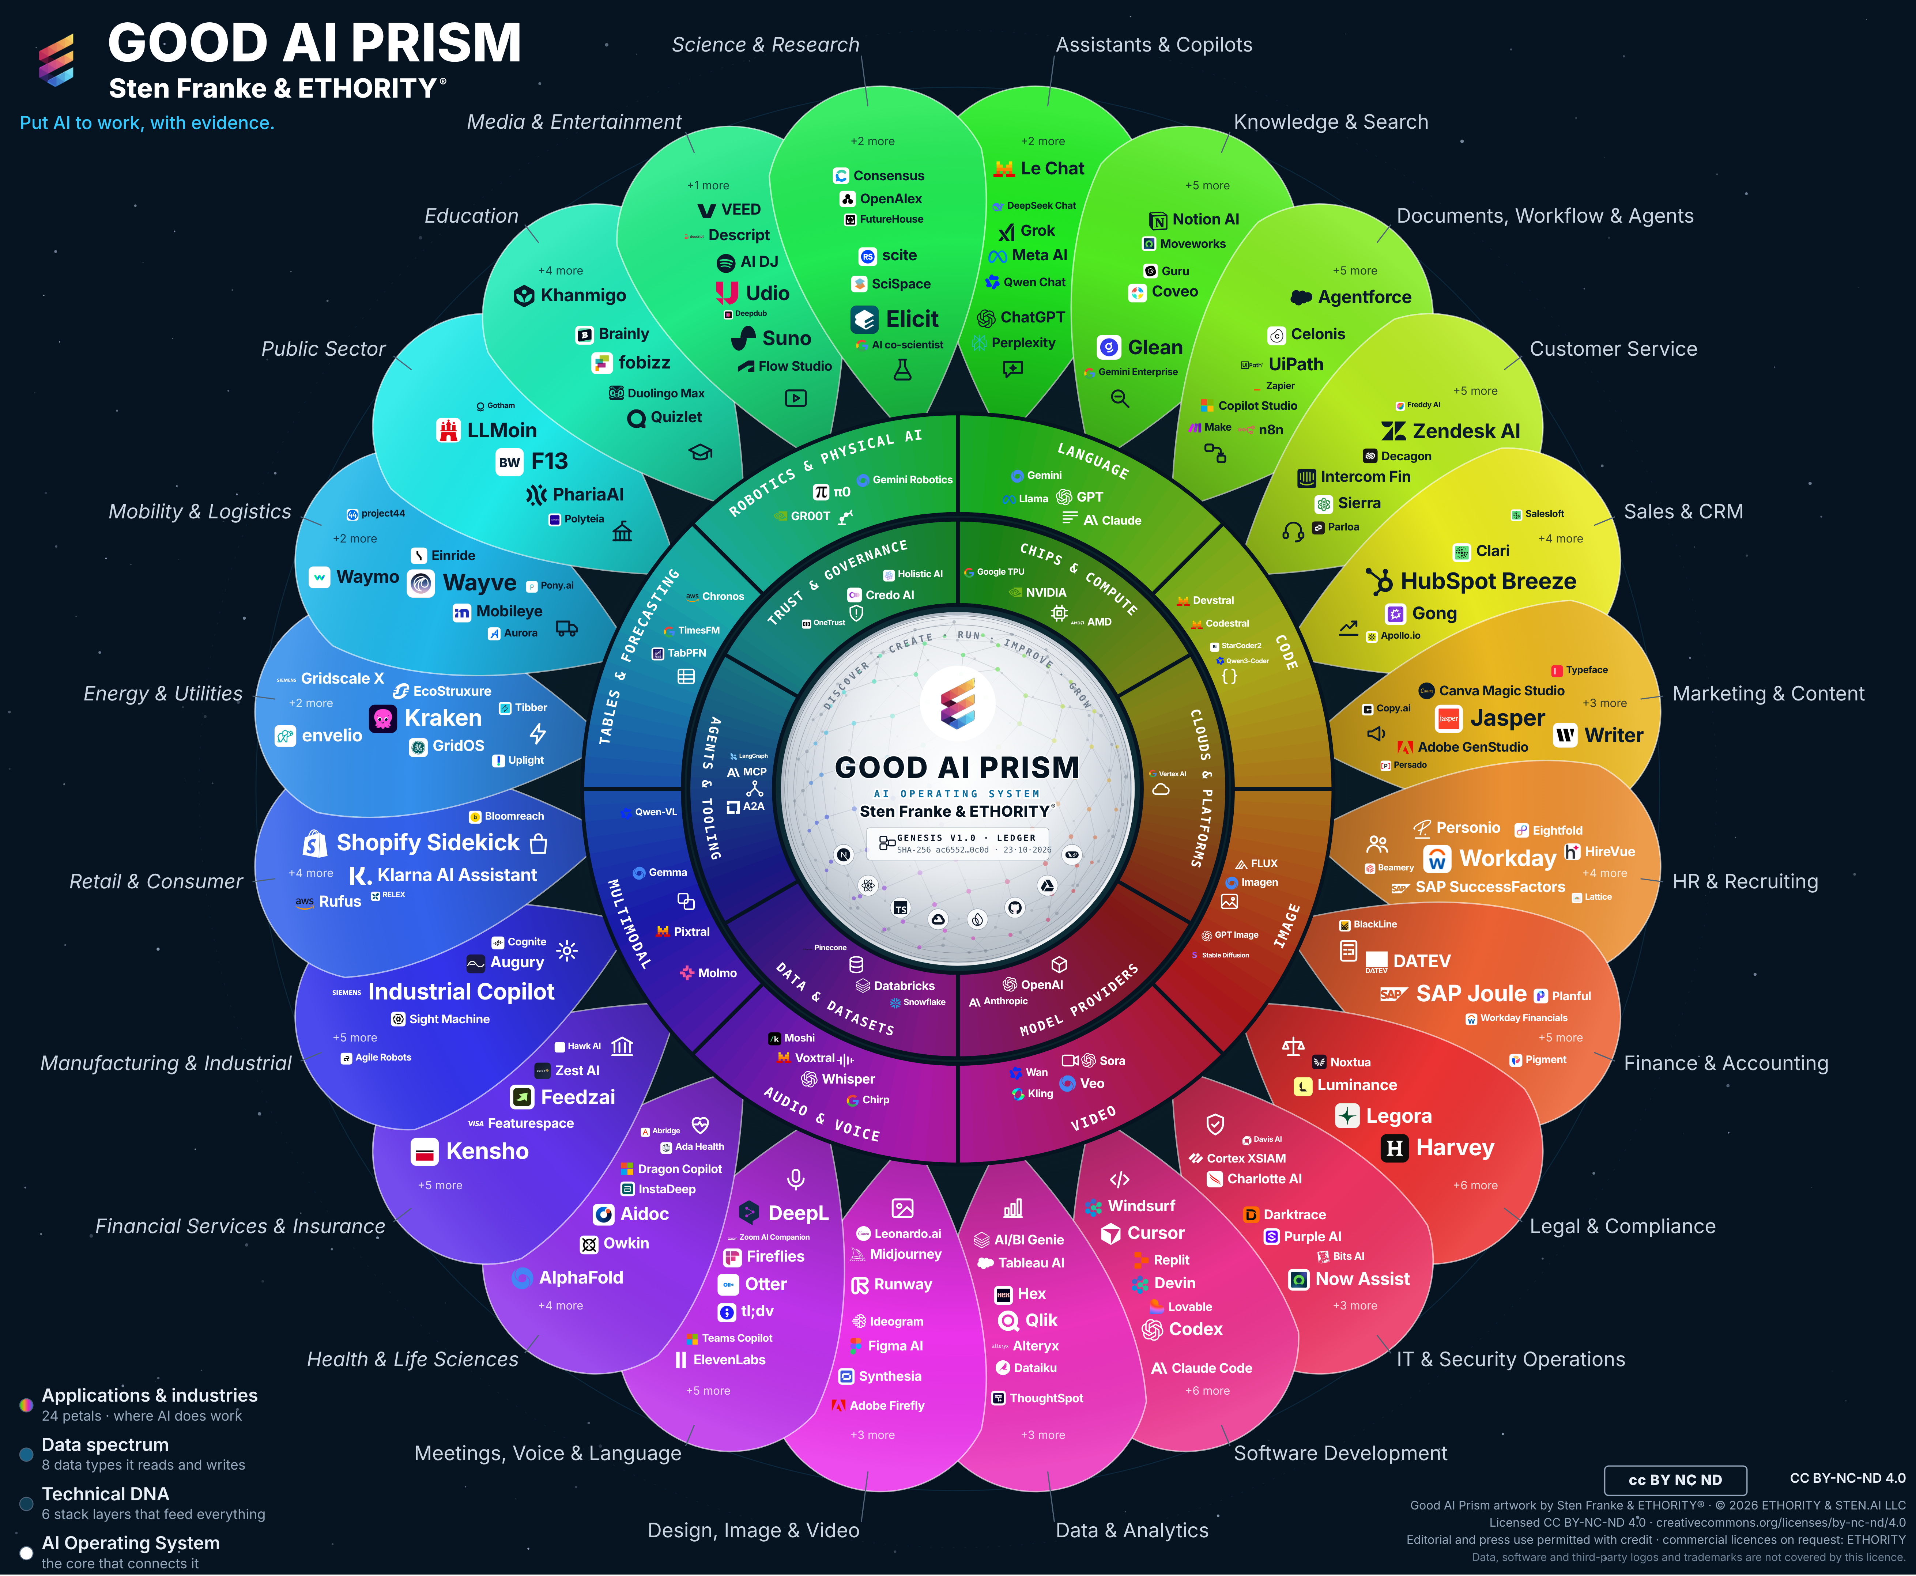
Put AI to work.
ETHORITY
AI BUSINESS OPERATING SYSTEM
The Good AI PRISM
by STEN & ETHORITY
KEYNOTE · GOOD AI PRISM MARKET STUDY 2026/27
What organisations need from AI now, and the decisions that will shape 2027.
Sten Franke · Founder, Principal Architect & Lead Creator
Notes:
Opening. Thank the hosts. One sentence on who I am: I build systems that make technological change usable for organisations. Today: what the evidence says about AI in business, and what to decide next. Everything I show is sourced in the study, which the audience can download.

Slide 2
AI adoption is advancing unevenly
THE QUESTION
One global survey of 1,719 organisations, three separate answers:
≈90%
44%
37%
of surveyed organisations report regular AI use in at least one function
report scaling AI across the enterprise
attribute any EBIT effect to AI
The question has moved from whether to use AI to which AI, how safely, and whether it pays.
Sources: McKinsey, The state of AI, Aug 2026 (1,719 respondents, 97 countries; self-reported, separate answers, not a funnel).
Notes:
These are separate answers, not a funnel. Most surveyed organisations use AI; a minority can point to a profit effect. That gap is the subject of this talk.

Slide 3
Wave 1 of a longitudinal research programme
ABOUT THE STUDY
Two parts: provider documentation, observed repeatedly in waves (research edition of 20 October 2026), and a synthesis of external market and buyer studies from 2025 and 2026.
30+ economies
998 market entries
194 depth records
775 sourced values
Official statistics, associations, academic and consulting surveys, each cited where it is used. Survey figures are never pooled.
Including 961 AI offerings, each recorded with a dated source from the provider’s own pages.
Customer Service and Manufacturing researched for pricing unit, price, hosting, training use, integrations and limits.
216 relations checked against first-party pages; 103 values re-checked in a separate research pass.
Wave 1 documents the state of the provider information ETHORITY reviewed on 19–20 October 2026. Changes are recorded in subsequent waves.
Notes:
Explain the method briefly: we keep market data and client data apart, we do not pool surveys, and every Prism entry carries a dated source.

Slide 4
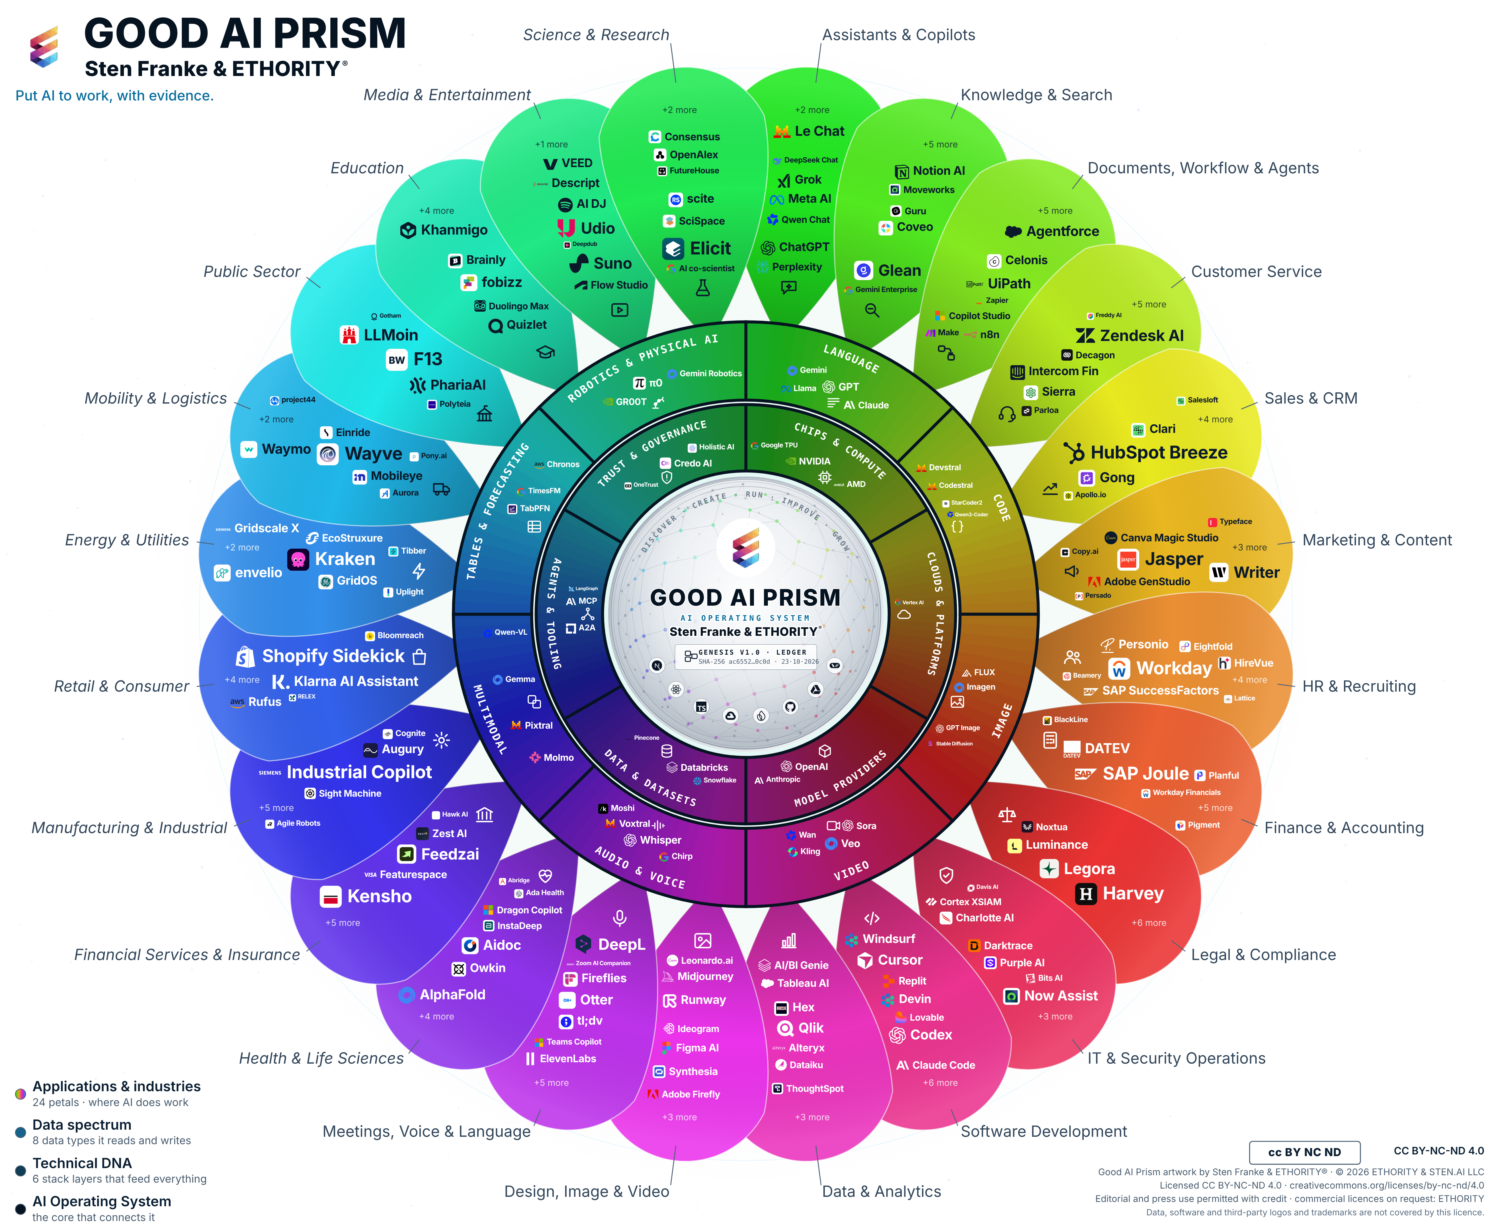
Three rings. One AI market
THE GOOD AI PRISM
The Good AI Prism maps the AI market from the outside in: where AI does the work, what it works with and what it is built on.
Outer petals · 24 business areas
Where AI does the work: 14 functions such as Customer Service or Finance, and 10 industries such as Manufacturing or Public Sector.
Middle ring · 8 data types
What the AI works with: language, code, image, video, audio, multimodal, tables, robotics.
Inner ring · 6 technology layers
What it is built on: chips, clouds, models, data, agents and tooling, trust and governance.
1,037 placements for 998 entries; an entry can appear in more than one area. Names on the wheel are an illustrative selection.
Notes:
Walk the wheel from outside to inside. The outer ring is where a business leader starts: the job to be done. The inner rings show the dependencies underneath, which matter for cost, control and risk.

Slide 5
A map of what exists, with its evidence attached
HOW TO READ THE PRISM
Listed
Sourced
Researched
Evaluated
An entry shows that an option exists and where it does the work.
Each entry carries its provider source and the date it was read.
Depth shows how far decision facts have been established.
Evaluation for a specific use is a separate, documented step.
Unknown facts stay open research questions until a source is found.
Notes:
This is the most important reading rule: the map shows what exists and what is known about it; the decision still has to be made for a specific use.

Slide 6
From the Social Media Prisma to the Good AI Prism
WHY A MAP, AGAIN
Then: social media, 2010–2019
The lesson
Now: AI, 2026
The Social Media Prisma mapped a fragmented social web for German brands, adapted from the Conversation Prism by Brian Solis and JESS3.
Signals are abundant; useful decisions are scarce. A map of the ecosystem helps more than a list of platforms.
The Good AI Prism maps the AI market in three rings and keeps the evidence attached to every entry.
Independent references to the Social Media Prisma include Cool Infographics (2010) and a Springer chapter (2021).
Notes:
Founder story in one slide: the same problem, a larger market.

Slide 7
Big spend, broad use, rare scale
1
Spending grows by half; results trail behind.

Slide 8
AI spending grows by half in one year
1 · THE GLOBAL MARKET
Worldwide AI spending, US$ trillion (broad definition including infrastructure).
+49.5% in 2026
More than half goes into infrastructure: US$1.48 tn of the US$2.67 tn. Asia/Pacific spending is forecast to grow 4.6-fold by 2030.
Source: Gartner, Sep 2026; IDC, Sep 2026 (Asia/Pacific). 2027 is a projection.
Notes:
Budget alone does not buy results. The distance between trying AI and running it in a core process is where value is won or lost.

Slide 9
Official statistics tell a soberer story
2 · ADOPTION
Firms with 10+ employees using AI, 2025 (Eurostat and national statistics).
One firm in five
In the EU, one firm in five with ten or more staff uses AI. National ranges run from about 5% to 42%.
Sources: Eurostat (Dec 2025) and national statistics offices; UK = firms with 10+ employees, June 2026 (ONS). Definitions differ by country.
Notes:
Contrast with the 90% from surveys: statistics offices count firms, surveys count large-firm respondents. Both are true; they measure different things.

Slide 10
Large firms adopt more often, in every study we compared
2 · ADOPTION BY FIRM SIZE
Share of firms using AI, small versus large (size bands differ by country).
1.6 to 4.3 times
The size gap is the most consistent pattern in the data. Small firms need proportionate entry points and supplier programmes run by large customers.
Sources: Eurostat, INSEE, IMDA, ONS, KCCI via JoongAng Daily, Banxico via Ecosistema Startup; 2024–2026 releases.
Notes:
This is where policy and large companies can help: supplier programmes, shared patterns, practical support.

Slide 11
Know-how first, then law and cost
3 · BARRIERS
Asked why they do not use AI, or use it less, firms answer in a similar order across regions.
Know-how
Legal uncertainty
Cost
71% of EU firms that considered AI name lack of expertise; 85% of German non-users; 81% of Korean manufacturers have no AI specialists.
53% of EU firms that considered AI name unclear legal consequences; 56% of German users report legal uncertainty.
63% of German non-users find costs hard to calculate; in Brazilian industry, cost is named first.
Sources: Eurostat 2025; Bitkom, Sep 2026; KCCI 2025; IBGE via Poder360.
Notes:
The first barrier is skills, not technology. That is good news: it is the barrier organisations can address themselves, quickly.

Slide 12
Rules diverge. The dates are concrete
2
Regulation is a set of dated deadlines that differ by jurisdiction.

Slide 13
The deadlines leaders should plan for
4 · REGULATION
Application dates, not adoption dates. Confirm the operative law for the intended use.
1
2
3
4
5
IN FORCE
2 DEC 2026
1 JAN 2027
13 MAY 2027
2 DEC 2027
Korea, Vietnam
EU marking
Colorado, California
India
EU high-risk
AI laws apply; labelling of AI-generated content is the rule most regimes share.
Machine-readable marking for generative AI already on the market.
Duties for covered automated decisions: notice, explanation, review.
Main data-protection duties under the DPDP Rules.
Duties for high-risk uses listed in Annex III; Annex I products from 2 Aug 2028.
Sources: Regulation (EU) 2026/1744 (EUR-Lex); Colorado SB 26-189; CPPA; India DPDP Rules 2025; ITA; Baker McKenzie. Not legal advice.
Notes:
One inventory of AI uses, mapped to every jurisdiction you operate in, is the practical answer for multinationals.

Slide 14
Six regions, six different starting points
5–8 · REGIONS
Europe
Germany
United States
From 5% (Romania) to 42% (Denmark) of firms; expertise and legal clarity first.
57% of firms with 20+ staff use AI; 98% of large firms have a strategy, 37% clear governance.
Leads on spend; 48% of small-business users struggle to choose the right tool.
Latin America
Middle East and Africa
Asia-Pacific
About US$10 bn in 2026; Brazil US$4.2 bn, Mexico US$2.4 bn.
Highest private use in the UAE; firm-level data still thin.
Spending forecast to grow 4.6-fold by 2030; a sharp size gap.
Sources: Eurostat; Bitkom, Sep 2026; KPMG, Jun 2026; Goldman Sachs 10KSB; IDC 2024–2026; Microsoft, Sep 2026.
Notes:
Tailor this slide to the audience’s region; the study has a full chapter per region.

Slide 15
Germany crossed the majority line
5 · GERMANY AND THE MITTELSTAND
German firms with 20+ employees using AI: 20% (2024), 36% (2025), 57% (2026).
57%
85%
21%
of firms with 20+ employees use AI in 2026
of non-users lack technical know-how
name licences as a cost driver; cloud 51%, data preparation 50%
Adoption is broad but shallow: text generation far outweighs automation and decision support in the Mittelstand.
Sources: Bitkom, Sep 2026 (n=603); KfW Fokus 554.
Notes:
For German audiences: the Mittelstand buys AI through people it already trusts: system houses, chambers, Mittelstand-Digital centres.

Slide 16
Buyers can rarely compare offerings on facts
3
What providers publish, and what they leave open.

Slide 17
10 of 107 offerings document both key data facts
11 · WHAT THE MARKET DOCUMENTS
Customer-service AI offerings whose own public pages document each fact; Wave 1; provider information reviewed by ETHORITY, 19–20 Oct 2026.
8 no training, 2 opt-in only
Missing documentation does not mean a capability is missing. Ask suppliers to confirm plan, region and terms in writing before any demo.
Source: Good AI Prism research edition, 20 Oct 2026. Quote with both criteria; providers can submit corrections at ethority.ai/ai-prism-study.
Notes:
Read the finding carefully: both criteria, the 8/2 split and the review date. This is a finding about documentation, not about product capability; subsequent waves record how it changes.

Slide 18
The same pattern across the market
11 · WHAT THE MARKET DOCUMENTS
Marketing before documentation
Prices are hard to compare
564 of 701 new placements rest on provider marketing pages; 137 on technical documentation.
Customer-service AI is billed in at least seven units: per resolution, per seat, per conversation, per minute, credits, tiers or on request.
Dependencies stay hidden
Identities change fast
Verified relations show many applications resting on a few hubs, so one model or platform change can affect many products.
34 renamings and 26 ownership changes within weeks of research.
Source: Good AI Prism research edition, 20 Oct 2026.
Notes:
For buyers: convert prices to your own volume; for providers: documentation is becoming a buying criterion.

Slide 19
AI decisions in an uncertain world
4
A credible AI strategy must remain useful when conditions change.

Slide 20
AI rests on chips, power, capital and law
12 · PHYSICAL AND FINANCIAL FOUNDATIONS
Hyperscalers are investing more than US$700 billion in 2026; the pace is set by grids, connection queues and permits.
485 TWh
950 TWh
56%
data-centre electricity use in 2025, all data centres
projected for 2030, about 3% of global demand
of CEOs report no significant financial benefit from AI so far
Sources: IEA, Key Questions on Energy and AI, 2026; PwC 29th Global CEO Survey, Jan 2026 (4,454 CEOs).
Notes:
For buyers the risk is not a blackout; it is a change in capacity, price or terms in their region during the contract.

Slide 21
Choose reversible ways through
12 · SIX DECISIONS, TWO RISKS EACH
DECISION | MOVING TOO FAST | MOVING TOO SLOWLY | A REVERSIBLE WAY THROUGH
Invest now or stage it | Paying for capability that is soon cheaper or obsolete | Falling behind competitors who redesign the work | Staged commitments with a review date
Buy, build or combine | Lock-in to one supplier’s roadmap | Owning maintenance the business cannot staff | Hybrid with clear exit and export terms
Keep control of data | Data used or stored beyond what is agreed | Blocking the uses that create value | Documented hosting, training and access terms
Rely on which providers | Concentration: price, capacity or access changes | Integration cost of too many suppliers | A tested fallback for each critical use
Redesign whose work | Resistance, skill gaps and unowned errors | Gains that stay as unused saved time | Participatory change plan with owners
Evidence before scale | Scaling an unproven result | Endless pilots that never decide | Stop/go criteria agreed in advance
Workforce lens (Severin L. Wilson): plan adoption, training, participation and oversight as part of every staged commitment.
Notes:
Pick the two rows most relevant to this audience and tell one story for each.

Slide 22
What the evidence adds up to
CONCLUSIONS
1
Connect adoption with outcomes
2
Build capability around a useful first task
3
Adapt the route to the organisation
Track use, accepted outcomes, quality and full cost together.
One worthwhile process, a baseline, time and support to learn.
Proportionate entry points for small firms; clear ownership in large ones.
4
Use published evidence to improve the shortlist
5
Make governance part of progress today
6
Invest in learning and resilience
Treat missing documentation as an open question; get terms in writing.
An AI inventory with named owners, checked against the operative law.
Staged pilots, tested fallbacks, scale when the evidence supports it.
Notes:
Six conclusions; each maps to a chapter of the study.

Slide 23
Three phases, two gates
13 · THE 2027 AGENDA
Establish the baseline, run a supported pilot, learn from the result and scale where the outcome justifies it.
1
◆
2
◆
3
NOW · BEFORE THE PILOT
GATE 1
NEXT 90 DAYS
GATE 2
2027
Choose and measure
Baseline agreed
Compare and pilot
Threshold met
Scale and steer
One process that matters, an accountable owner, today’s volume, cost and quality.
No pilot without a measured starting point and a named owner.
Three credible options, deciding facts in writing, one pilot under a written charter.
No scale-up without the agreed result on accepted outcomes.
Cost per accepted outcome over time; one owner per system; yearly estate review.
Notes:
Each phase ends with a decision the audience can name: proceed, request more evidence, redesign or stop.

Slide 24
Measure the cost of an accepted outcome
PRACTICAL APPENDIX
One measure makes AI options comparable across billing units and providers.
Cost per accepted outcome
usage or licence + amortised integration + monitoring, change and training + human review + handling of failed cases
attempted cases × acceptance rate
Worked example (illustrative)
10,000 cases a month; usage €6,000, integration €1,500, monitoring and training €500, human review €2,000, rework €1,000. The tool resolves 40%: €11,000 ÷ (10,000 × 0.40) = €2.75 per accepted outcome, compared with today’s cost per resolved case on the same monthly boundary.
Notes:
If nothing is accepted, the measure is undefined, not zero. Savings are a separate calculation.

Slide 25
Decide on facts, start small, govern early
14 · WHAT LEADERS SHOULD DO NEXT
Founders and small firms
Mittelstand and mid-sized firms
Large enterprises
Pick one recurring task, not a platform
Compare three tools on cost per unit at your volume
Keep what meets its objective
Readiness assessment and staff AI literacy
One process live, cost per accepted outcome
Map every AI use to the rules
One AI inventory, including shadow AI
Owner and KPIs per use case, stop/go gates
Control usage-based costs; sovereignty criteria
Boards: ask for outcomes, not usage. Providers: publish pricing units, hosting regions and data-use terms.
Notes:
Close the content part with the audience’s own segment.

Slide 26





Connected work, from market orientation to the next decision
WHAT ETHORITY BUILDS
Discover → Create → Run → Improve → Grow: research, software, engineering, implementation and operations.
Discover
Create
Run
Improve
Grow
Good AI Prism · Buyer Intelligence
Decision Record · Opportunity Case
AI Estate · governed agents
Workspace · evidence record
Trust Infrastructure
Sourced market map; dated comparisons and shortlists.
Options, owner, economics and stop criteria; signed result.
Demonstrates system ownership, permissions and fallback.
Planned versus observed results; corrections kept.
Trust Profiles, Passport, Handshake (simulation).
AVAILABLE
AVAILABLE
DEMONSTRATION
PREVIEW
ROADMAP
October 2026: services by agreement; Workspace demonstration; trust-network roadmap. The illustrated evidence record describes an intended event history.

Slide 27


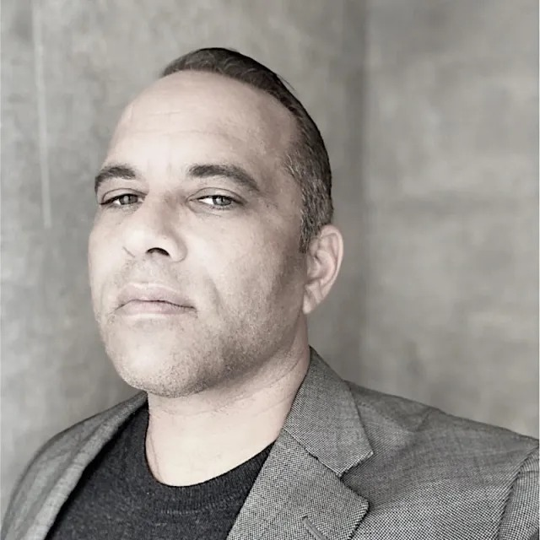
THE STUDY
Read the study. Take the Prism home.
Download the Good AI Prism Market Study 2026/27 in English and German, with the large-format Prism.
Download the study
Sten Franke
Founder, Principal Architect & Lead Creator
Creator and architect of ETHORITY’s AI systems, connecting business strategy, market intelligence and engineering.
Severin L. Wilson
Chief Business & Transformation Officer
Connecting enterprise relationships, organisational transformation and responsible AI adoption.
ethority.ai/ai-prism-study · sten@ethority.ai
Put AI to work, with evidence.
Notes:
Invite questions. Point to the download and offer the A3 Prism to participants.
People (full bios):
Sten Franke, Founder, Principal Architect & Lead Creator: Sten Franke is a digital pioneer, entrepreneur and AI systems architect who has built companies since 1997. Through mediatime, Gridpatrol and ETHORITY, his work has served hundreds of national and international brands and public institutions. His contributions include the Social Media Prisma and industry work involving BITKOM and BVDW.
He creates ETHORITY’s vision, products and research methods, including the Good AI Prism and AI Business Operating System. His work also extends into biomedical innovation: from advising the Dr. Rurainski Foundation and developing its digital presence to EpiTrace.AI and an agenda focused on cancer research, longevity and healing. Across these fields, he connects market intelligence, engineering and entrepreneurship to build useful AI systems with clear economics, evidence and human accountability.
Severin L. Wilson, Chief Business & Transformation Officer: Severin L. Wilson connects business ambition with the people, capabilities and governance needed to deliver change. Drawing on experience involving Detecon, SAP SuccessFactors and E.ON, he brings expertise in human capital management, digital transformation and international organisational change.
At ETHORITY, his focus is developing client relationships and translating AI opportunities into organisational progress: aligning leadership, developing workforce capabilities, involving employees and establishing accountable human oversight. His contribution to the study examines how organisations turn technical capability into improvements they can sustain.

Slide 28
Artwork, sources and reuse
Edition v2.8 · 23 October 2026. Updated v3.11 artwork; evidence cut-offs and substantive content are retained. The artwork shows the 17 October reference selection, not the extent of the study research inventory or live website catalogue.
Good AI Prism artwork © 2026 ETHORITY & STEN.AI LLC, by Sten Franke & ETHORITY®. CC BY-NC-ND 4.0. ETHORITY additionally permits unchanged editorial and press use with credit. Commercial licences: ETHORITY. Data, software and third-party logos and trademarks are not covered.
CC BY-NC-ND 4.0 · licence terms
Study, source, software and trademark rights remain separate. Linked citations do not grant blanket redistribution rights.

