Slide 1

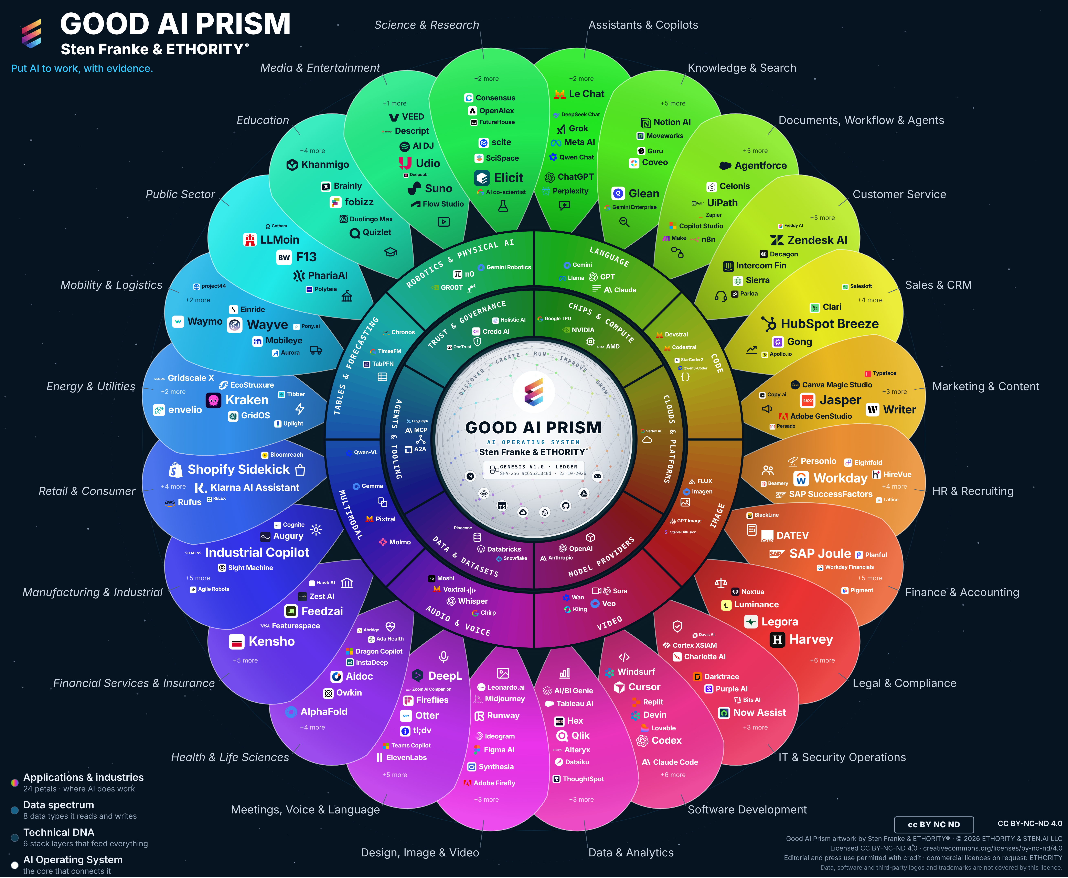
ETHORITY
AI BUSINESS OPERATING SYSTEM
KEYNOTE · GOOD AI PRISM MARKET STUDY 2026/27
Put AI to work.
AI adoption is advancing unevenly. Value needs an operating approach: decide on evidence, then build and run.
≈90%
of surveyed organisations report regular AI use
1 in 5
EU firms with 10+ staff use AI, by official count
37%
attribute any EBIT effect to AI
McKinsey, The state of AI, Aug 2026 (1,719 respondents, 97 countries; self-reported, separate answers). Eurostat, Dec 2025.
Executive edition · v2.8 · 21 Oct 2026 · Full presentation: Keynote, 27 slides

Slide 2
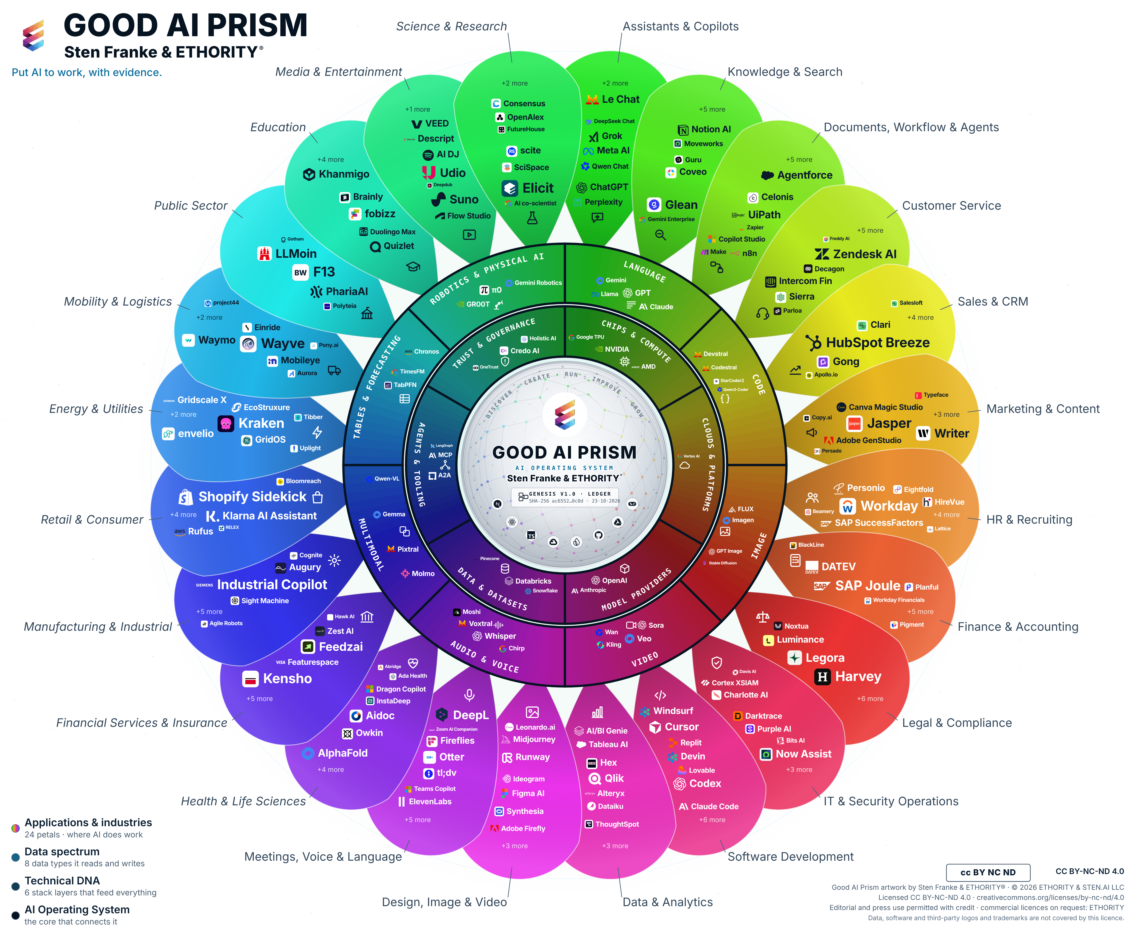
One sourced map of the AI market
THE GOOD AI PRISM
998 market entries, 961 AI offerings; Wave 1 of a longitudinal research programme.
Outer petals · 24 business areas
14 functions and 10 industries; Customer Service and Manufacturing are two examples.
Middle ring · 8 data types
Language, code, image, video, audio, multimodal, tables, robotics.
Inner ring · 6 technology layers
Chips, clouds, models, data, agents and tooling, trust and governance.
Use it to shortlist: what exists for your task, what it is built on and what is documented.
Good AI Prism, Wave 1 of ETHORITY’s longitudinal research programme; provider information reviewed 19–20 Oct 2026. Full sector coverage: ethority.ai/ai-prism-study.

Slide 3
Use is broad, value and documentation are thin
THREE FINDINGS
37%
of surveyed organisations attribute any EBIT effect to AI; 44% report scaling it (separate answers).
1.6–4.3×
Large firms adopt AI 1.6 to 4.3 times as often as small ones, in every study compared.
10 of 107
customer-service AI offerings document both an EU hosting option and limits on training with customer data (8 no training, 2 opt-in only).
Ask for outcomes, not usage; get hosting and data-use terms in writing before any demo.
McKinsey, Aug 2026; adoption studies compared in the study; Good AI Prism Wave 1, provider information reviewed 19–20 Oct 2026.

Slide 4
Three phases, two gates: from first choice to scale
THE 2027 AGENDA
Choose
Gate 1
Pilot
Gate 2
Scale
NOW
BASELINE AGREED
NEXT 90 DAYS
THRESHOLD MET
2027
One process, an owner, today’s volume, cost and quality.
No pilot without a measured start and a named owner.
Three options compared, facts in writing, one pilot under a charter.
Scale only with the agreed result on accepted outcomes.
Cost per accepted outcome over time; one owner per system.
Each gate is a decision: proceed, request more evidence, redesign or stop.

Slide 5


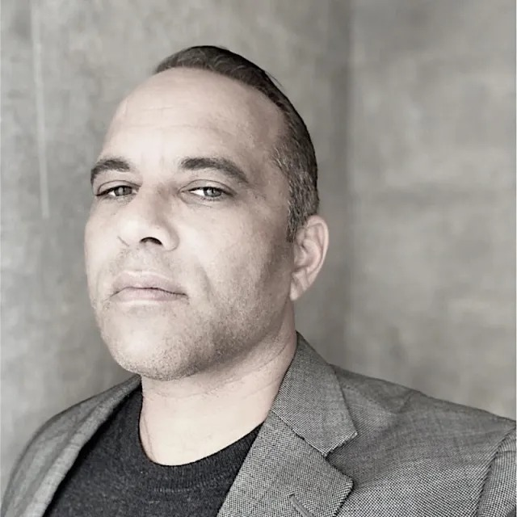
THE STUDY
Read the study. Take the Prism home.
One action for tomorrow: choose one process and measure its cost per accepted outcome.
Download the study
Sten Franke
Founder, Principal Architect & Lead Creator
Creator and architect of ETHORITY’s AI systems, connecting business strategy, market intelligence and engineering.
Severin L. Wilson
Chief Business & Transformation Officer
Connecting enterprise relationships, organisational transformation and responsible AI adoption.
ethority.ai/ai-prism-study · sten@ethority.ai
Put AI to work, with evidence.
Notes:
People (full bios):
Sten Franke, Founder, Principal Architect & Lead Creator: Sten Franke is a digital pioneer, entrepreneur and AI systems architect who has built companies since 1997. Through mediatime, Gridpatrol and ETHORITY, his work has served hundreds of national and international brands and public institutions. His contributions include the Social Media Prisma and industry work involving BITKOM and BVDW.
He creates ETHORITY’s vision, products and research methods, including the Good AI Prism and AI Business Operating System. His work also extends into biomedical innovation: from advising the Dr. Rurainski Foundation and developing its digital presence to EpiTrace.AI and an agenda focused on cancer research, longevity and healing. Across these fields, he connects market intelligence, engineering and entrepreneurship to build useful AI systems with clear economics, evidence and human accountability.
Severin L. Wilson, Chief Business & Transformation Officer: Severin L. Wilson connects business ambition with the people, capabilities and governance needed to deliver change. Drawing on experience involving Detecon, SAP SuccessFactors and E.ON, he brings expertise in human capital management, digital transformation and international organisational change.
At ETHORITY, his focus is developing client relationships and translating AI opportunities into organisational progress: aligning leadership, developing workforce capabilities, involving employees and establishing accountable human oversight. His contribution to the study examines how organisations turn technical capability into improvements they can sustain.

Slide 6
Artwork, sources and reuse
Edition v2.8 · 23 October 2026. Updated v3.11 artwork; evidence cut-offs and substantive content are retained. The artwork shows the 17 October reference selection, not the extent of the study research inventory or live website catalogue.
Good AI Prism artwork © 2026 ETHORITY & STEN.AI LLC, by Sten Franke & ETHORITY®. CC BY-NC-ND 4.0. ETHORITY additionally permits unchanged editorial and press use with credit. Commercial licences: ETHORITY. Data, software and third-party logos and trademarks are not covered.
CC BY-NC-ND 4.0 · licence terms
Study, source, software and trademark rights remain separate. Linked citations do not grant blanket redistribution rights.

