Slide 1

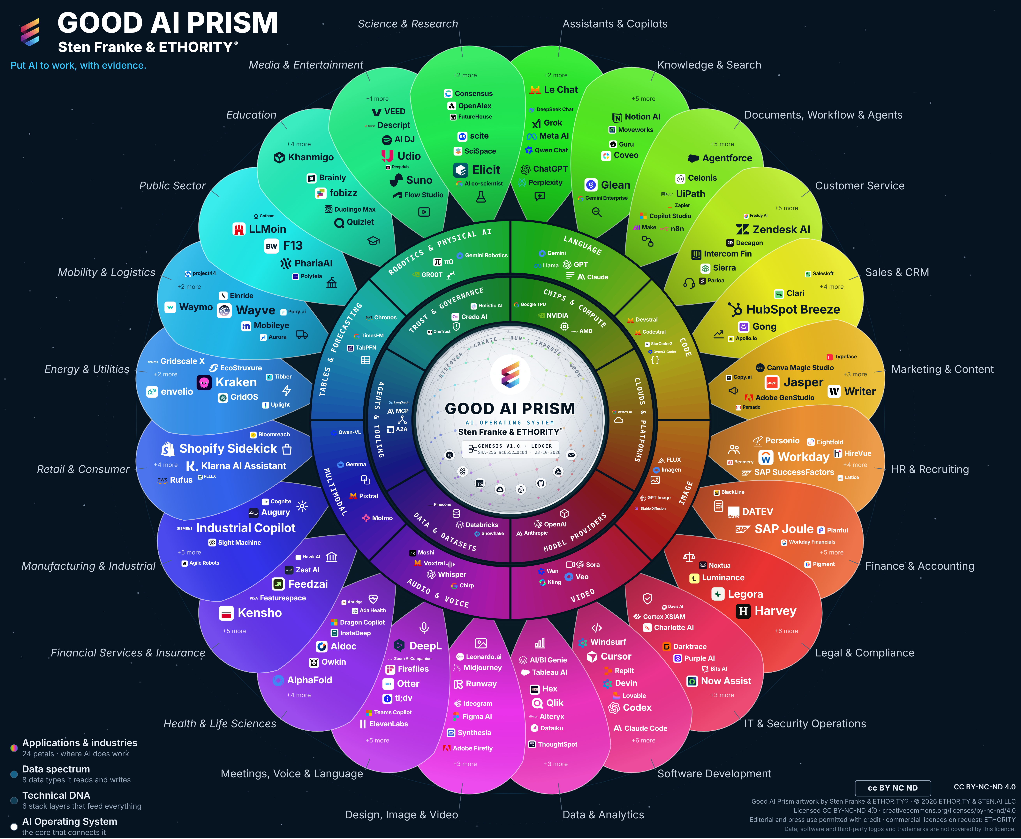
ETHORITY. Put AI to work.
ETHORITY
AI BUSINESS OPERATING SYSTEM
COMPANY OVERVIEW
Help organisations choose and put AI to work with clear evidence, accountable decisions and measurable business value.
ETHORITY & STEN.AI LLC · San Francisco · Hamburg
ethority.ai

Slide 2






AI-assisted work, accountable people
THE AI1ST ORGANISATION
People frame the question, review evidence and agree the next step. AI supports defined work; the Workspace demonstrates the intended connections.
Humans and AI agents, one team
Missions instead of handoffs
Connected work
Named people stay accountable; AI agents carry out defined work within the authority they are given.
Work is organised around outcomes, each with an owner, a target and evidence.
The intended AI Business Operating System connects research, decisions and evidence. The Workspace demonstrates this direction.
Authority before automation
Measured by accepted outcomes
Research workflow
Capability does not grant authority; people decide anything irreversible, public or customer-specific.
The key figure is cost per accepted outcome, not activity, hours or tokens.
The Wave 1 study reports 998 research-inventory entries and 775 sourced values. These research counts are distinct from the live review catalogue and admission status.
Notes:
ETHORITY applies to itself what it offers clients: missions with owners, AI agents with explicit authority, and results measured as accepted outcomes.

Slide 3
One operating cycle, from opportunity to growth
WHAT WE DO
ETHORITY connects market intelligence, research and practical delivery.
1
2
3
4
5
Discover
Create
Run
Improve
Grow
Find and qualify the opportunity: market options, evidence, constraints.
Design and build with the organisation’s data, systems and people.
Operate responsibly, with owners, controls and support.
Measure against the objective and adjust.
Develop new capability and value from what was learned.

Slide 4





Connected work, from market orientation to the next decision
WHAT ETHORITY BUILDS
Discover → Create → Run → Improve → Grow: research, software, engineering, implementation and operations.
Discover
Create
Run
Improve
Grow
Good AI Prism · Buyer Intelligence
Decision Record · Opportunity Case
AI Estate · governed agents
Workspace · evidence record
Trust Infrastructure
Sourced market map; dated comparisons and shortlists.
Options, owner, economics and stop criteria; signed result.
Demonstrates system ownership, permissions and fallback.
Planned versus observed results; corrections kept.
Trust Profiles, Passport, Handshake (simulation).
AVAILABLE
AVAILABLE
DEMONSTRATION
PREVIEW
ROADMAP
October 2026: services by agreement; Workspace demonstration; trust-network roadmap. The illustrated evidence record describes an intended event history.

Slide 5


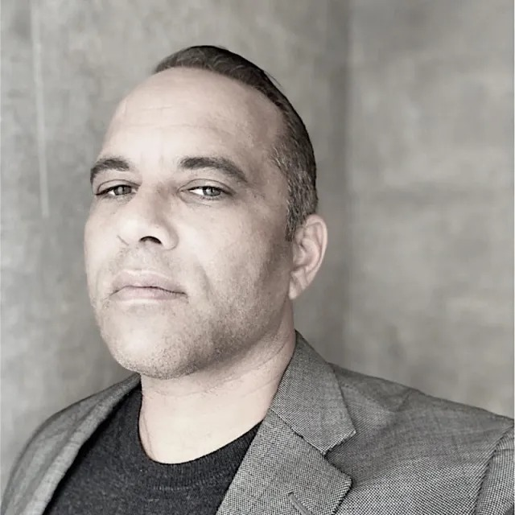
START
What decision is on your desk?
A readiness check, an AI Act sprint or an investment case: fixed scope, signed result.
Request a 30-minute call
Sten Franke
Founder, Principal Architect & Lead Creator
Creator and architect of ETHORITY’s AI systems, connecting business strategy, market intelligence and engineering.
Severin L. Wilson
Chief Business & Transformation Officer
Connecting enterprise relationships, organisational transformation and responsible AI adoption.
sten@ethority.ai · ethority.ai
Put AI to work, with evidence.
Notes:
People (full bios):
Sten Franke, Founder, Principal Architect & Lead Creator: Sten Franke is a digital pioneer, entrepreneur and AI systems architect who has built companies since 1997. Through mediatime, Gridpatrol and ETHORITY, his work has served hundreds of national and international brands and public institutions. His contributions include the Social Media Prisma and industry work involving BITKOM and BVDW.
He creates ETHORITY’s vision, products and research methods, including the Good AI Prism and AI Business Operating System. His work also extends into biomedical innovation: from advising the Dr. Rurainski Foundation and developing its digital presence to EpiTrace.AI and an agenda focused on cancer research, longevity and healing. Across these fields, he connects market intelligence, engineering and entrepreneurship to build useful AI systems with clear economics, evidence and human accountability.
Severin L. Wilson, Chief Business & Transformation Officer: Severin L. Wilson connects business ambition with the people, capabilities and governance needed to deliver change. Drawing on experience involving Detecon, SAP SuccessFactors and E.ON, he brings expertise in human capital management, digital transformation and international organisational change.
At ETHORITY, his focus is developing client relationships and translating AI opportunities into organisational progress: aligning leadership, developing workforce capabilities, involving employees and establishing accountable human oversight. His contribution to the study examines how organisations turn technical capability into improvements they can sustain.

Slide 6
Artwork, sources and reuse
Edition v2.8 · 23 October 2026. Updated v3.11 artwork; evidence cut-offs and substantive content are retained. The artwork shows the 17 October reference selection, not the extent of the study research inventory or live website catalogue.
Good AI Prism artwork © 2026 ETHORITY & STEN.AI LLC, by Sten Franke & ETHORITY®. CC BY-NC-ND 4.0. ETHORITY additionally permits unchanged editorial and press use with credit. Commercial licences: ETHORITY. Data, software and third-party logos and trademarks are not covered.
CC BY-NC-ND 4.0 · licence terms
Study, source, software and trademark rights remain separate. Linked citations do not grant blanket redistribution rights.

