Slide 1

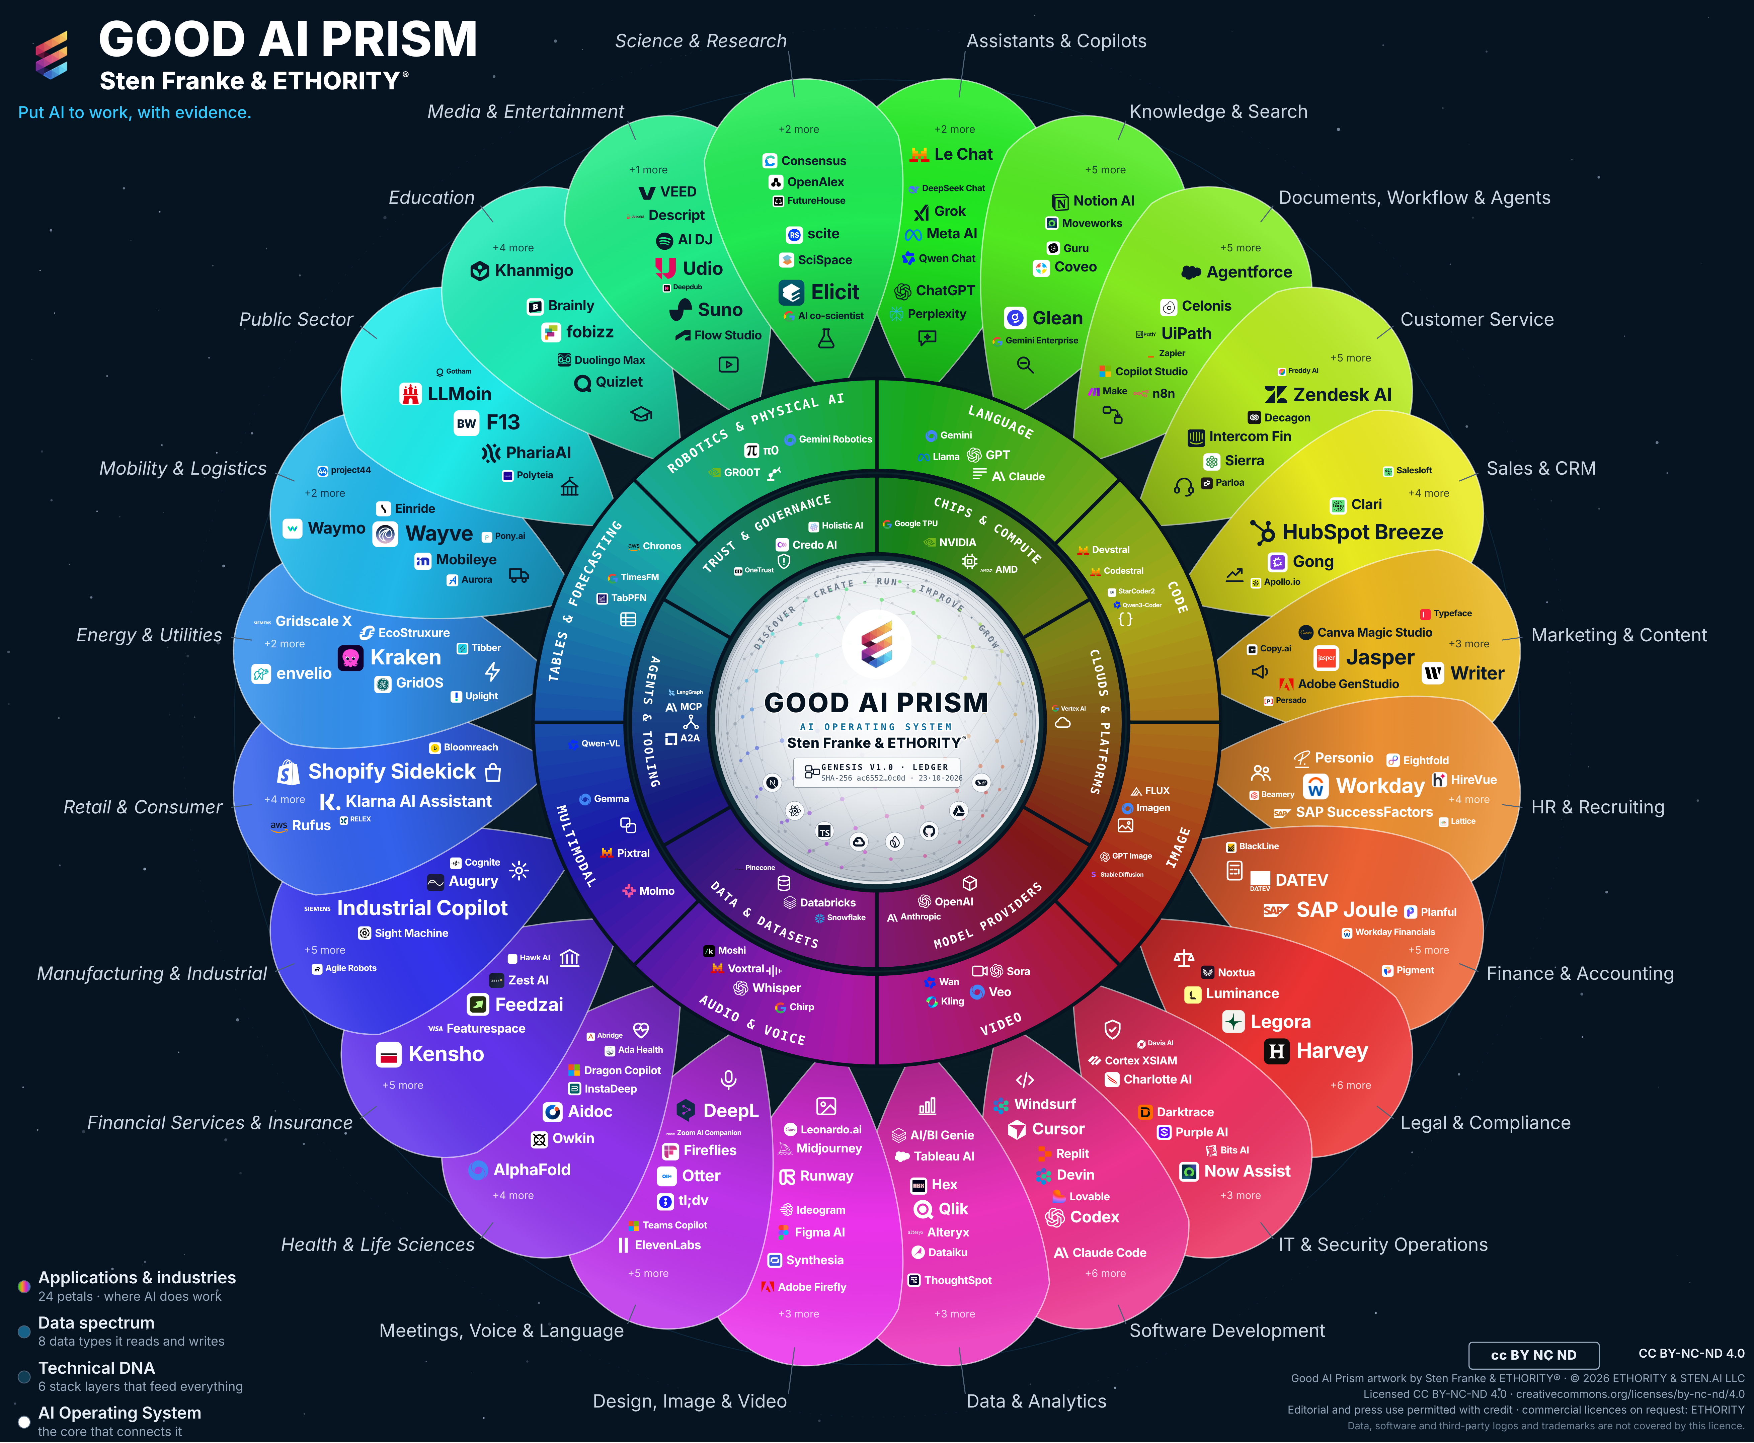
ETHORITY
AI BUSINESS OPERATING SYSTEM
COMPANY OVERVIEW
ETHORITY. Put AI to work.
Help organisations choose and put AI to work with clear evidence, accountable decisions and measurable business value.
Research
Good AI Prism
Software
Buyer Intelligence · AI Estate
Engineering
Workflows, agents, data
Implementation
Enterprise Services · Transformation
Operations
Governed AI that runs
Company overview · v2.8 · 21 Oct 2026 · Five slides; full product detail in Products & Services

Slide 2





Connected work, from market orientation to the next decision
WHAT ETHORITY BUILDS
Discover → Create → Run → Improve → Grow: research, software, engineering, implementation and operations.
Discover
Create
Run
Improve
Grow
Good AI Prism · Buyer Intelligence
Decision Record · Opportunity Case
AI Estate · governed agents
Workspace · evidence record
Trust Infrastructure
Sourced market map; dated comparisons and shortlists.
Options, owner, economics and stop criteria; signed result.
Demonstrates system ownership, permissions and fallback.
Planned versus observed results; corrections kept.
Trust Profiles, Passport, Handshake (simulation).
AVAILABLE
AVAILABLE
DEMONSTRATION
PREVIEW
ROADMAP
October 2026: services by agreement; Workspace demonstration; trust-network roadmap. The illustrated evidence record describes an intended event history.

Slide 3
One customer-service decision, shortlist to outcome
ONE CONNECTED JOURNEY · SAMPLE CASE
SAMPLE CASE · ILLUSTRATIVE
Discover
Decide
Implement
Operate
Improve
GOOD AI PRISM
OPPORTUNITY CASE
CONTROLLED PILOT
AI ESTATE
WORKSPACE
Shortlist with dated facts on hosting, training use and price.
Baseline cost per resolution, options and stop criteria.
Agent with defined permissions and a fallback to people.
System registered with owner, data and vendor terms.
Planned versus observed cost per accepted outcome.
Shortlist with sources
Signed Decision Record
Pilot log, acceptance
Estate entry
Reviewed decision
The decision, its evidence and its owner stay connected after the engagement ends.

Slide 4




Scoped evidence, accountable people
WHY TRUST THE WORK
Research
Wave 1 study: 998 research-inventory entries and 775 sourced values. These are separate from the live catalogue and its admission status.
AI1st practice
Agents work within defined mandates; a named person makes each decision.
People
Sten Franke leads vision and architecture; Severin L. Wilson connects clients, people and organisational change.
Heritage
Market intelligence since 2005; historical references include Bosch, BMW, Siemens and Deutsche Bank.
Historical references describe the group’s earlier work, in projects or through former group companies.

Slide 5


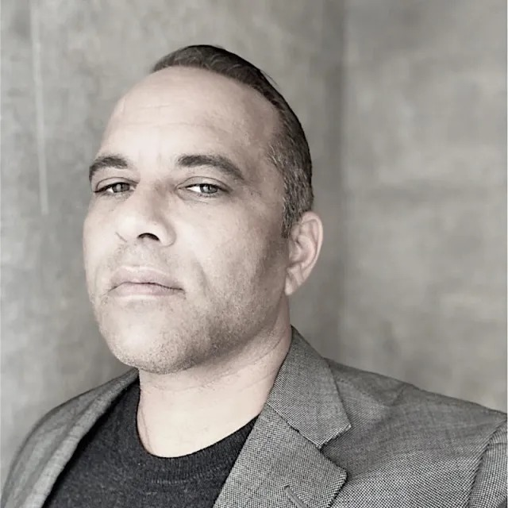
START
What decision is on your desk?
A readiness check, an AI Act sprint or an investment case: fixed scope, signed result.
Request a 30-minute call
Sten Franke
Founder, Principal Architect & Lead Creator
Creator and architect of ETHORITY’s AI systems, connecting business strategy, market intelligence and engineering.
Severin L. Wilson
Chief Business & Transformation Officer
Connecting enterprise relationships, organisational transformation and responsible AI adoption.
sten@ethority.ai · ethority.ai
Put AI to work, with evidence.
Notes:
People (full bios):
Sten Franke, Founder, Principal Architect & Lead Creator: Sten Franke is a digital pioneer, entrepreneur and AI systems architect who has built companies since 1997. Through mediatime, Gridpatrol and ETHORITY, his work has served hundreds of national and international brands and public institutions. His contributions include the Social Media Prisma and industry work involving BITKOM and BVDW.
He creates ETHORITY’s vision, products and research methods, including the Good AI Prism and AI Business Operating System. His work also extends into biomedical innovation: from advising the Dr. Rurainski Foundation and developing its digital presence to EpiTrace.AI and an agenda focused on cancer research, longevity and healing. Across these fields, he connects market intelligence, engineering and entrepreneurship to build useful AI systems with clear economics, evidence and human accountability.
Severin L. Wilson, Chief Business & Transformation Officer: Severin L. Wilson connects business ambition with the people, capabilities and governance needed to deliver change. Drawing on experience involving Detecon, SAP SuccessFactors and E.ON, he brings expertise in human capital management, digital transformation and international organisational change.
At ETHORITY, his focus is developing client relationships and translating AI opportunities into organisational progress: aligning leadership, developing workforce capabilities, involving employees and establishing accountable human oversight. His contribution to the study examines how organisations turn technical capability into improvements they can sustain.

Slide 6
Artwork, sources and reuse
Edition v2.8 · 23 October 2026. Updated v3.11 artwork; evidence cut-offs and substantive content are retained. The artwork shows the 17 October reference selection, not the extent of the study research inventory or live website catalogue.
Good AI Prism artwork © 2026 ETHORITY & STEN.AI LLC, by Sten Franke & ETHORITY®. CC BY-NC-ND 4.0. ETHORITY additionally permits unchanged editorial and press use with credit. Commercial licences: ETHORITY. Data, software and third-party logos and trademarks are not covered.
CC BY-NC-ND 4.0 · licence terms
Study, source, software and trademark rights remain separate. Linked citations do not grant blanket redistribution rights.

